Slide 1
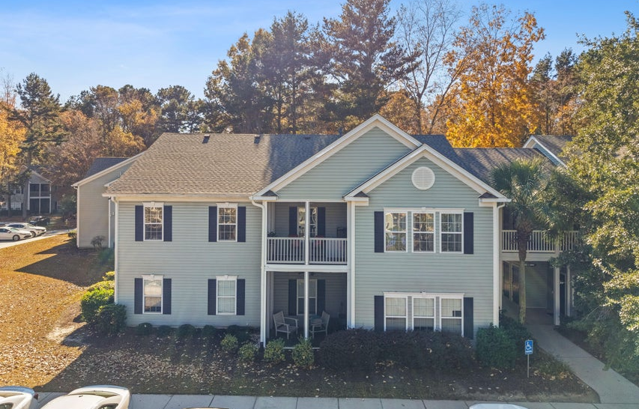
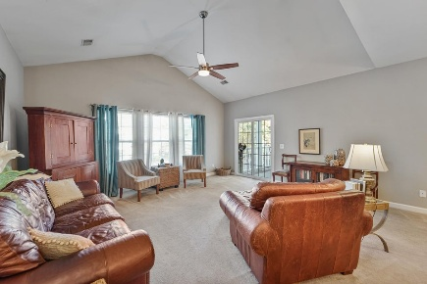
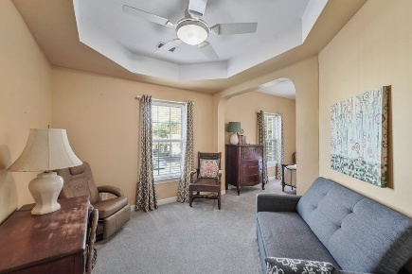
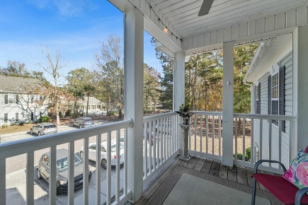
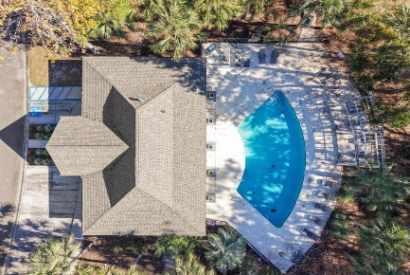
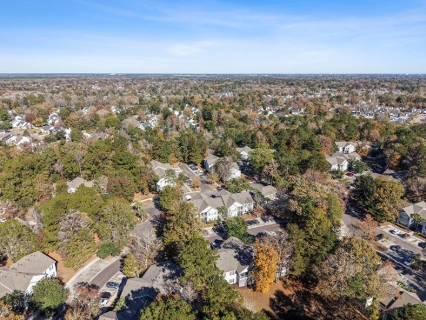






805 E Marymont Lane
Grand Oaks Plantation · Charleston, SC 29414 · MLS# 25031673
Price Improvement to $295,000
JOIN ME AT OUR OPEN HOUSE ON SATURDAY 1/17 FROM 10AM-1PM!
PROPERTY FEATURES:
2 Bedrooms
2 Bedrooms
1,320 Sq Ft
Welcome home to Grand Oaks & the tucked away subsection of The Grove Park Condominiums!! This spacious 2BR/2BA unit has soaring vaulted ceilings allowing natural light to flow in through the treetops. Both BR's are quite large, & the Primary has a large sitting area/office (some floor plans in Grove Park actually use that same space as a 3rd BR w/ some minimal framing and adding a couple of doors if that is desirable). The roof was replaced by the HOA in 2023, & the interior is ready to be updated to taste. You'll love the oversized screened porch overlooking the pool area, which is just steps away! An additional storage closet comes with this unit, & it is located in the breezeway just out front of the condo.
HAYNES JOHNSON
843-864-8159
haynes.charlestonproperties@gmail.com haynes.findhomesforsaleincharleston.com

