Slide 1
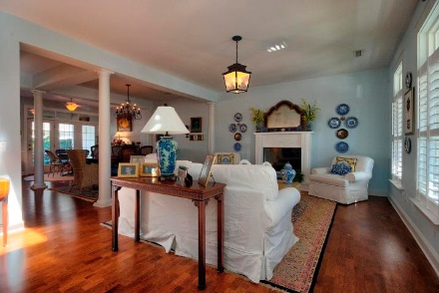
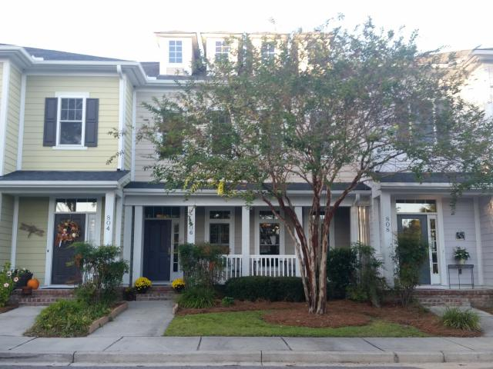
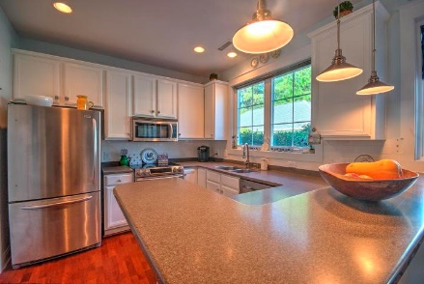
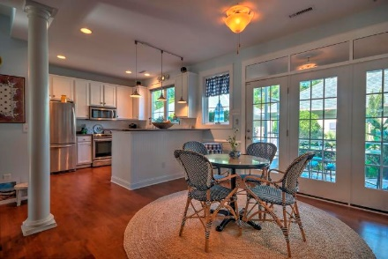
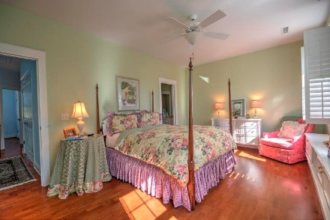
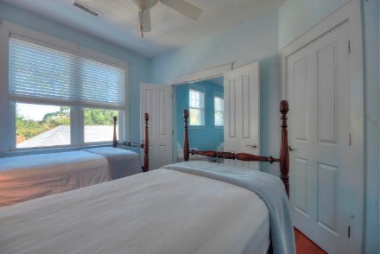
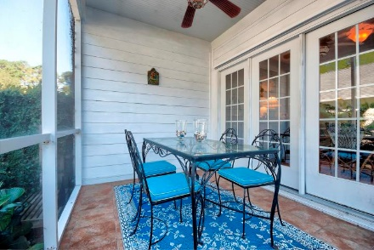
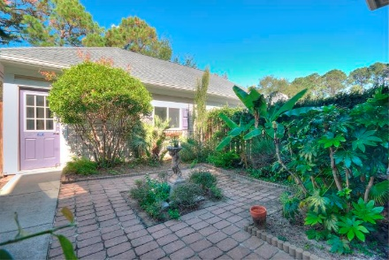
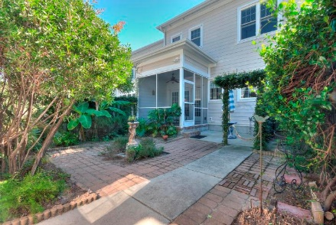


Brokers' Open House ~ Nov 7th ~ 12-2 Starbucks card to first 10 agents
Starbucks card to first 10 agents
806 Sage Bird
Eaglewood Retreat ~ Charleston, SC 29412
MLS# 17029101 ~ $390,000
Beautiful, immaculate townhome convenient to everything! Walk up the front stairs to a gracious front porch. Enter the large great room with high ceilings and a gas fireplace. Open floor plan allows entertaining with a big dining room and eat-in kitchen that leads to a screened back porch. From the back porch you can walk down to an enclosed backyard with a patio. That's where you will find the two car garage with its alley entryway. Upstairs you will find a big, bright master bedroom that is separated from the two secondary bedrooms by a hallway. Of course, it has its own bath with a walk-in shower. The two back bedrooms open to one another with double doors. It's gorgeous! We can't wait for you to see it!
Susan Kraber
(843) 779-9655
susankraber1@gmail.com
AgentOwned Charleston Group | 902 Savannah Hwy | Charleston, SC 29407-7802

