Slide 1
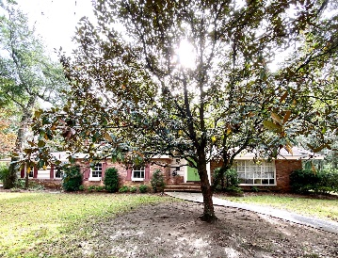
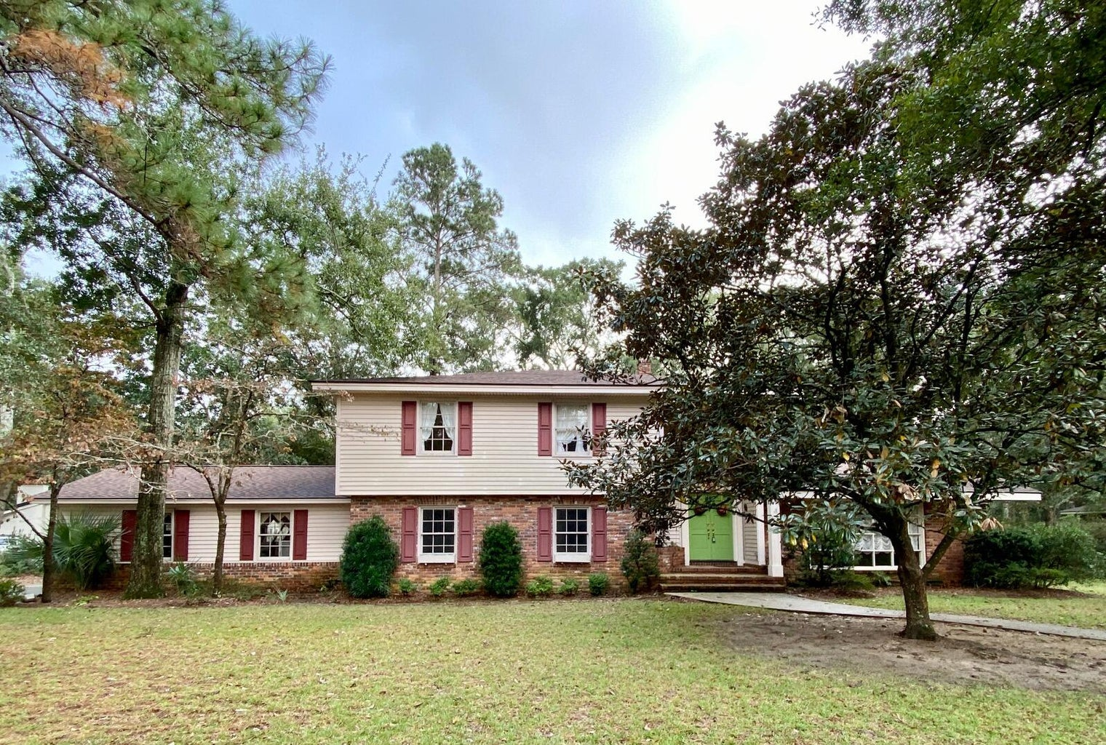
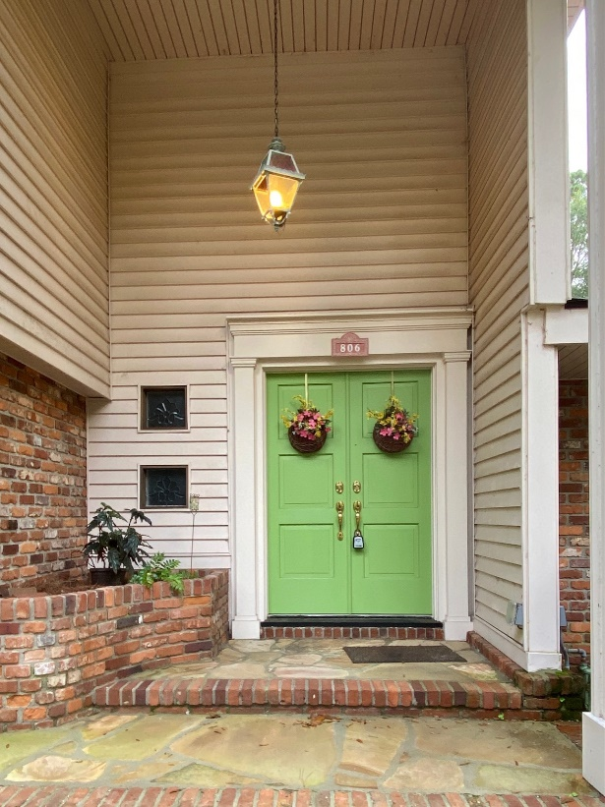
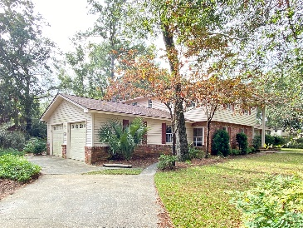
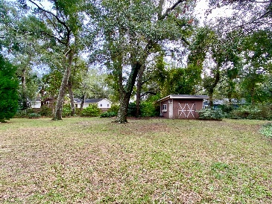
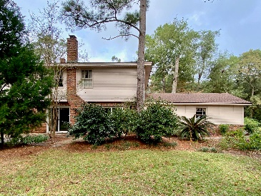


Make This Your Dream Home!
Great Price
On James Island
806 Jeb Stuart Road
Fort Johnson Estates · Charleston, SC 29412
MLS# 23005572 · $800,000
Michael Dew
O 843-769-5100
M 843-870-7000
michaeledew@gmail.com
www.michaeldewrealestate.com
Seller has begun demo for renovations. 4 bedroom 3 bath home with mother in law suite in Fort Johnson Estates. Sand stone front porch leading to double door entry. Checkered tiled foyer. Formal living room leads to formal dining room. Eat in kitchen open to den with large brick fire place. Off den is spacious mother in law suite with efficiency and full bath. Wide steps leading upstairs to 4 bedrooms and 2 baths. Hardwood floors through out upstairs. Patio overlooking huge high lot. 2 car garage with plenty of storage above. Additional parking for mother in law suite.
No flood insurance. No HOA! Great location!!
AgentOwned Charleston Group
902 Savannah Hwy
Charleston, SC 29407
Real Estate ● Mortgage
Insurance ● Business Brokerage

