Slide 1
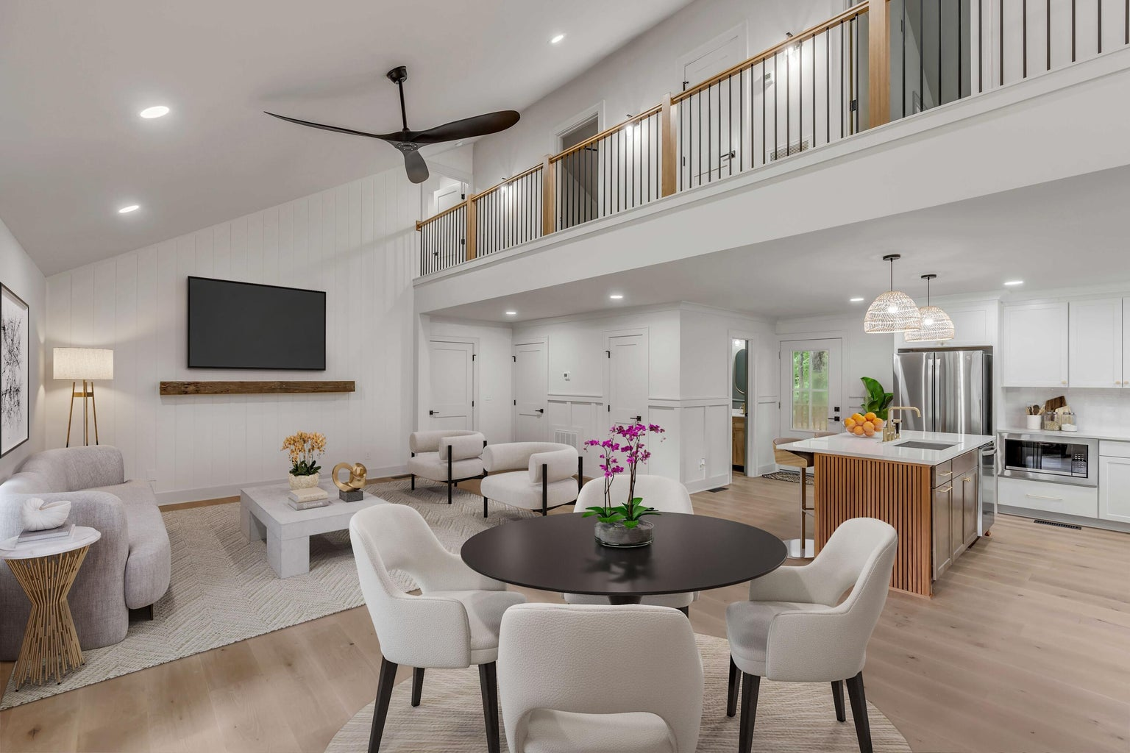
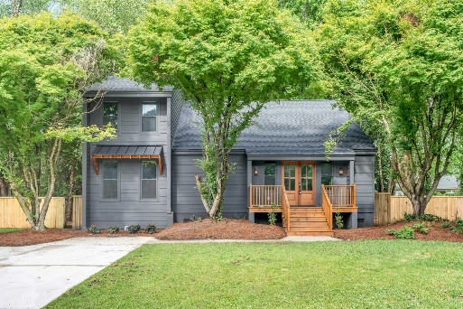
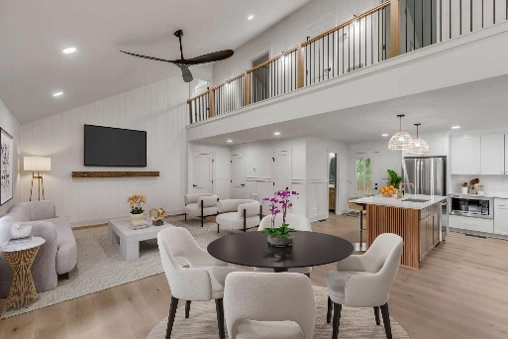


Snee Farm | New Everything!
806 Law Lane
Snee Farm | Mount Pleasant, SC 29464 | MLS# 24017659 | $999,750
Everything has been renovated in this gorgeous Snee Farm home. Quiet street and huge private lot backing up to woods. Two en-suite primaries one up and one down, both with big closets. The other two bedrooms share a Jack and Jill bath, plus a sleek powder room downstairs. New roof, HVAC, Hardi-plank siding, floors, paint, windows and doors. Gorgeous open kitchen and all new bathrooms as well. A country club, pool, golf course, and tennis courts are all at your fingertips inside the neighborhood, which is right in the middle of Mount Pleasant. Not many homes like this under seven figures right now.
Justin Natale
843-437-9739 | jnatale1982@gmail.com
www.theblvdcompany.com
The Boulevard Company, LLC | 806 Johnnie Dodds Blvd Ste 100 | Mt Pleasant, SC 29464

