Slide 1
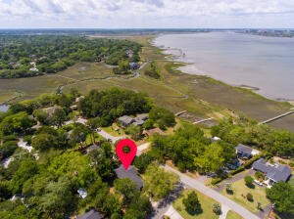
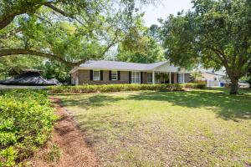
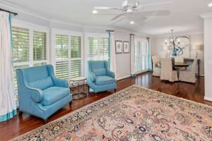
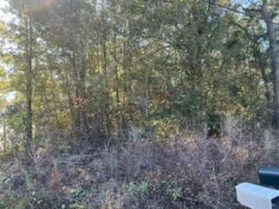
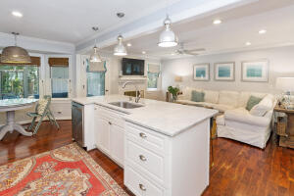
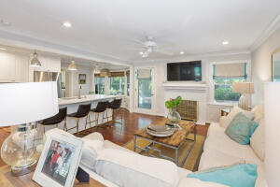
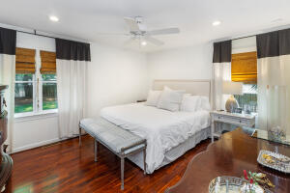
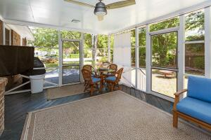


New Listing ~ Amazing Harbor Views!!
Reduced!
807 Clearview Drive
Clearview · Charleston, SC 29412
MLS# 22011231 · $950,000
Michael Dew
O 843-769-5100
M 843-870-7000
michaeledew@gmail.com
www.michaeldewrealestate.com
3 bed 2 bath brick ranch in highly sought after Clearview neighborhood. Large nicely landscaped corner lot on quiet street across from the harbor. Spacious front porch. Plantation shutters on entire front of house. Beautiful hardwood floors through out. Open floor plan. Living/dining room and family room with gas fireplace. Updated eat in kitchen with Carrara marble counter tops, tiled back splash, newer cabinets, gas range, island, and stainless steel appliances. New lighting through out. Calacatta Gold counter top in hall bath. Newly renovated frog, not included in square footage. Cedar hall closet. Tons of storage. Screened in porch overlooking back yard. Huge attached 2 car garage adorned with gas lanterns with work space. Updated electrical panel. Newer water heater. Nest t-stat. Well pump with 2 pumps (1 brand new) to water entire yard at same time. HVAC replaced 2017. Fabulous location! Must see!
AgentOwned Charleston Group
902 Savannah Hwy
Charleston, SC 29407
Real Estate ● Mortgage Insurance ● Business Brokerage

