Slide 1
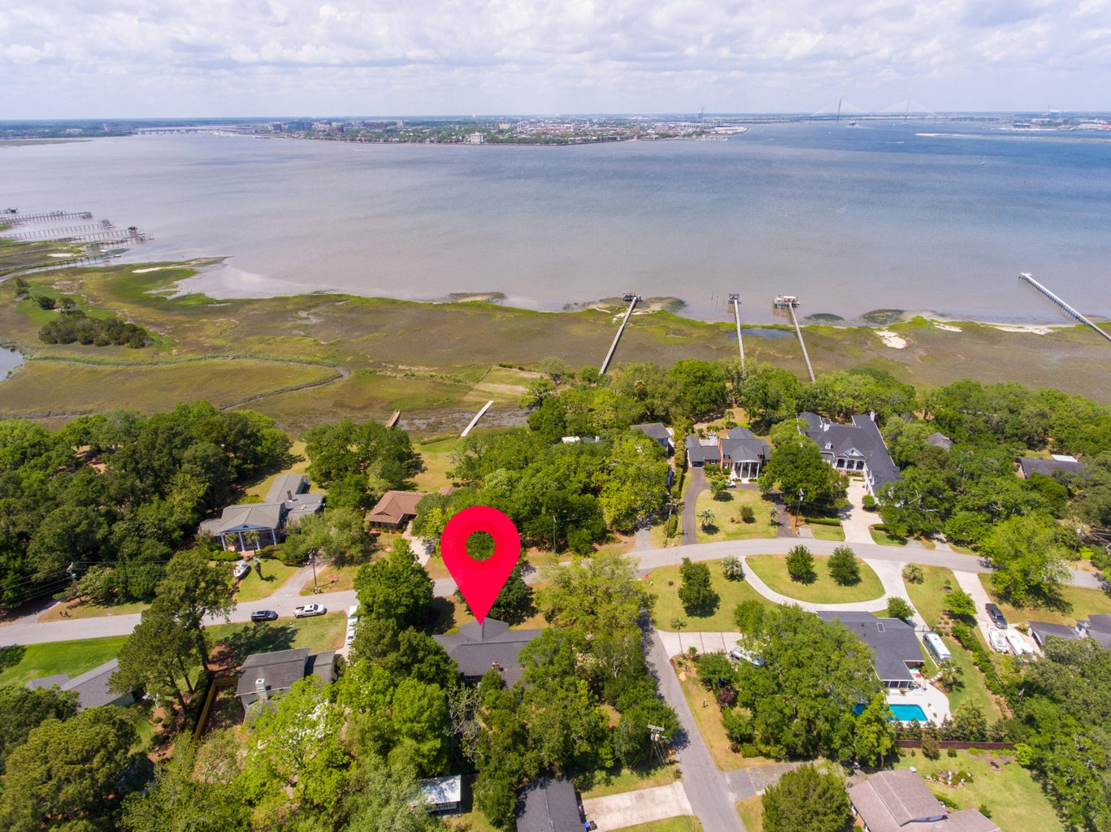
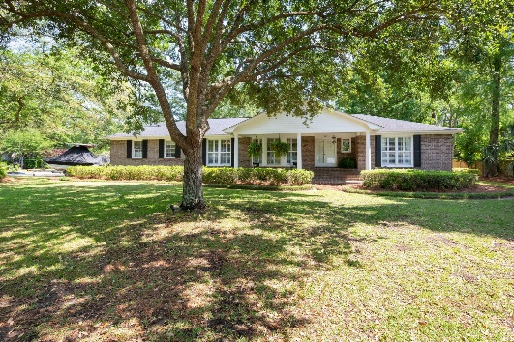
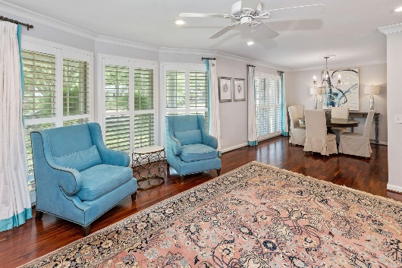
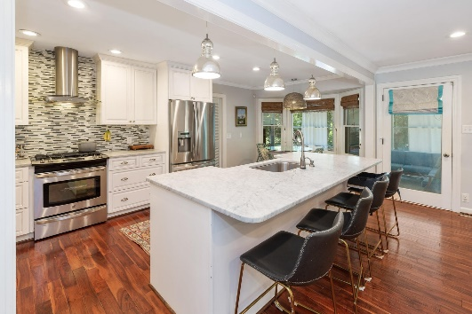
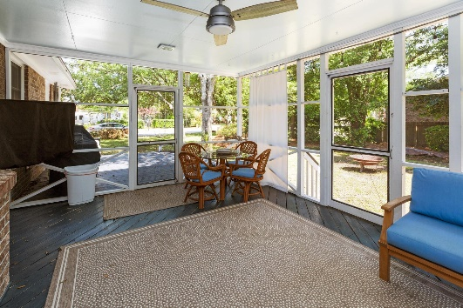


Amazing Harbor Views!!
COMING
SOON
807 Clearview Drive
Charleston, SC 29412
MLS# 23017813 · $885,000
Michael Dew
O 843-769-5100
M 843-870-7000
michaeledew@gmail.com
www.michaeldewrealestate.com
3 bed 2 bath, plus bonus room, brick ranch in highly sought after Clearview neighborhood. Large nicely landscaped corner lot on quiet street across from the harbor. Spacious front porch, plantation shutters, and hardwood floors throughout. Open floor plan with living/dining room and family room with gas fireplace. Updated eat in kitchen with marble counter tops, tiled back splash, gas range, island, and stainless steel appliances. Newly renovated frog and garage entrance way. Cedar hall closet, lots of storage and screened in porch overlooking backyard. Large attached 2 car garage adorned with gas lanterns, work space and overlay garage doors. Nest thermostat. Well pump and sprinkler system. HVAC replaced 2017, updated electrical panel, and newer water heater. Fabulous location! Located near Sunrise Park and James Island Yacht Club! Must see!
AgentOwned Charleston Group
902 Savannah Hwy
Charleston, SC 29407
Real Estate ● Mortgage Insurance ● Business Brokerage

