Slide 1
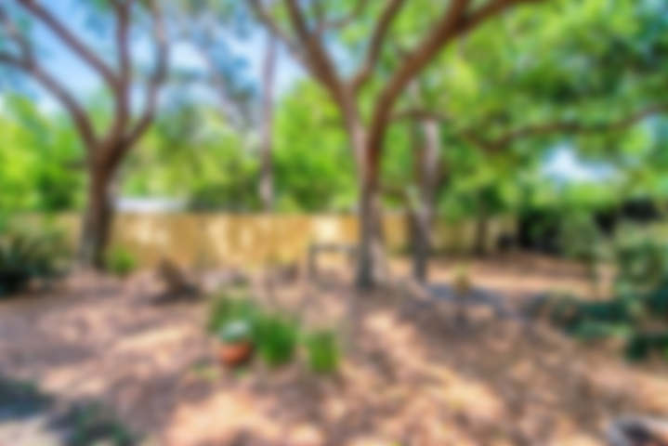
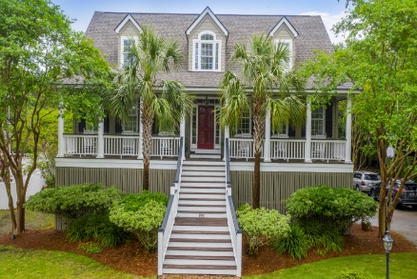
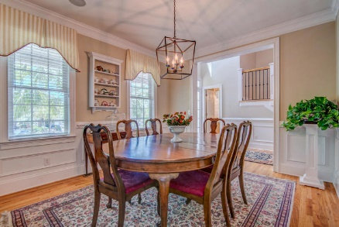
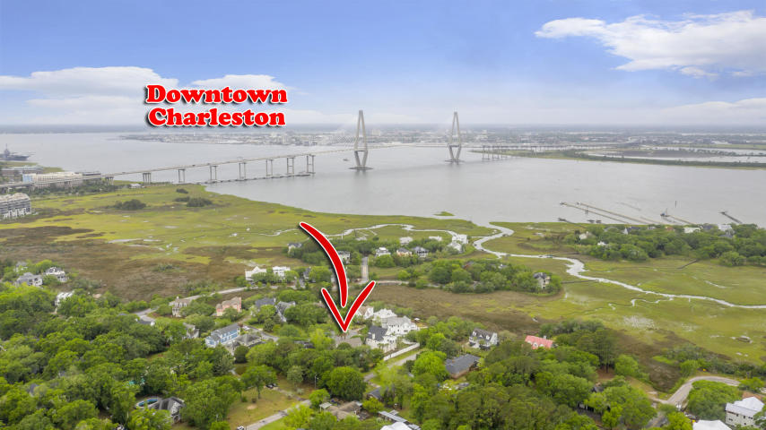
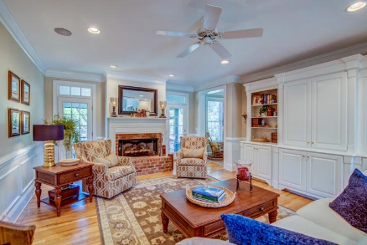
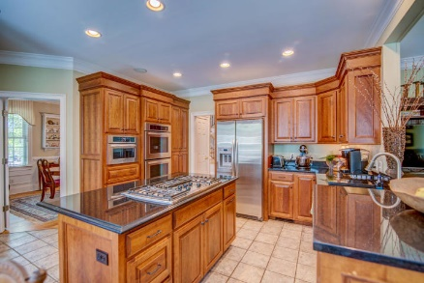
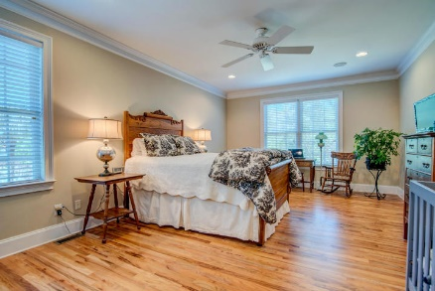
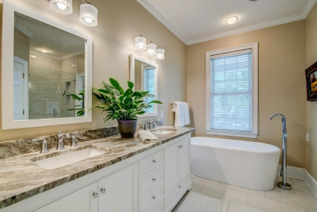
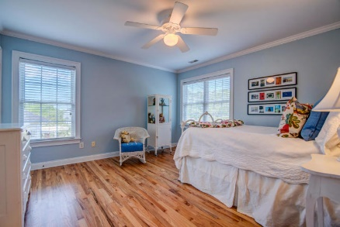
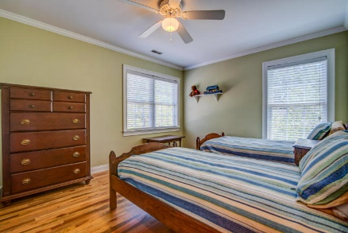
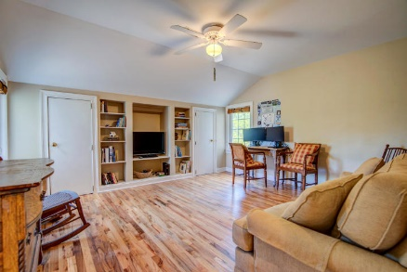
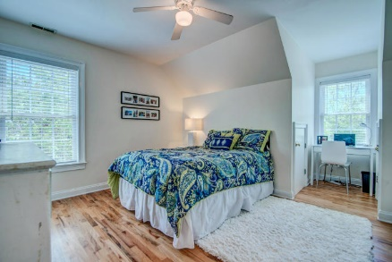
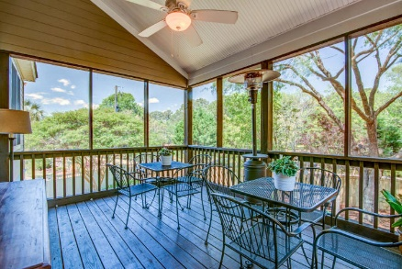
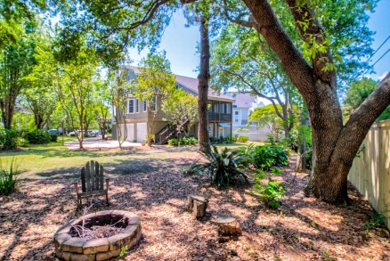


808 Fiddlers Point Lane
Harbour Watch
Mount Pleasant, SC 29464
MLS# 20011093 | $879,000
Location…
Location…
Location!!
Unbeatable location just five minutes to Downtown Charleston, this home is full of Lowcountry charm and nestled into a quiet neighborhood minutes from the foot of the Ravenel Bridge. Walk or bike to Mount Pleasant's Waterfront Park & Pier! If location wasn't enough, the custom details found throughout this Hilton Googe designed custom home are sure to impress!
This exceptional custom home offers numerous recent upgrades including two new water heaters in 2019 (50 gallons each, one for each side of the house), dual heat pumps replaced in 2017, new roof in 2018 (Certainteed Landmark 30 year shingles), and the Hardiplank exterior was painted in 2018. All of this and located in Harbour Watch, a small 68 home coastal village on the banks of the Cooper River with a community swimming pool, children's play area, and gazebo, just minutes to all of Mount Pleasant's most desired attractions and a mere 5 minutes to historic Downtown Charleston's world-class shopping and dining.
Don Dawson
843-514-0452
ddawson@carolinaone.com
Carolina One Real Estate • 2713 Highway 17 North • Mount Pleasant, SC 29466
www.TeamDawsonSC.com

