Slide 1
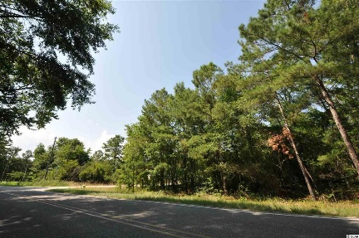
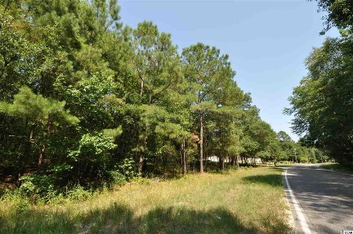
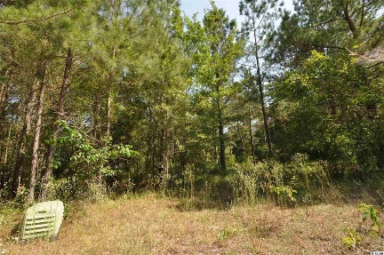
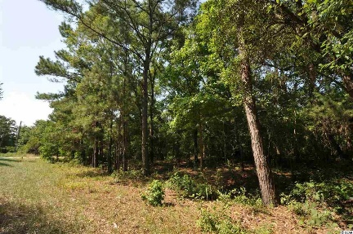
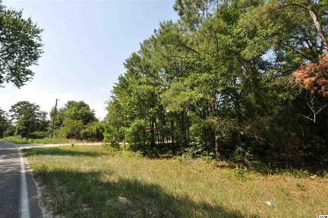
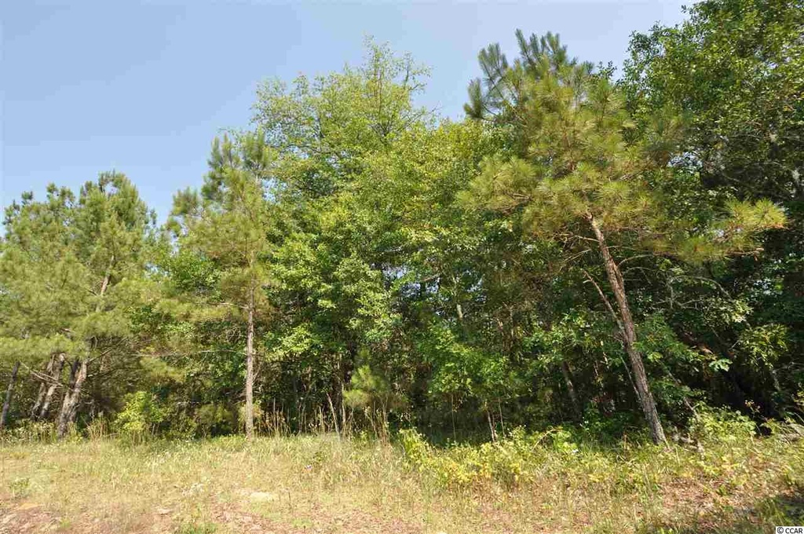
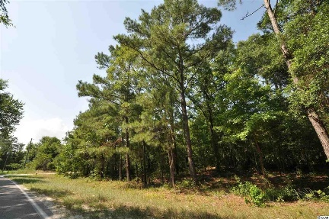
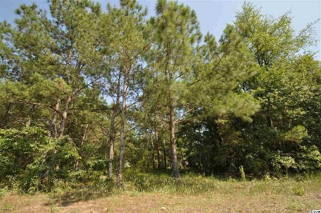


808 Pint Cir
Longs, SC 29568
MLS# 1512489
$19,900
0.7 acres
Perfect for your dream home
Beautiful, wooded .70-acre with mature trees boasting frontage on adjoining roads with potential for lovely, circular drive. Location affords great privacy. Minutes to North Myrtle Beach and Little River via Highway 90 or to Myrtle Beach via Highway 22. Enjoy country living outside the city limits with low taxes.
Deborah Collins
843-424-9013
dctidewater@yahoo.com
Connie Ross-Karl
702-306-2643
conniesross@aol.com
NEW WAY PROPERTIES MYRTLE BEACH

