Slide 1
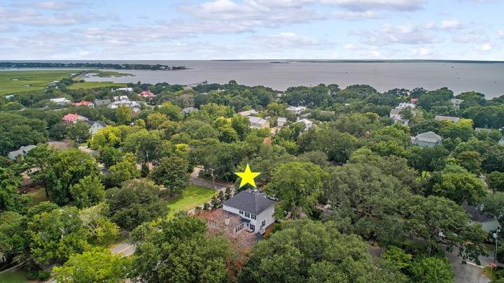
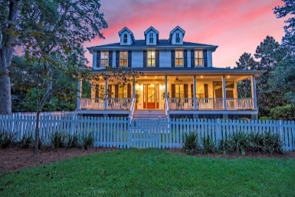
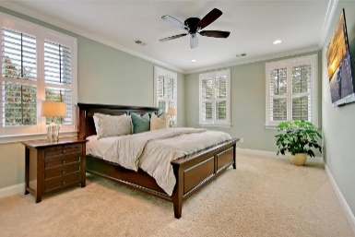
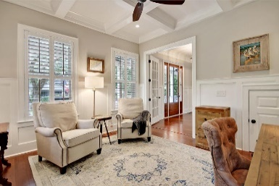
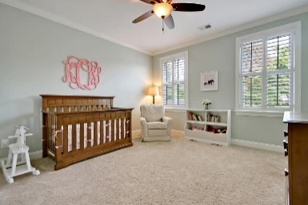
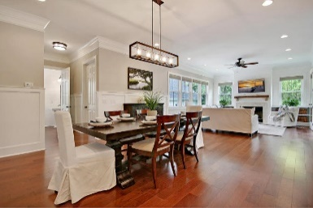
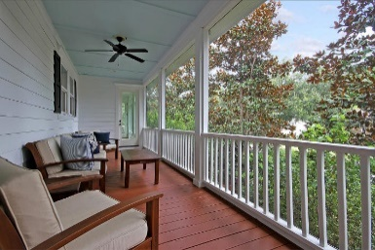
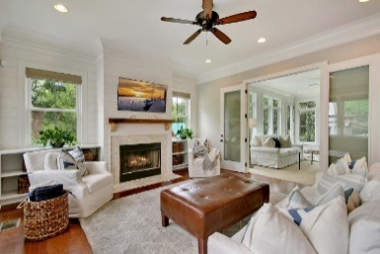
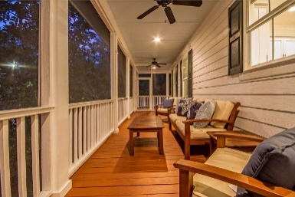
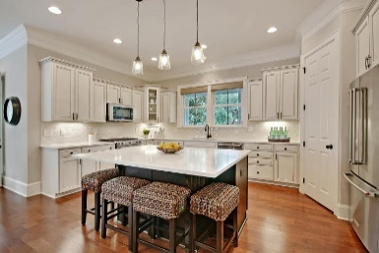
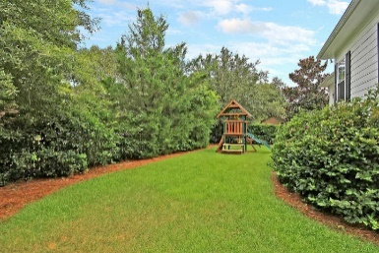
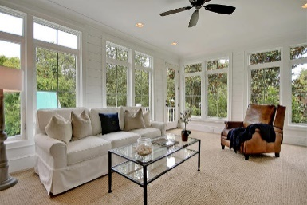
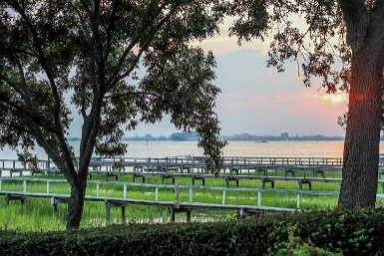
Great Downtown Investment Opportunity
$100K Price Reduction!
808 Royall Avenue
Mount Pleasant, SC 29464 ~ MLS# 18024800 ~ $1,395,000
Newer construction in Old Village just one block from the water brings you into one of the most coveted neighborhoods in all of the low country. Unlike many of the homes found here, there is absolutely nothing left to be done in this magnificent residence that boasts a classic, white picket fence, welcoming wrap around porch and a detached two car garage. This amazing, open floor plan features a first floor bedroom with en-suite bath, hardwood floors, high ceilings, crown molding, a coffer ceiling in the study, fireplace in the living room and a sun-drenched family room with built-ins. The relaxing owner's oasis has a massive walk-in closet and luxurious en-suite bath with dual vanity, soaking tub and huge, walk-in shower with two heads. This is a home and location that is hard to beat!
Additional features include:
Wainscotting and ship lap
Kitchen has a center island with break fast bar seating, a built-in wine fridge, stainless steel appliances, quartz counters, tile backsplash, pendant lighting and custom cabinets
Upgraded lighting throughout
Wrought iron staircase
Freshly painted
Screened-in side porch
Back deck perfect for BBQ
Fenced-in backyard
Walk to Old Village shops and restaurants
Book your showing today!
Book your viewing today!
Matt O'Neill matt@mattoneillteam.com 843-619-0401

