Slide 1

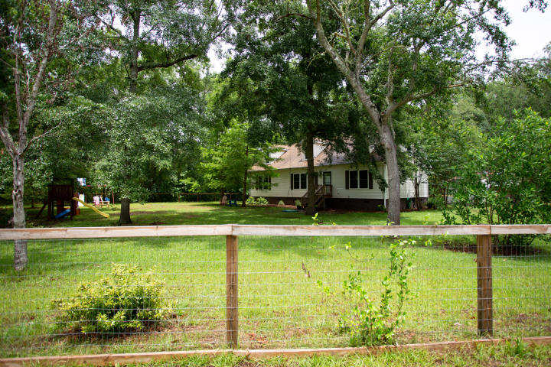
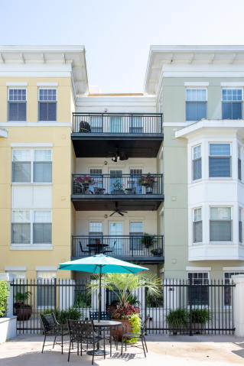
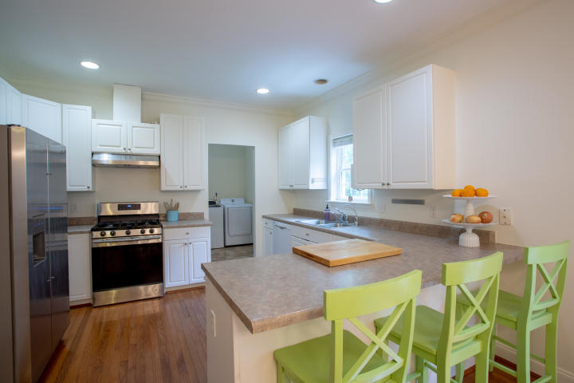
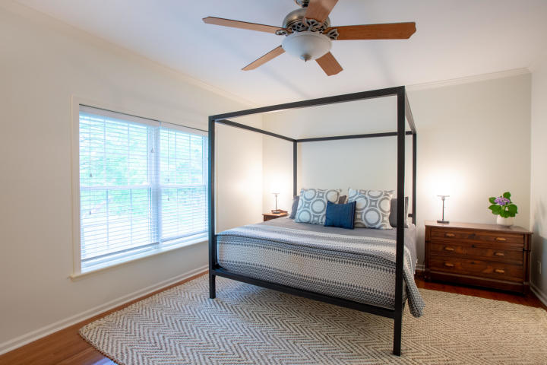
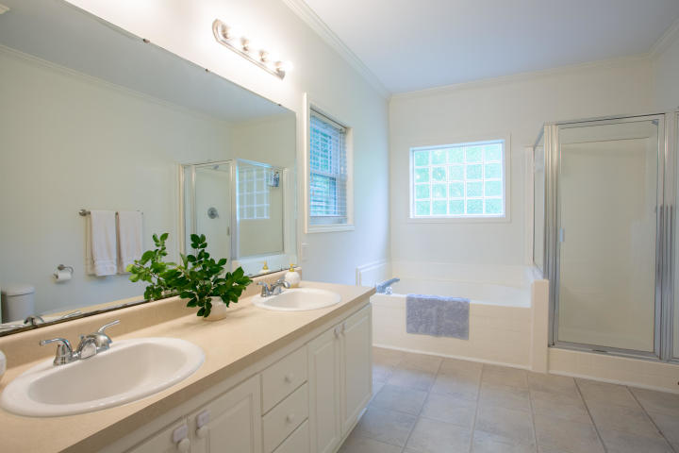
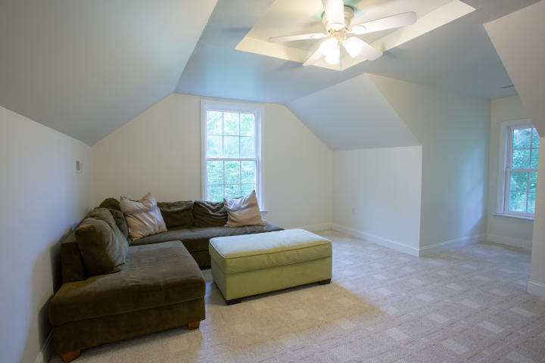
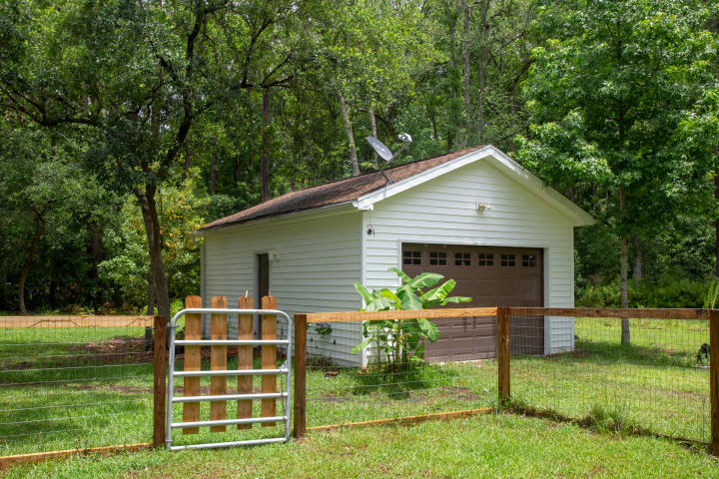


DRAFT
This Recently Listed Country Home Is A Must See!
8090 Bird Pond Road
Adams Run, SC 29426 | MLS# 19017025 | $289,000
Beautiful country home sitting on a large corner lot in Adams Run. This four bedroom home has an open floor plan with hardwoods throughout the main level. The kitchen has a newer stainless steel refrigerator, gas range, and bar seating. There's an eat-in kitchen/dining area leading into the large living room. The spacious living room overlooks the fenced in front yard and gets a ton of natural light throughout the day. The downstairs master has a walk-in closet, bathroom w/ double vanities, shower, and garden tub. There are two additional bedrooms and another full bath on the first floor. The upstairs has a bedroom/full bath and is perfect for guests and in-laws. You could easily convert a portion of the space upstairs into a fifth bedroom or office space. There's a ton of storage w/ the shed and 1.5 car garage. The property backs up to a large wooded area and is off of a dirt road. Perfect for a young family or retirees looking for country living. Conveniently located minutes from the Food Lion on 17 and a 40 minute drive from downtown Charleston.
Greg Gelber
(843) 494-2354
greg.gelber@agentownedrealty.com
AgentOwned Charleston Group | 902 Savannah Hwy | Charleston, SC 29407-7802

