Slide 1
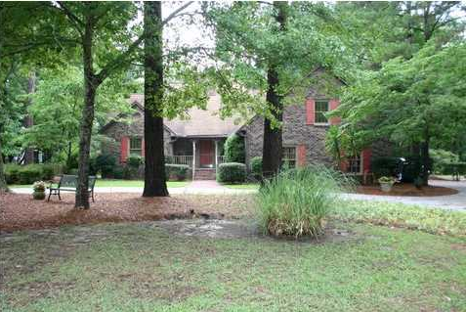
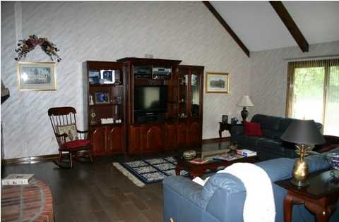
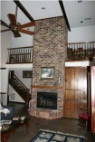
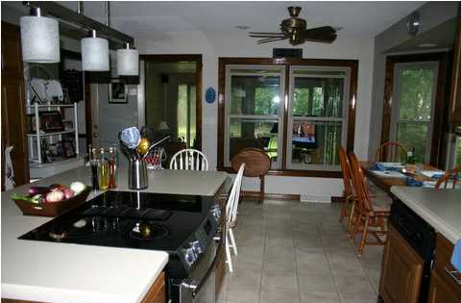
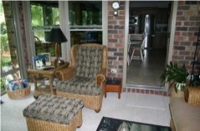
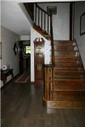
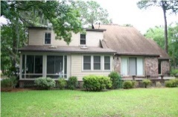


Snee Farm Open House All Weekend
Stop by Saturday or Sunday from 1-5
809 Farm Quarter Rd
MLS# 1416880
$610,000
Owner is a SC Licensed Real Estate Agent. Sit in your favorite chair in this Sun Room and have your Private Haven. 3/4 acre lot (wooded in back) and long tee view of the sixth hole gives you all the peace you could ever want. a Deck for entertaining across the back with exits from master Bedroom and Great Room. Five minutes to Towne Center with all kinds of shopping and eateries. Ten minutes to Isle of Palms beach. Fifteen minutes to downtown Charleston and all the joys of a little New York. Enjoy the best food in the Country. House looks small from the front but is a massive 3515 SQF per appraisal measurements (buyer measure if important). From the street a large Circular Drive with Pineapple Posts invites you into a large Foyer, with beautiful dark wood steps on right leading to the first landing which enters a large guest bedroom with full bath (FROG). To the left inside the front door is the huge Master Bedroom Suite. Opening up in front of you from the Foyer is a huge Great Room, Brick Fireplace all the way to a high cathedral ceiling all open to Dining Room on right. Interior decorator picked out new flooring to bring all the wood and fireplace together. All wood is solid in the house and has beautiful dark finish, highly glossed with polyurethane. (House boasts 5 large bedrooms, an office with lots of built-ins and wet bar and of course that sunroom, a Landing with bookshelves 14 feet long and 5 shelves high. A large Eat-in-Kitchen with cabinets galore, Island with jenn-Aire Stove, corian countertops and expansive views of the 6th tee and fairway. Has Great Room with wet bar and built-ins on right facing the fireplace. The Large laundry room has wet closet and deep sink. Included is 3.5 baths.) Many electrical savings have been added, bill averages under $200 a month. (see sheet on dining room table for dates appliances replaced and hidden joys of this house.) Outside is brick with siding in rear is Hardi-Plank, most all windows are new, and soffit is low maintenance.
Jean Gilmer
843-270-1666
jgilmergolfer@gmail.com
Agent Owned Realty
902 Savannah Hwy
Charleston, SC 29407

