Slide 1
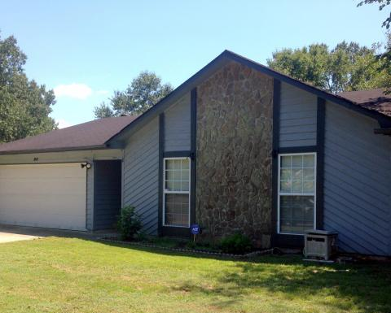
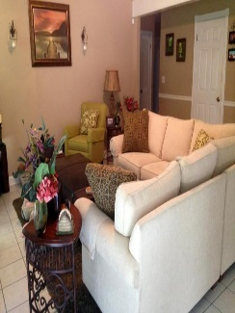
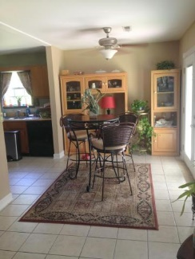
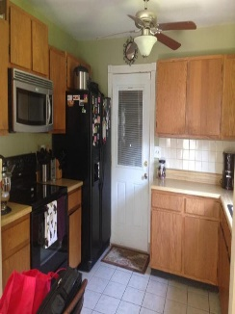
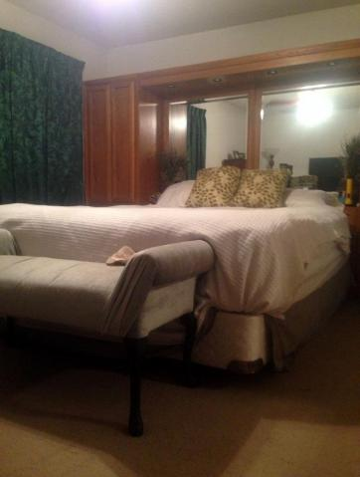
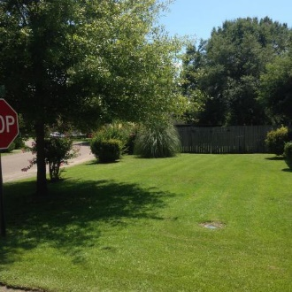



80 Peppertree Ln
Peppertree Sub.
Charleston, SC 29420
MLS# 15022511
$139,000
3 Bedrooms ▪ 2 Baths ▪ 1,373 sf.
New Listing ~ $10,000 roof/bath allowance
This adorable 3 bedroom, 2 bath, ranch has many upgrades and is aggressively priced for a quick sale. The owner is also offering a $10,000 allowance, with acceptable offer, for a new roof and for some master bath improvements. The roof doesn’t leak but is older. The nice sized kitchen has wood cabinets, tile flooring, built-in microwave, and a refrigerator which will convey. The dining area is open to the family room with tile flooring, ceiling fan, and new French Doors which lead to the patio and backyard. The family room has a vaulted ceiling, ceiling fan, tile flooring and a gas fireplace with granite surround. There is an attached two car garage with garage door opener and the HVAC is only a year old. Home sits on a large, beautiful corner lot with lots of landscaping and a fenced backyard. Home is conveniently located near USAF Base, Boeing, shopping, dining, Hwy. 26, and located in highly sought-after Dorchester II School District.
Jennifer Nipper, Realtor®
(843) 478-1800 | jen@AgentOwned.com
www.AgentOwned.com
The AgentOwned Realty Co | 824 Johnnie Dodds Blvd | Mt. Pleasant, SC 29464
Real Estate • Mortgage • Insurance

