Slide 1
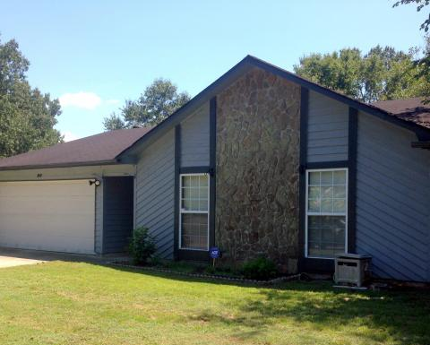
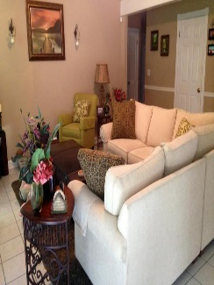
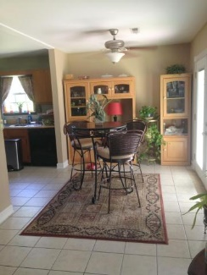
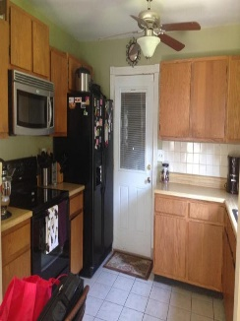
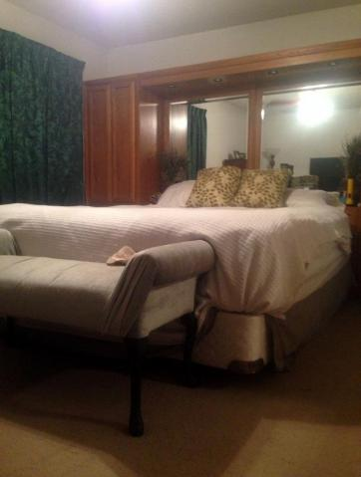
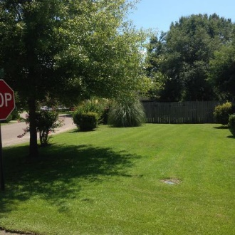



80 Peppertree Ln
Peppertree Sub.
Charleston, SC 29420
MLS# 15022511
$134,000
3 Bedrooms ▪ 2 Baths ▪ 1,373 sf.
New Roof is Being Installed!!
What a Fantastic, Cottage Style Home with New Roof being Installed, New French Doors, New Dishwasher, HVAC is Only One Year Old, Washer, Dryer and Refrigerator Will Convey!
The home is minutes from dining, shopping, USAF Base, Interstate 26, and as an added bonus, is located in Dorchester II School District. This 3 bedroom, 2 bath, home has an open floor plan with vaulted, smooth ceilings in family room with a gas fireplace and granite surround. The family room is open to the dining area for easy entertaining with new French Doors leading to the large, fenced backyard.
Home sits on a beautiful, large corner lot with a two car garage and garage door opener. Ceiling fans in almost every room. Schedule an appointment today – it won’t last long!
Jennifer Nipper, Realtor®
(843) 478-1800 | jen@AgentOwned.com
www.AgentOwned.com
The AgentOwned Realty Co | 824 Johnnie Dodds Blvd | Mt. Pleasant, SC 29464
Real Estate • Mortgage • Insurance

