Slide 1
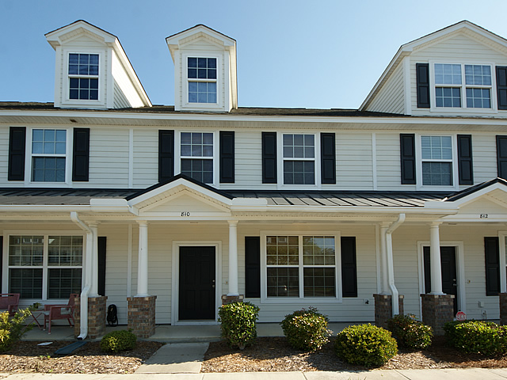
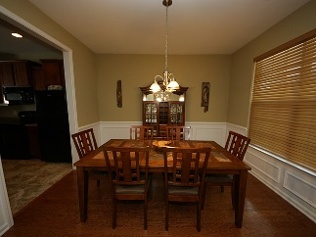
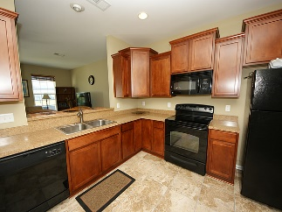
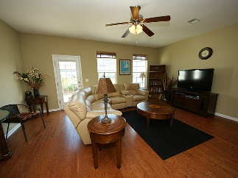
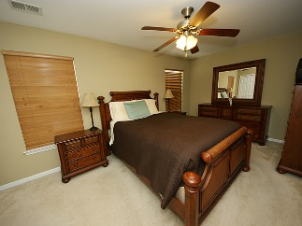
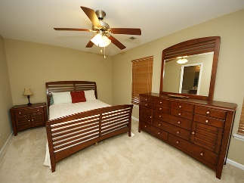
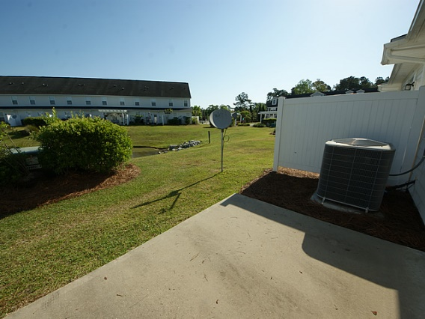
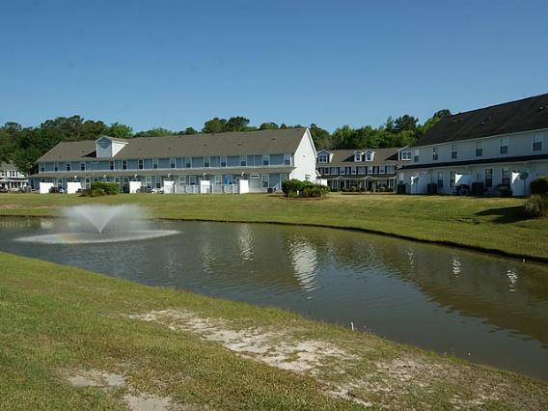

810 Hemingway Cir Central Commons Summerville MLS# 16011295 | $119,500 1,395 Sq Ft - 2 Bedroom - 2 Bath
New Listing for a 2 bedroom Townhouse in a quiet gated community
Wonderfully maintained townhouse in quiet gated community only 2 miles from Downtown Summerville.
Upon entering the townhouse you are greeted by the gleaming hardwood floors that carry you through the downstairs. In the dining room that will be great for entertaining you will find beautiful wainscoting. The spacious kitchen boast 36" Sundale Maple Paprika cabinets with ceramic tile flooring.
You will find the roomy Master Bedroom upstairs which includes double sinks in the Master Bath. The 2nd Bedroom also has a private Bath. The laundry room is conveniently located in the upstairs hallway.
Enjoy the gorgeous view of the pond from your family room or sitting on your back patio. A peaceful place you can call home.
Barbara Limehouse
843-870-8291
bllimehouse@gmail.com
Weichert Palmetto Coast
1035 Johnnie Dodds, Ste B2
Mt. Pleasant, SC 29464

