Slide 1
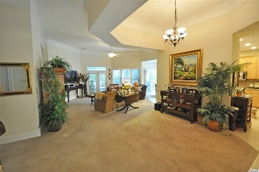
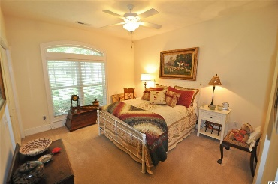
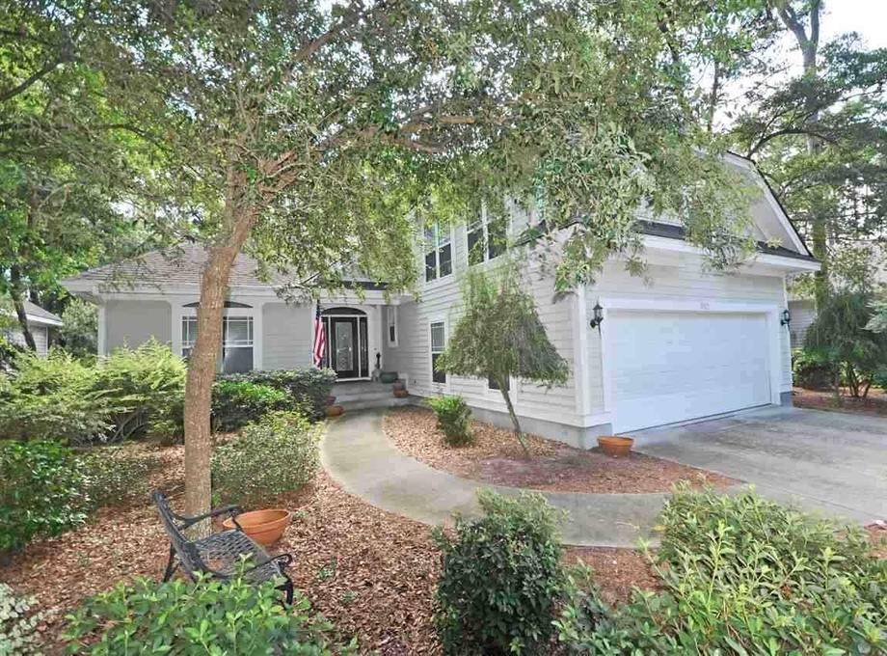
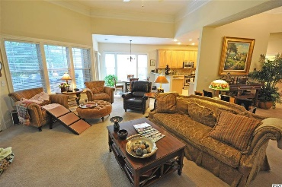
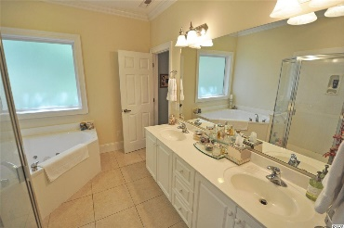
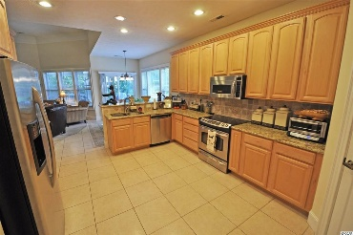
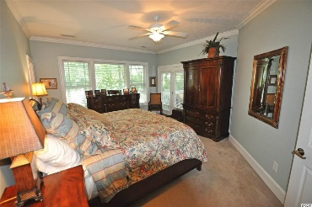
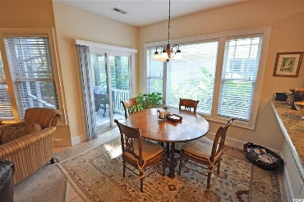
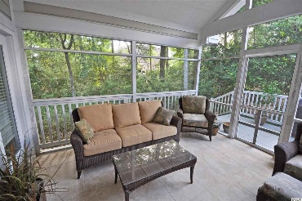
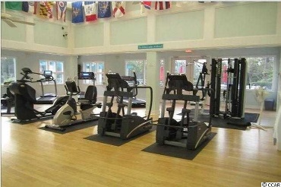
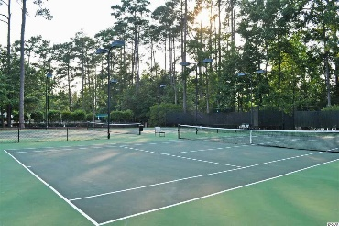
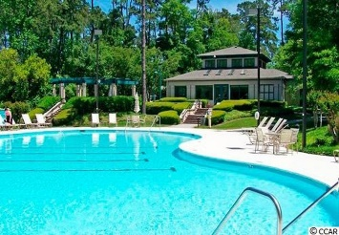
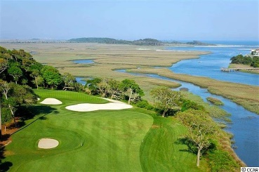
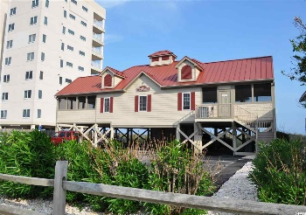


Multiple Luxury Homes Open House Tidewater Plantation North Myrtle Beach
Friday, July 13, 2018, from 11am - 1:30pm - Lunch and Prizes! Be sure to sign up at each home!!
(Show business card and ask directions at Guard House. Be sure to visit the rich Tidewater amenities at low HOAs.)
$1,000 selling agent bonus paid by seller if sold by 3/31/16
810 Morrall Dr
Tidewater Plantation - North Myrtle Beach, SC 29582
MLS# 1807840 - $349,900
NEW UPGRADED, STATE-OF-THE-ART HVAC SYSTEM!
The house has been redone to picture-perfect inside and out -- a BIG opportunity, therefore, to purchase a one-owner custom-home in the Bluffs of Tidewater Plantation Resort at today's low pricing. This livable floor plan features an expansive entry view from the front porch, encompassing the formal dining and living areas, straight through to the screened back porch, accessed from the living room, master bedroom and kitchen breakfast nook, which also adjoins a convenient deck for outdoor cooking. It is a BIG GREAT ROOM concept with lots of unique details and ceiling treatments, so comfort, flexible decorating ideas and style abound. On the main floor living space, there is also a guest bath, entry closet and two bedrooms in a popular split-bedroom floor plan with a large shared full bath. The master with ensuite and walk-in closet backs up to a secluded wooded conclave and the ease of the adjoining screened porch for a private, peaceful retreat and access to the deck and backyard. The yard is lightly wooded and nicely landscaped. Back inside, the dream kitchen has stainless steel appliances, granite countertops and a walk-in pantry. The utility room is off of the kitchen, leading to a two-car garage. Also off the kitchen hallway to the entry is the oversized upstairs bonus room with tons of storage! Looking for a one-level home with a separate man cave, game room, office or hobby loft, this is it. The home has been pre-inspected, painted, recarpeted in neutral Berber and is ready for immediate occupancy. Easy living, symmetry of design and a pleasingly hidden-away lot invite a simple but elegant beach lifestyle.
Deborah Collins
843-424-9013
dctidewater@yahoo.com
Connie Ross-Karl
702-306-2643
conniesross@aol.com
NEW WAY PROPERTIES MYRTLE BEACH

