Slide 1
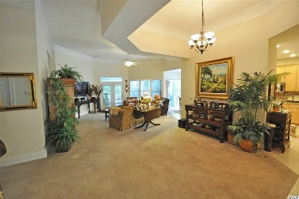
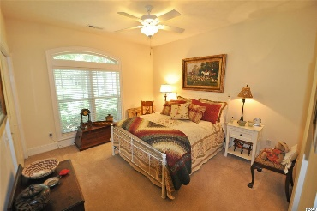
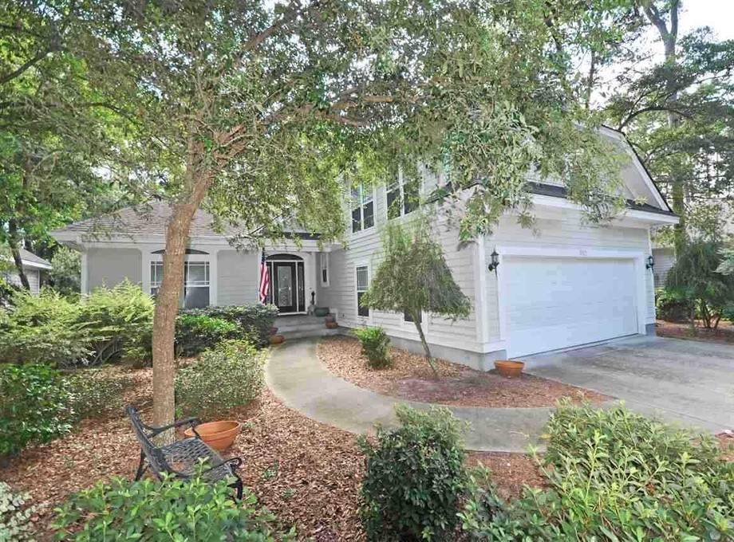
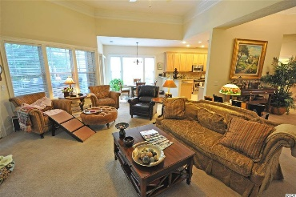
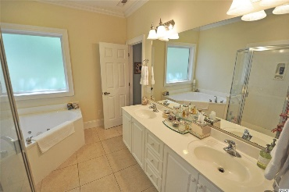
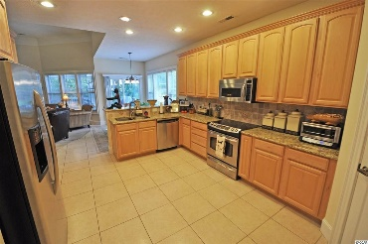
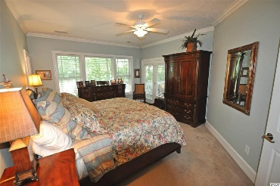
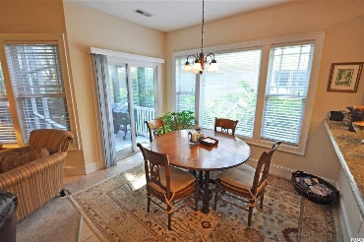
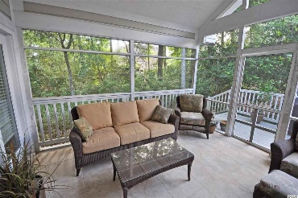
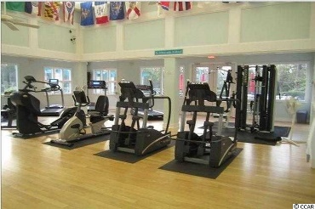
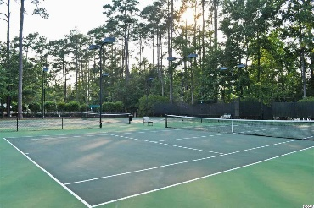
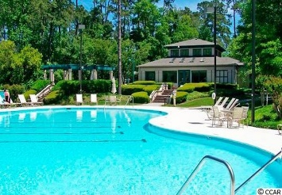
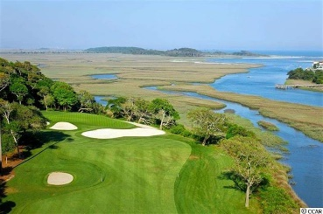
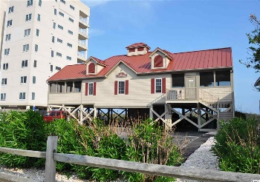


Lots Of Upgrades - Overlooks Tidewater Nature Enclave
$1,000 selling agent bonus paid by seller if sold by 3/31/16
810 Morrall Dr
Tidewater Plantation - North Myrtle Beach, SC 29582
MLS# 1519775 - $350,000
Located in prestigious Tidewater Plantation - one of the top rated golf courses in the area with 24 hour gated security. Home is in impeccable, move-in condition. Very desirable, private lot, being sold unfurnished with the exception of appliances and window coverings. Lots of upgrades in a wonderful, free-flowing floor plan, including upstairs bonus room with easy access to large attic, as well as three storage closets. Memorable kitchen with granite counter tops and stainless steel appliances. Nice outdoor living space, featuring screened porch adjoining deck overlooking wooded enclave. Tidewater also offers large, gated storage yard with security for boats, motorcycles, campers, jet skis and more. Other Tidewater amenities include private, oceanfront beach cabana featuring open/screened porches, kitchen, showers and bathrooms. Enjoy the driving range, golf shop and clubhouse with bar and dining facilities overlooking the 18th hole. Additional amenities include clay and hard surface tennis courts, bocce courts, exercise facility overlooking pool. Group work out classes and water aerobics. Amenity center is adjacent to owners' pool for private/public functions. Active recreation committee sponsors outdoor summer concert series, parties, happy hours, dinners at private homes, bridge, mahjong, book clubs and holiday events plus more! Wonderful, friendly neighbors will welcome you to your new home.
Deborah Collins
843-424-9013
dctidewater@yahoo.com
Connie Ross-Karl
702-306-2643
conniesross@aol.com
NEW WAY PROPERTIES MYRTLE BEACH

