Slide 1
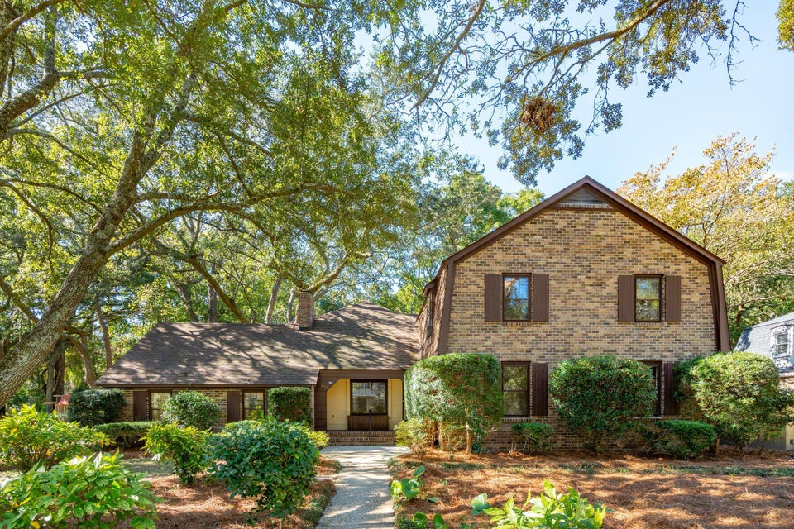
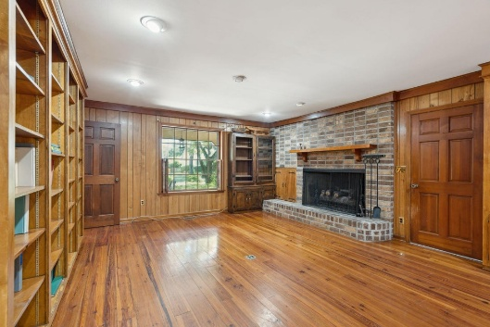
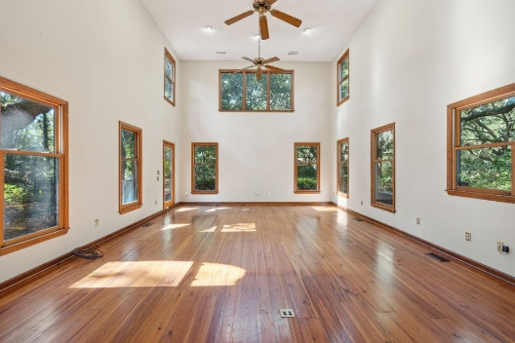
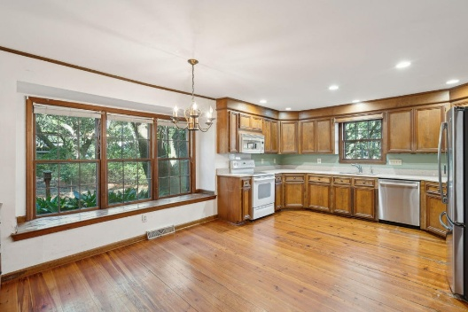


Creekside Park Price Reduction!
810 Creekside Drive | Mount Pleasant
Creekside Park | MLS# 25011870 | $1,599,000
Welcome to Creekside Park! This opportunity does not come often! Discover this charming two-story brick home nestled in one of Mount Pleasant's most desirable and family-friendly neighborhoods. Situated on one of the best lots in the area, this property offers a serene lifestyle with 10 acres of protected greenspace directly behind the home, a private neighborhood boat landing, and the Creekside Tennis and Swim Club just steps away from your front door. The spacious backyard features lush landscaping adorned with majestic Live Oaks, offering both privacy and scenic views. Inside, you'll find hardwood floors throughout, a formal layout, and a welcoming great room with soaring 20-foot ceilings, a large brick fireplace, and plenty of natural light.
The open and beautifully illuminated great room flows seamlessly into the kitchen and breakfast area, as well as the formal dining and living rooms. A cozy living room with library and charming bay window provides additional elegance and character.
This well-maintained home is move-in ready or offers the perfect opportunity to customize it into your dream space. The layout allows for the potential to create a large primary suite on the main floor or to open up the floor plan further by reconfiguring the kitchen and great room. Additionally, one of the bedrooms could be used for a large office or game room, perfect for working from home.
A prime location and opportunity, Creekside Park is ideally located just minutes from Highway 17, Downtown Charleston, and the pristine beaches of Isle of Palms and Sullivans Island. Plus, you'll enjoy easy access to Whole Foods, Trader Joe's, and an array of shopping and dining options in Mount Pleasant. Don't miss your chance to see this beautiful home and schedule a tour today! It won't stay on the market for long. AS-IS Estate Sale.
Greg Boger
843-277-5845
gboger@avenuerealtyco.com
Avenue Realty Company
www.avenuerealtyco.com

