Slide 1
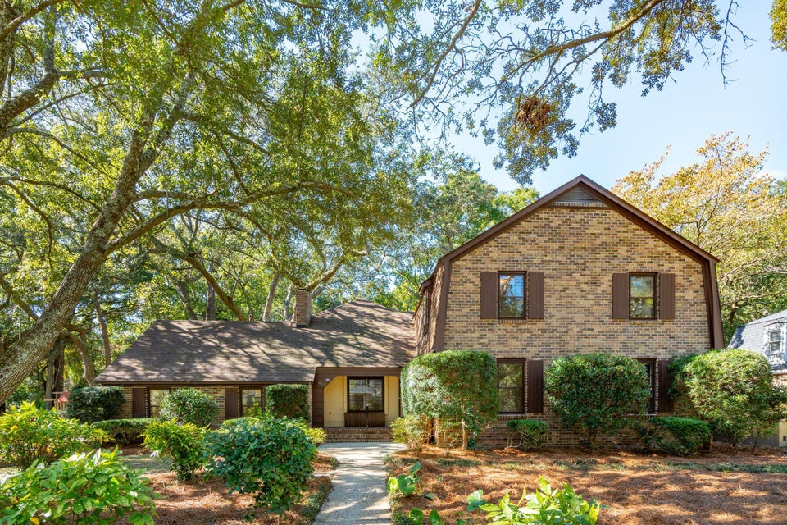
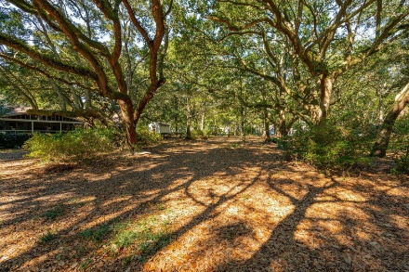
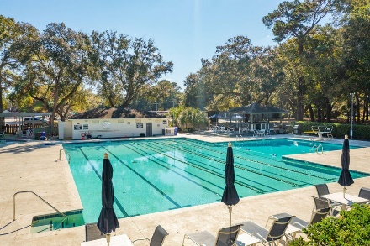
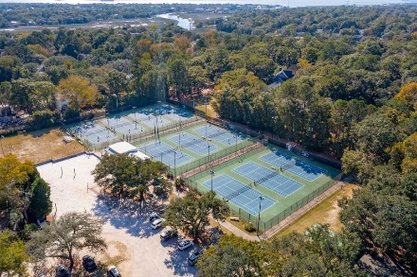


Boat Landing on Shem Creek! | Neighborhood Amenities
810 Creekside Drive | Mount Pleasant
Creekside Park | MLS# 24029139 | $1,750,000
Welcome to Creekside Park! This opportunity does not come often! Discover this charming two-story brick home nestled in one of Mount Pleasant's most desirable and family-friendly neighborhoods. Situated on one of the best lots in the area, this property offers a serene lifestyle with 10 acres of protected greenspace directly behind the home, a private neighborhood boat landing, and the Creekside Tennis and Swim Club just steps away from your front door.
A prime location and opportunity, Creekside Park is ideally located just minutes from Highway 17, Downtown Charleston, and the pristine beaches of Isle of Palms and Sullivans Island. Plus, you'll enjoy easy access to Whole Foods, Trader Joe's, and an array of shopping and dining options in Mount Pleasant. Don't miss your chance to see this beautiful home and schedule a tour today! It won't stay on the market for long. AS-IS Estate Sale.
Greg Boger
843-277-5845
gboger@avenuerealtyco.com
Avenue Realty Company
www.avenuerealtyco.com

