Slide 1
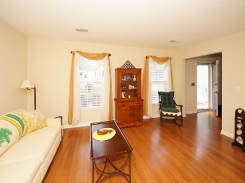
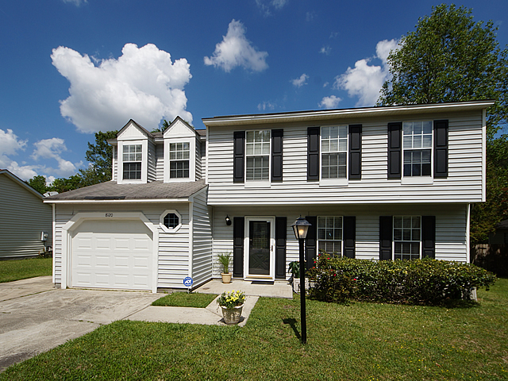
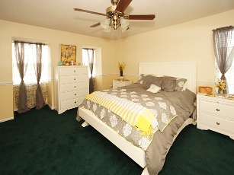
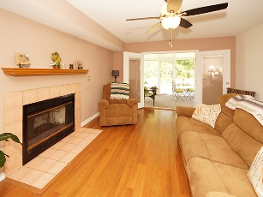
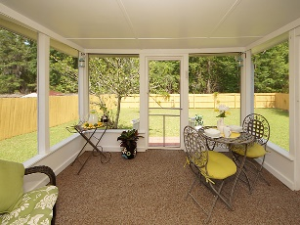
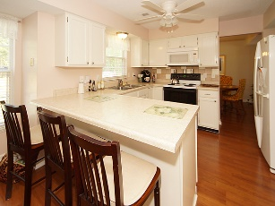
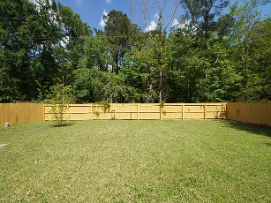


PRICE JUST REDUCED
Motivated Seller!!!
8120 Halifax Way Windsor Hill | Charleston, SC 29420 | MLS# 17010873 | $199,000
Come see this spectacular, charming 2 story spacious home located in Windsor Hill/Governors Estate. You will feel welcomed driving home to the landscaping that offers a spectacular curb appeal. The first floor features a unique entryway heading to a nice open kitchen with plenty of cabinet space, and open eating area to enjoy many dinners with the family. Create memories in the formal dining room and entertain in the spacious family room with the cozy wood-burning fireplace. The beautiful French doors take you out to the fenced in backyard to enjoy your morning cup of coffee behind a large screened in-porch. Upstairs boasts a huge master suite with a large walk-in closet and master bath. The 3 additional bedrooms are upstairs, all spacious with large closets. This home will go fast ! This home had only one owner, has been well loved and cared for, it is a must see! Schedule a showing today! Located within the highly desirable Dorchester School District 2, just minutes from Bosch, Boeing, CAFB & CHS International Airport.
Betty Ellis
REALTOR
(843) 270-2948
betty217@bellsouth.net
www.agentownedrealty.com
AgentOwned Premiere Group
1800 Trolley Rd
Summerville, SC 29485

