Slide 1
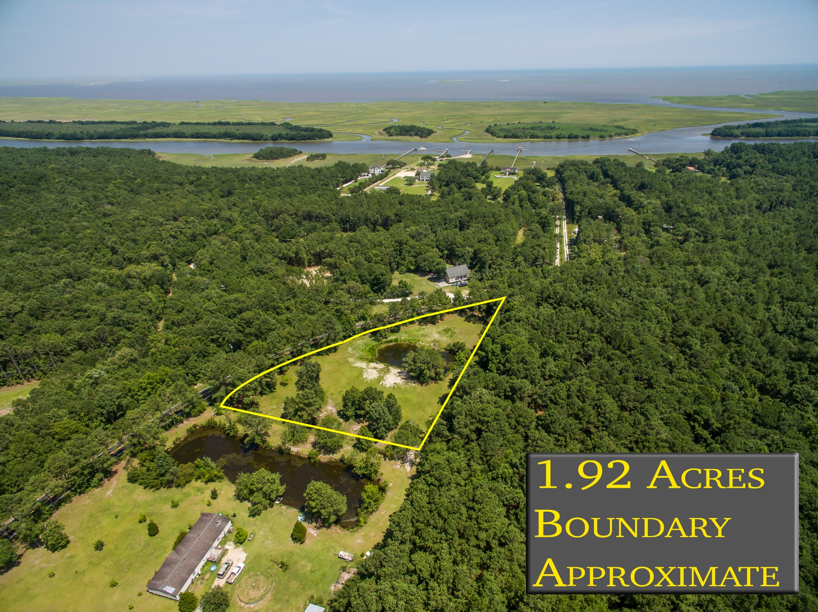
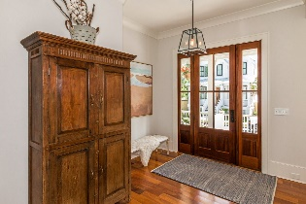
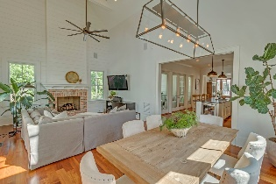
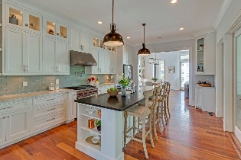
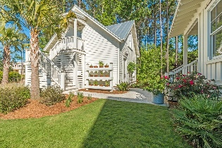
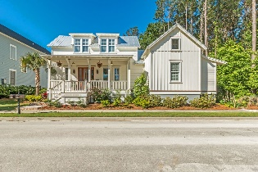


Nearly 2 Acres Cleared & Ready To Build!
8128 Doar Road
Awendaw, SC 29429 | MLS# 16017761 | $89,000
The beautiful Awendaw lot you have been waiting for, perfect for building your private and peaceful new home on desirable Doar Road. This lovely lot features nearly 2 acres, plenty of cleared build-able space, a pond for enjoying wildlife, all safely situated in an X zone - no flood insurance required. Sellers have a septic permit, and lot will also permit a mobile home. Short drive to Garris Boat Landing and Buck Hall Recreation Area, Sewee Outpost, Sewee Restaurant. Opportunities to enjoy the water and nature abound, don't miss this one!
Crissy Rowell
Mobile - (843) 377-5177
crissy.rowell@carolinaone.com
www.crissyrowell.com
Carolina One Real Estate | 195 W Coleman Blvd | Mt Pleasant, SC 29464

