Slide 1

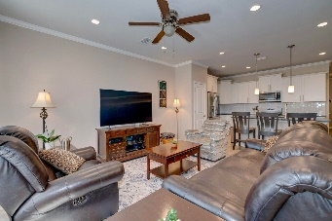
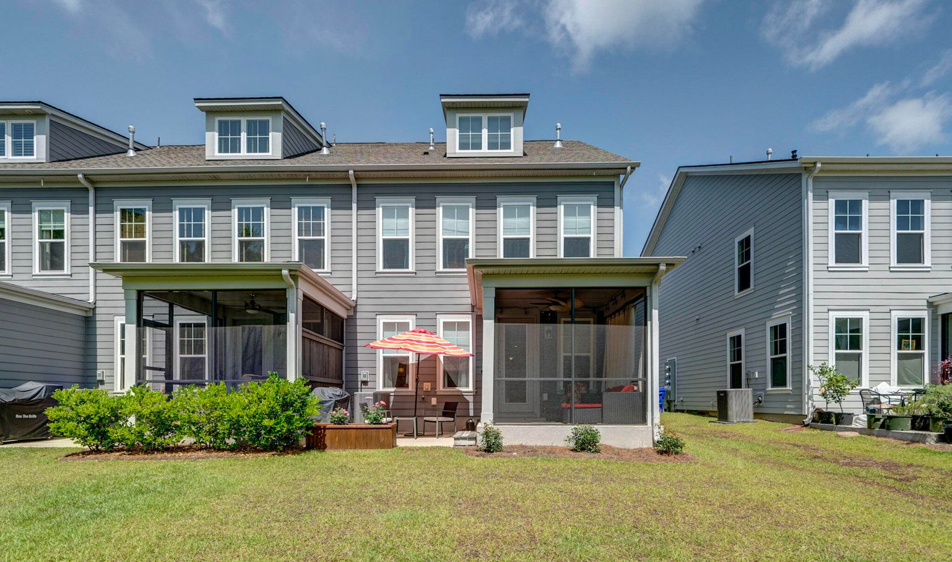
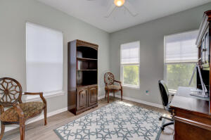
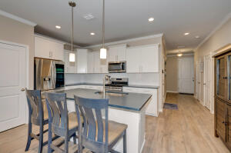
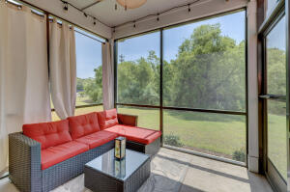
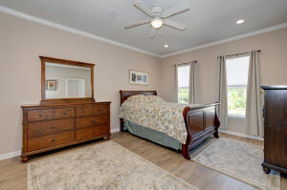
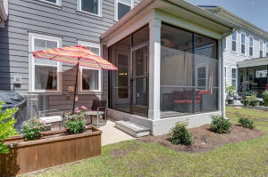
New Price! Come Check It Out Before It’s Gone!! End unit Townhouse on beautiful James Island!
812 Porcari Street
Harborwalk | Charleston, SC 29412 | MLS# 22013544 | $519,000
Ideally located minutes from downtown Charleston for your easy commute and for your fun time at Folly Beach. This is a great size for your first home or larger family. Large mother in law suite is a great option! Home comes with desirable open floor plan, four bedrooms and 3.5 bathrooms. Custom touches with crown molding, pantry shelving, neat computer nook, window coverings and shades, ceiling fans in each room, and cozy screen porch that seller is leaving furnished. Seller is leaving you a super high tech fridge you will love. Kitchen highlights a central Island, Quartz countertops, stainless appliances, and spotless white cabinets. A nicely sized, one car garage will protect your vehicle with room to spare. Packed away in the garage are hurricane panels - just in case! Remaining bedrooms give you plenty of options for swing space for a variety of needs, such as office or quest space. For your convenience, community boasts a dog park and fire pit. Home was constructed in 2019, and still enjoys the freshness that comes with a newer home. Location is absolutely the best - walk to grocery shopping, and park recreation. Combined with a very reasonable HOA, the home and Harborwalk development are a super place to live.
Donald Campbell
843-471-1085 | campbelldec@me.com
BHHS Carolina Sun Real Estate | 774 S Shelmore Blvd Suite 106 | Mt Pleasant, SC 29464

