Slide 1

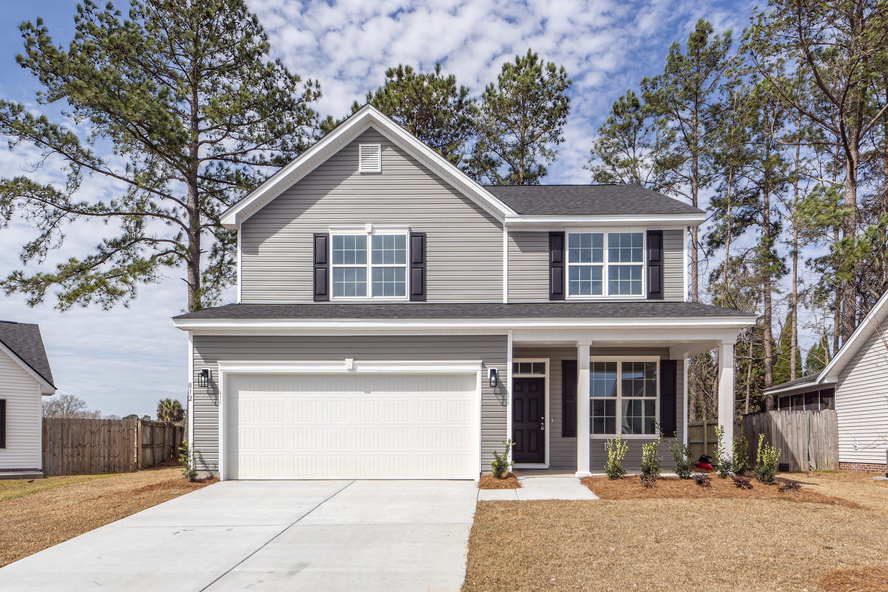
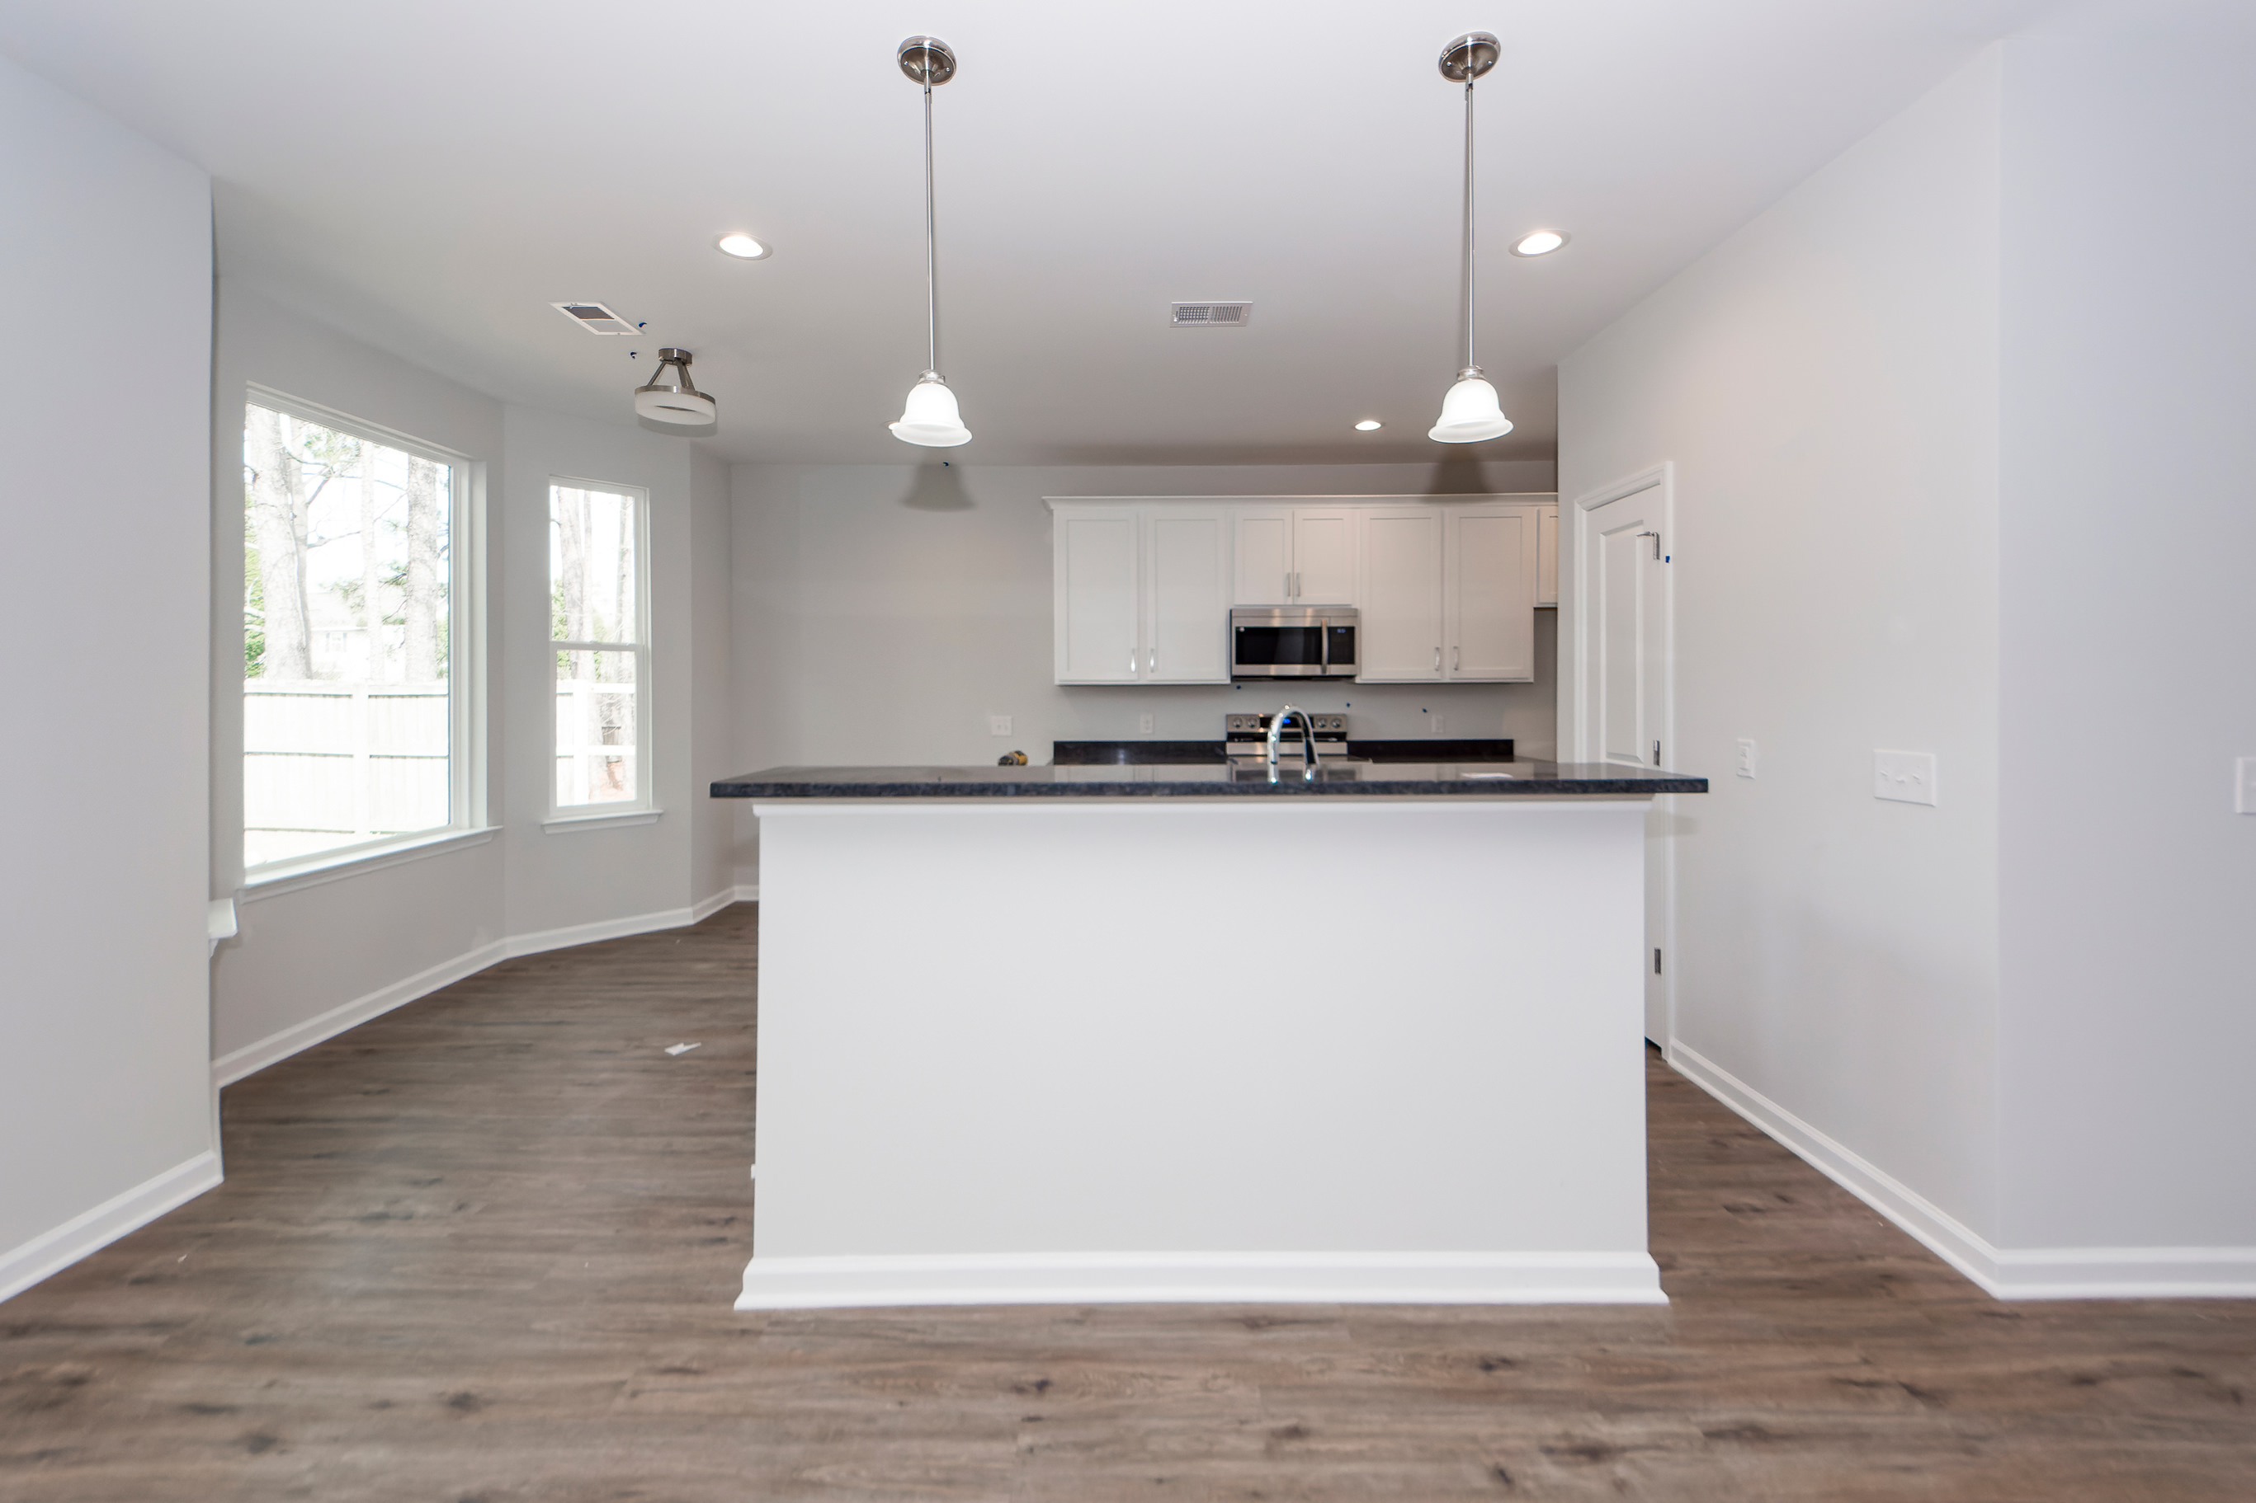
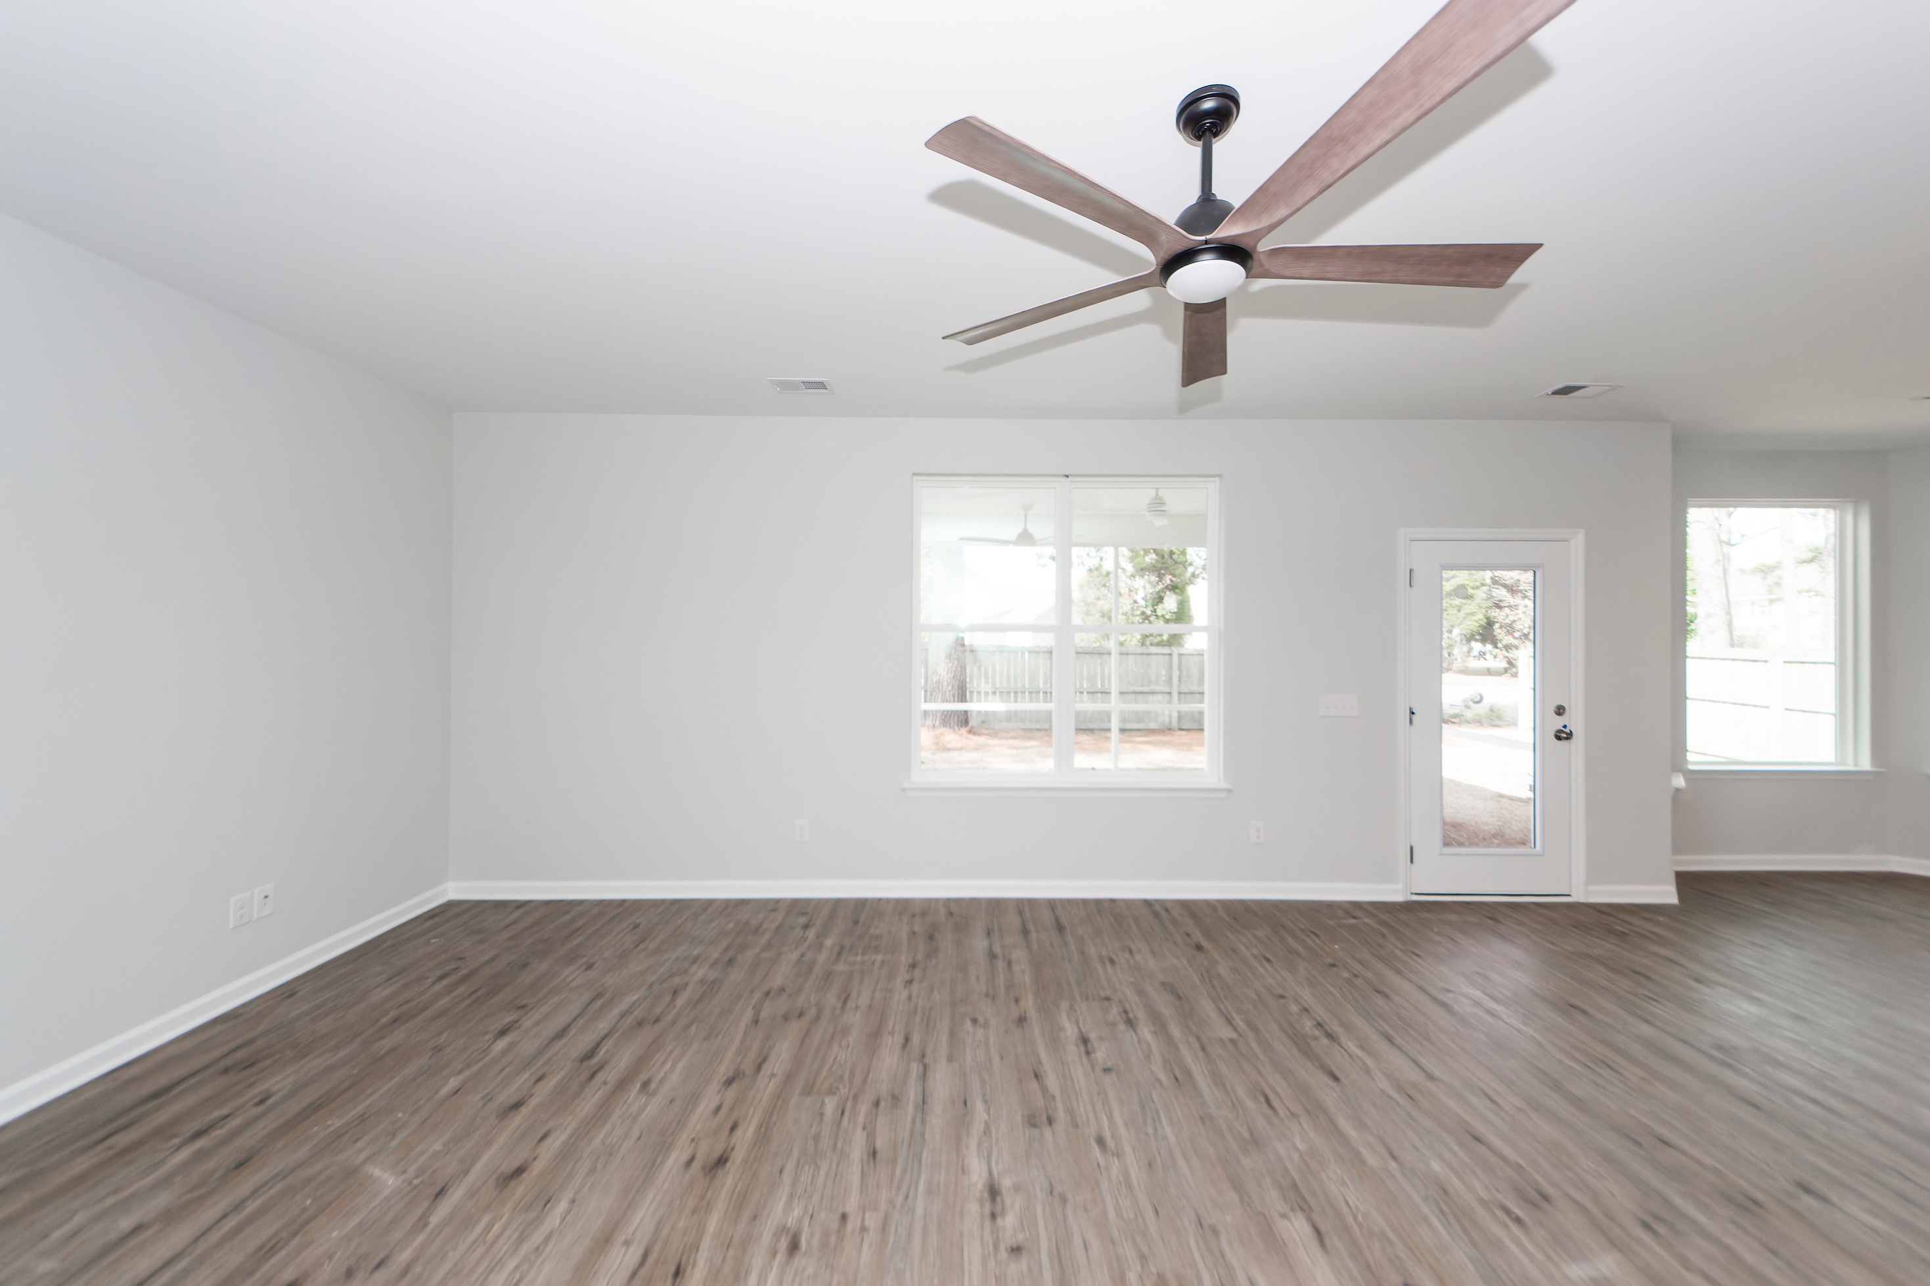


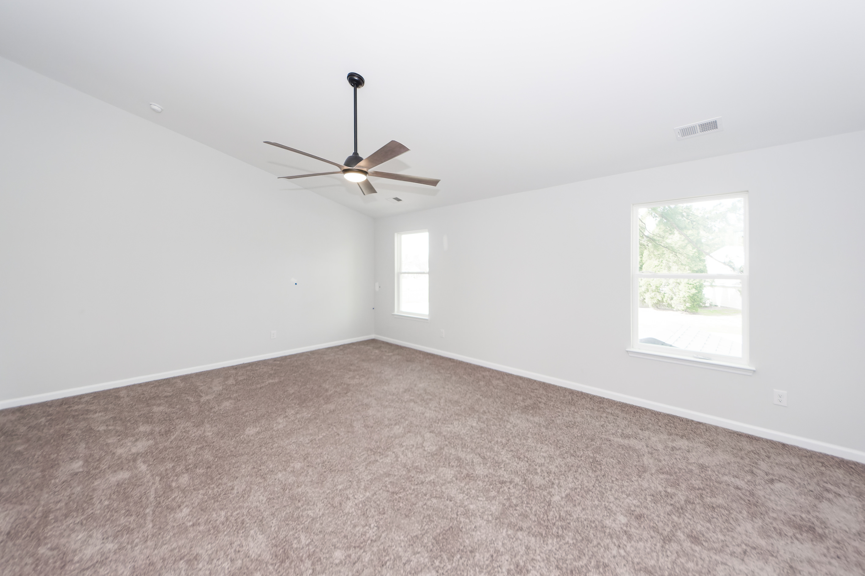
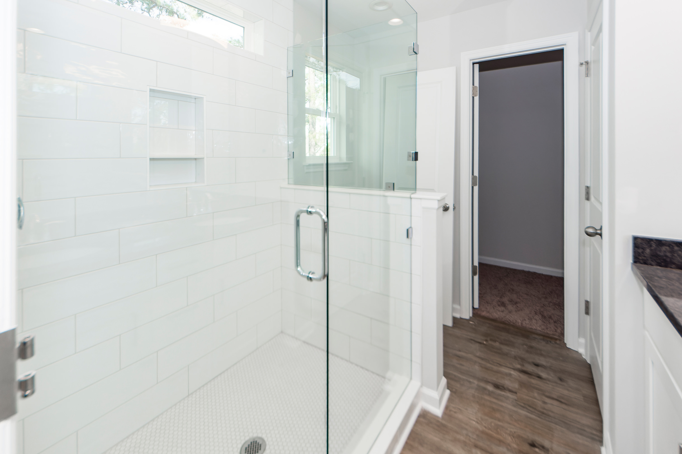



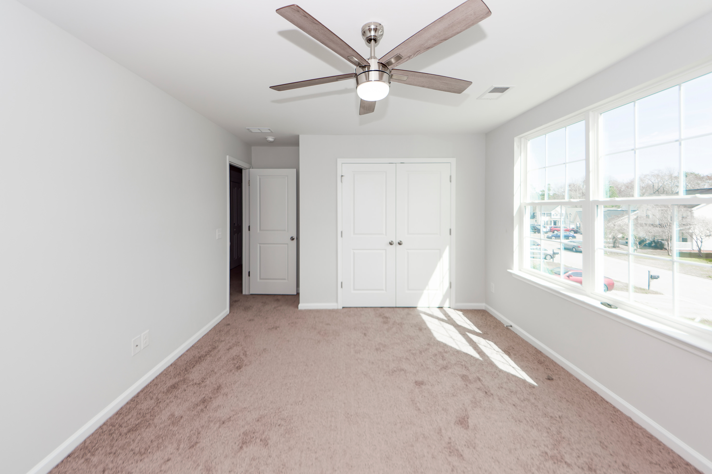
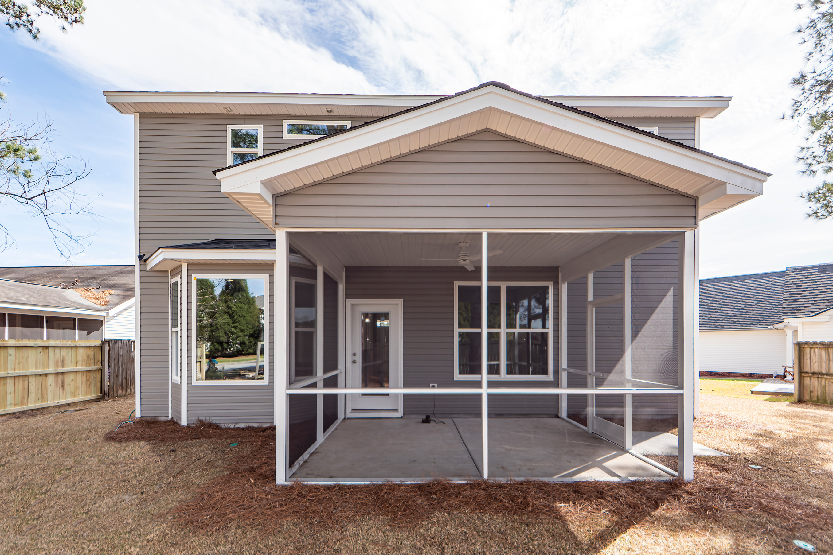

New Construction!
812 W Saltash Alley
Devon Forest | Goose Creek, SC 29445 | MLS# 24001942 | $389,500
New Construction in Devon Forest! Own a new home with all of the upgrades in an established, desirable neighborhood. Front porch leads to a spacious first floor with formal dining room (or bonus room), open concept eat in kitchen and living room. Stainless Samsung Electric Stove, Microwave and Dishwasher and granite counter tops show case the kitchen. First floor boasts LVP, granite counter tops and 42'' white cabinets. Bedrooms are upstairs and secondary bedrooms are large. Master bedroom is spacious with a vaulted ceiling and walk in closet. Master bath has walk in shower with glass door and white tile back splash. Oversized screened porch and fenced in yard make this New Construction Home a must see and must own!
3 Bedroom
2½ Bath
1,879 sf
Virtual Tour
Connie White, Broker
843-532-3356
connie@conniewhiteteam.com
conniewhiterealestate.com
Connie White Real Estate & Design, LLC
102 Six Point Court
Goose Creek, SC 29445

