Slide 1
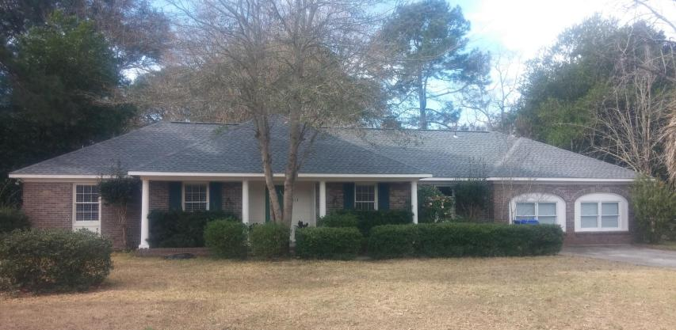
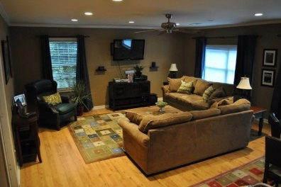
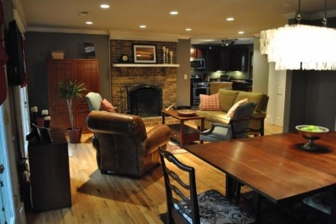
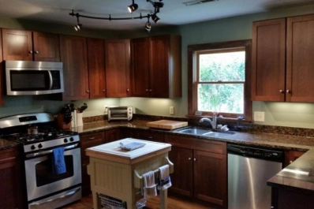
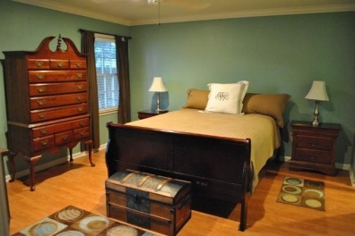
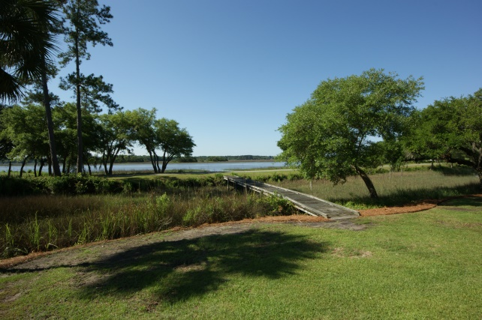
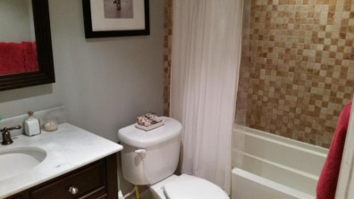
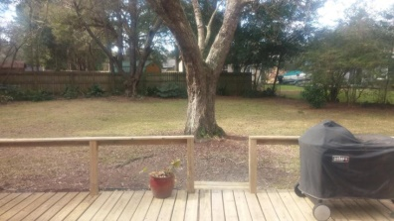
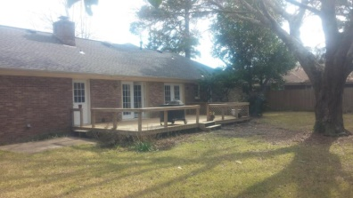
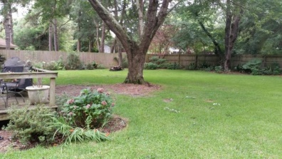

813 Weir Street - Lawton Bluff - Charleston, SC 29412
MLS# 15003448 - $359,000
Renovated brick ranch in awesome neighborhood with great schools.
Tucked in between downtown Charleston and Folly Beach. Can't beat this location. The kitchen and all bathrooms have been renovated and updated with top quality finishes. The kitchen features granite countertops, wood cabinets and stainless steel appliances. The bathrooms boast granite counter tops and custom stone work in both. The beautiful oak hardwood floors have been refinished and look amazing. The roof is only 3 years old and the HVAC is only 5 years old. The Crown molding adds to the detail of the home. There is a wood burning fireplace in the main living area. The home features an open floor plan which makes it a great house for entertaining. Besides the open kitchen/living area there is a separate dining room and huge second den or playroom. There are two double doors off the main living area that take you to a massive deck overlooking a huge private backyard. Don't miss your opportunity to buy a great home on James Island.
Rob Sturm
M 843-478-2404
rsturm@century21properties.com
Bud Poston
M 843-697-3786
bposton@century21properties.com
Century 21 Properties Plus | 3301 Salterbeck St Suite 100 | Mt. Pleasant, SC 29466

