Slide 1
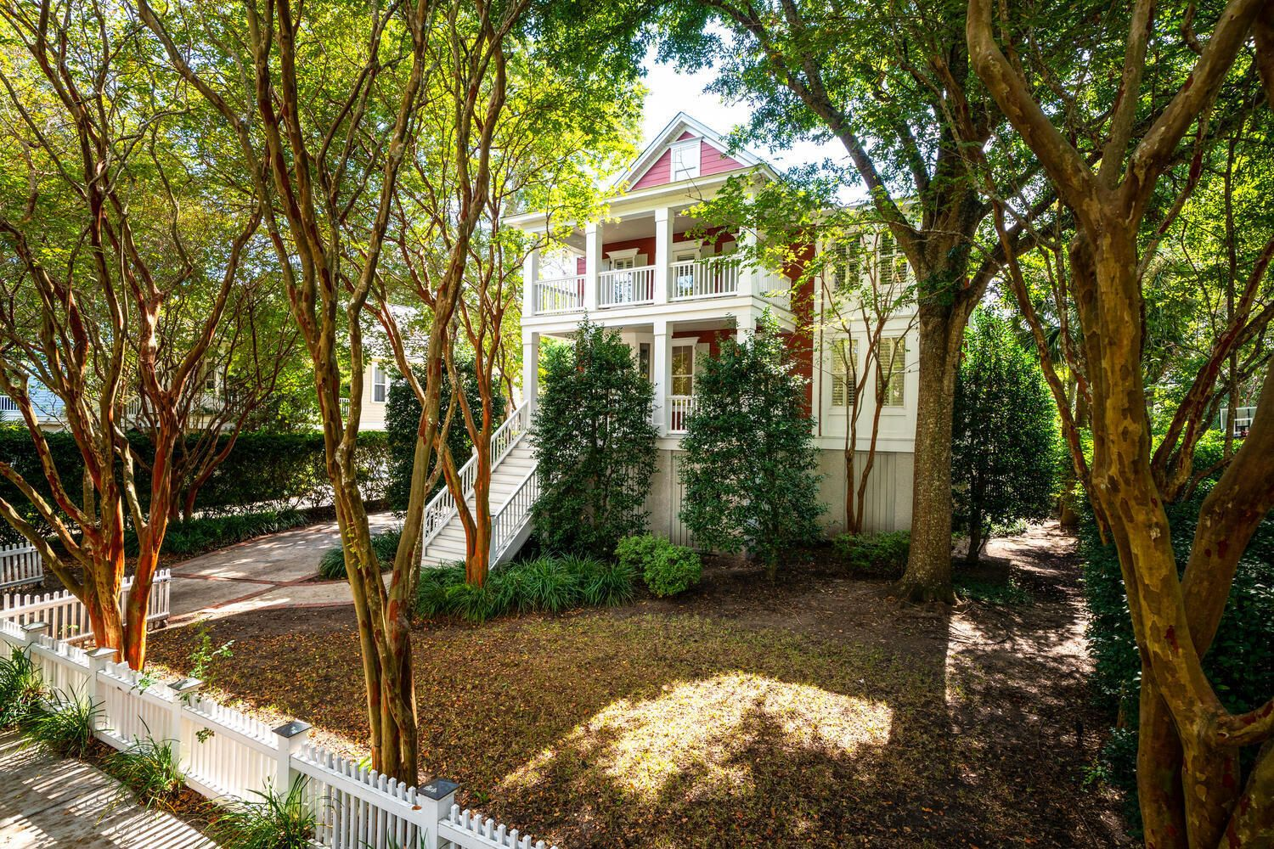
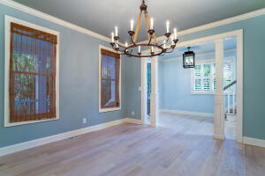
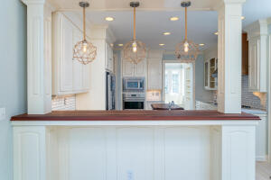
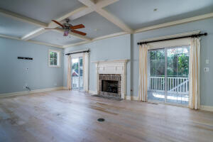
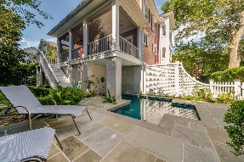
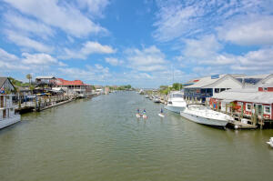
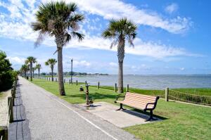
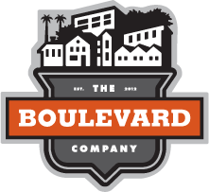

Custom Built Home in Old Mt Pleasant
813 Marsh Grove Avenue
Saltgrass Pointe ~ Mt Pleasant
MLS# 21027113 ~ $1,700,000
This stunning custom built elevated home is located in the serene neighborhood of Saltmarsh Pointe. It is within walking distance to the Old Bridge, Pitt St. business district, Shem Creek and more. The main floor has a smart open and versatile layout that can suit the needs of any family. The kitchen with marble countertops, gas cooktop, and custom copper hood is central to everything. Double cased openings lead to the large family room with a fireplace and 2 sliding doors leading to the spacious screened porch. The breakfast nook and larger dining area or sitting area wing both sides of the kitchen. There is also a home office with 2 built in desk and custom shelving. The front room can be used as a formal dining room or living/sitting room.
Up the stairs you will find an open common area, the master suite which has it's own private porch, 3 large guest bedrooms, and a Jack & Jill bathroom.
The wonderful backyard boast a beautiful bluestone patio, heated swimming pool and custom pool house.
There are 2 garage bays with doors and more than ample storage area underneath the home.
This is a rare find in today's market. This one will surely not last for long so book your showing today.
Timothy Scalise
843-408-3017
timothyscalise@gmail.com | www.theblvdcompany.com
The Boulevard Company, LLC | 806 Johnnie Dodds Blvd Ste 100 | Mt Pleasant, SC 29464

