Slide 1
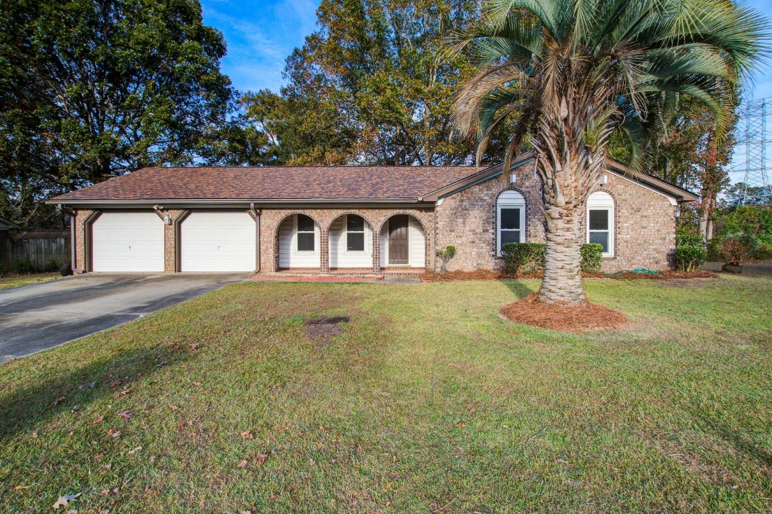
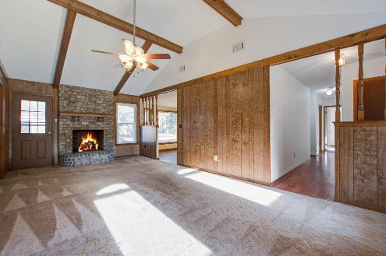
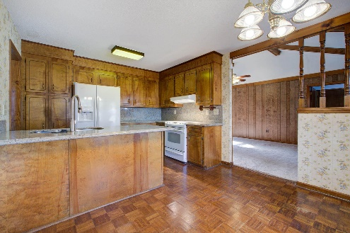
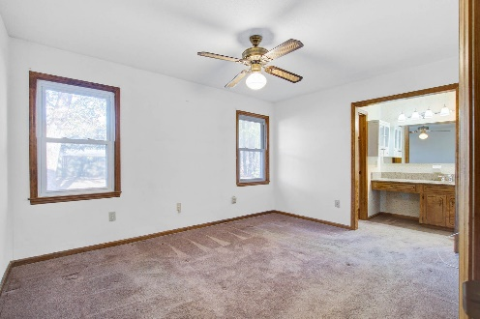
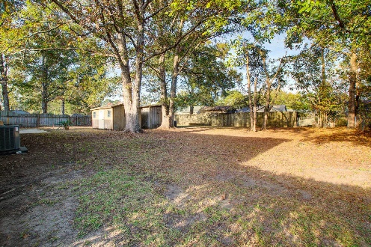


Great Location!
REDUCED
8142 Long Shadow Lane
Northwood Estates · North Charleston, SC 29406
MLS# 23025867 · $300,000
Michael Dew
O 843-769-5100
M 843-870-7000
michaeledew@gmail.com
www.michaeldewrealestate.com
Great Location!
3 bed 2 bath brick ranch with 2 car garage.
Family room with cathedral ceilings and brick fireplace.
Eat in kitchen.
Huge fenced in yard with shed for extra storage.
New roof and HVAC!!!
AgentOwned Charleston Group
902 Savannah Hwy
Charleston, SC 29407
Real Estate ● Mortgage
Insurance ● Business Brokerage

