Slide 1
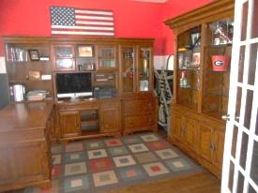
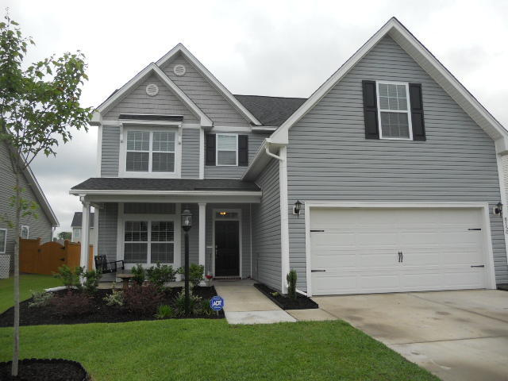
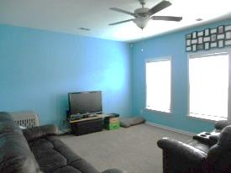
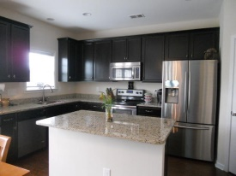
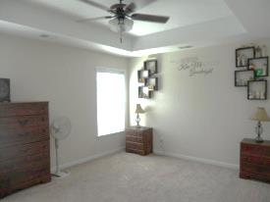
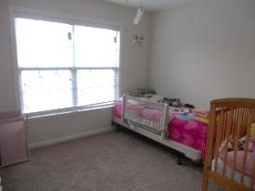
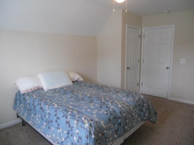

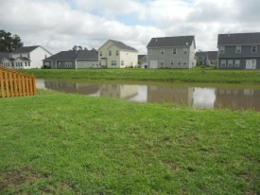

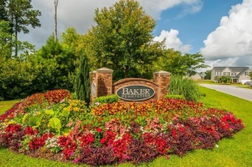
Pond Lot – Just Listed!
8150 Little Sydneys Way
Baker Plantation
North Charleston, SC 29406
MLS# 15010255 | $224,000
4 Bed / 2½ Bath
Premium lot! 4 beds/2.5 baths on Pond. Features include Hardwood floors , Gorgeous kitchen island with Granite Countertops, Stainless Steel Energy Star Whirlpool Appliances including self cleaning smooth top stove, dishwasher and microwave, 42'' birch cabinets with crown molding and upgraded cabinet door hardware, recessed lighting in kitchen, brushed nickel lighting and door hardware, crown molding and chair rail in dining room, Ceiling Fan with light in family room and additional pre-wires in all beds and bonus, overhead lighting in all other bedrooms, tray ceiling in master bedroom, dual sinks in master, separate 36'' tub and shower in master bathroom. Fourth bedroom has separate stair case to give extra privacy that could easily be used as an office.
Connie White
C: 843-532-3356
conniesyouragent@gmail.com
Charleston Homes
111 Spring Hall Dr
Goose Creek, SC 29445

