Slide 1
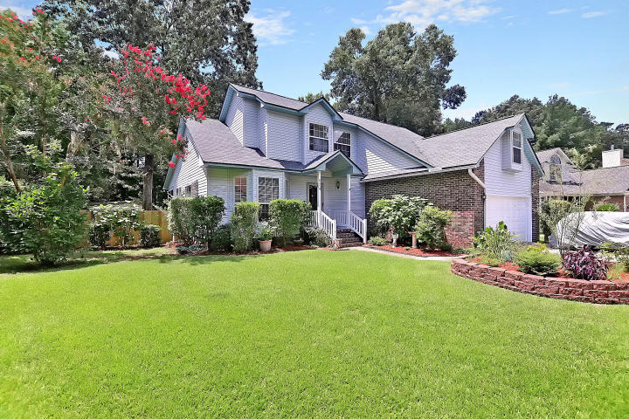
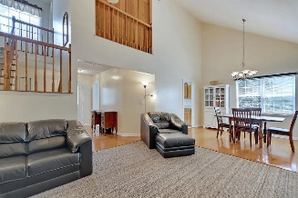
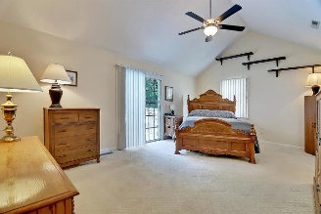
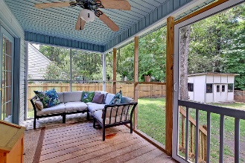
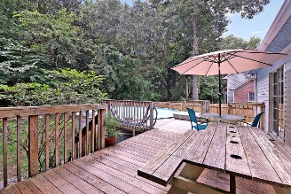
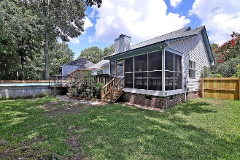


JULY 4TH SPECIAL
$15,000 Agent Bonus
with ratified contract by 4/15/18
8159 Sherbrooke Lane
Archdale
N Charleston, SC 29418
MLS# 19018376
$259,900
$12,100 Under
Recent Appraised Value
This Incredible fully detached 2 story home is situated on a quiet tree-lined street and is surrounded by a large fenced landscaped yard.This Remarkable home with beautiful wood flooring and freshly painted interior offers 3 large bedrooms upstairs (3rd bedroom is the FROG) and several large rooms on the main level including the spacious master bedroom suite that offers a huge walk-in closet, authentic vaulted ceilings with a classic ceiling fan and a Distinctive master bathroom offering ceramic flooring, modern plumbing fixtures, a large jetted tub, double vanities and a unique walk-in shower. The bright and spacious family sized kitchen is appointed with crafted wood cabinets, ceramic flooring and upgraded stainless appliances. The stylish formal dining area with vaulted ceilings is filled with natural lighting and is appointed with beautiful wood flooring. The huge gathering room with vaulted ceilings, classic ceiling fan and a cozy fireplace is perfect for entertaining friends and for family gatherings. There is a French door walk-out to the priceless screened-in porch that leads to a valuable deck and the awesome pool. Perfect for Pool parties and cook-outs. The back yard backs UP to wooded wet lands and offers extreme privacy! Included with this home is a separate work shop that is serviced with Central HV/AC, electricity and water and is perfect for the handyman or for a man cave. This Incredible home is located in the Dorchester District 2 School System and is located close to shopping. At acceptable price, the following items will convey at no additional cost: Master Bedroom: Solid Oak Bed, TV Hutch and Cabinet, Dining Room: Antique Dining Table & Chairs, White Hutch Cabinet and matching Shelves, Living Room: Broyhill Black Leather Couch, Loveseat, Chair, Ottoman & Glass TV Stand, Spare Bedroom: Twin Bed & Shelves.
Opportunity Knocks. DO YOU RECOGNIZE A GREAT BUY? Age, sqft, taxes, acreage, HOA dues, flood zone and schools are approximate, buyer to verify any and all information deemed necessary.
William R Everett, Jr
(843) 693-8539– C (843) 576-2701 – O
bill@theeverettgroup.net
RE/MAX Pro Realty, 9209 University Blvd, Charleston, SC 29406

