Slide 1
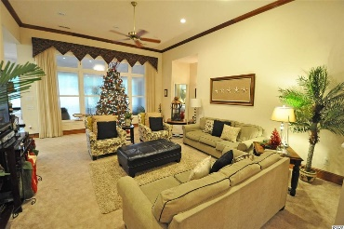
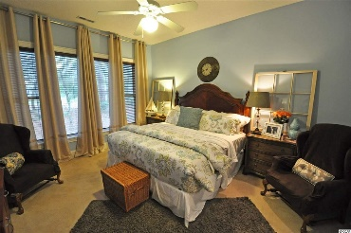
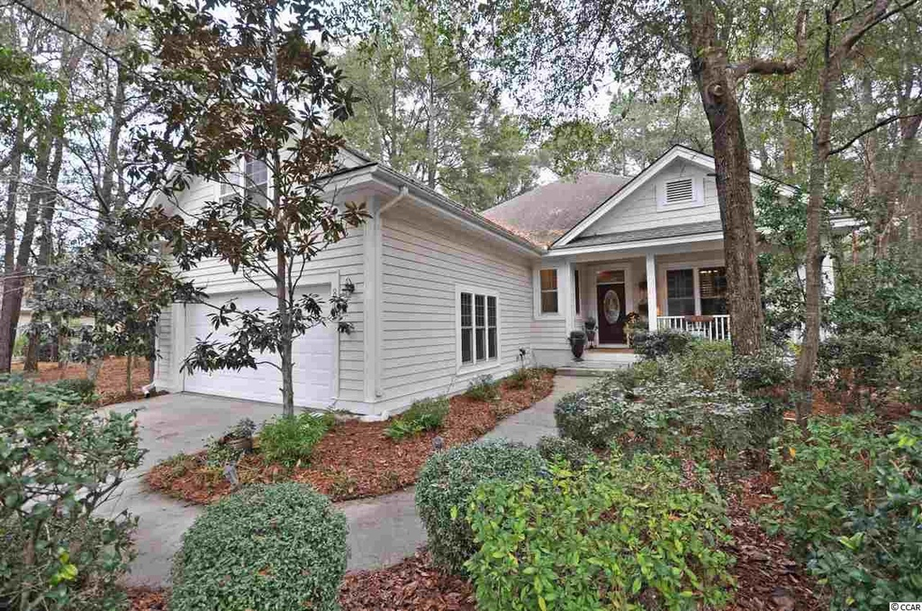
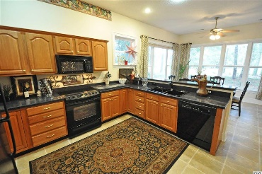
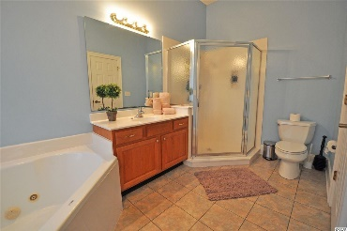
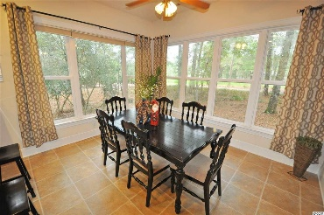
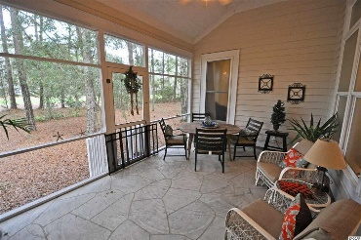
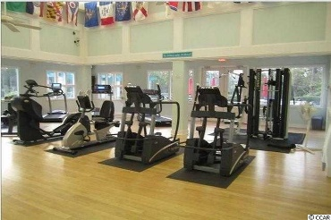
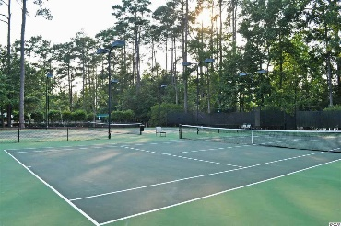
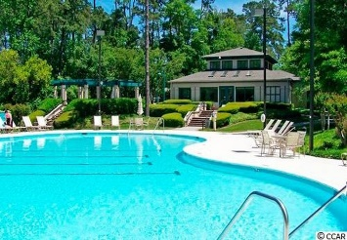
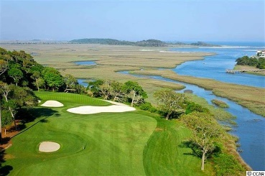
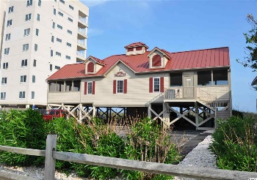


Hear the Atlantic Ocean from your back porch
$1,000 selling agent bonus paid by seller if sold by 3/31/16
815 Morrall Dr
Tidewater Plantation - North Myrtle Beach, SC 29582
MLS# 1600012 - $319,900
Charm and ease of living best describe this perfect beach home, nestled between the Intracoastal Waterway and Cherry Grove Marsh, which peaks at the Atlantic Ocean, in the Bluffs section of Tidewater Plantation of popular North Myrtle Beach. You can hear the ocean from the back porch! The relaxed atmosphere is enhanced by lush trees, greenery, a lake and direct views of the 14th hole of this world-class golf course from many aspects of the lovely, well-planned house. A large covered front porch invites rocking chairs and warm summer nights outside, and the large screened porch on the back offers a breathtaking full panorama of the stunning golf course. Vistas are also enjoyed from the master bedroom and dining room which afford a wall of surrounding windows. Featuring 3 bedrooms and two baths with a den/office that has French doors and plantation shutters, the floor plan is open, airy and quite roomy. Enjoy lots of upgrades, too. Master bedroom has walk-in closet, lots of storage and a master bath with double sinks, Jacuzzi tub and walk-in shower. The kitchen is big and boasts counter space and storage galore as well as a big space for family dining and gathering. Thoughtful touches include a built-in desk, large pantry/closet and a conveniently located, large laundry room. To tour this beauty is to immediately fall in love with its innate personal appeal and the lifestyle of its community, at one of the area's most affordable prices. Lot adjoining left is also for sale for additional consideration. Prestigious Tidewater Plantation is one of the top rated golf courses in The Grand Strand - with 24 hour gated, manned security. Lovely, free flowing floor plan with gorgeous, panoramic views of golf course. Enjoy the natural, wooded environment which surrounds you perfect for biking, walking and jogging. Tidewater amenities include and OCEANFRONT beach cabana for owners' use with open/screened porches, kitchen, bathrooms and showers. Additional amenities include access to 3 pools/hot tubs, onsite clubhouse with restaurant and bar overlooking the 18th hole, driving range, golf shop, tennis courts with clay and hard surface, fitness center, bocce courts, lending library and amenity center for public/private events. Group activities include outdoor summer concert series, group work out classes including water aerobics, art classes, Happy Hours, dinner clubs, book clubs, bridge, mahjong and holiday events/parties. Tidewater also offers a gated, security monitored storage lot for motorcycles, boats, jet skies, kayaks etc. Tidewater Plantation and its full range of amenities truly reflects a "way of life" where friendly neighbors will welcome you to your new home.
Deborah Collins
843-424-9013
dctidewater@yahoo.com
Connie Ross-Karl
702-306-2643
conniesross@aol.com
NEW WAY PROPERTIES MYRTLE BEACH

