Slide 1
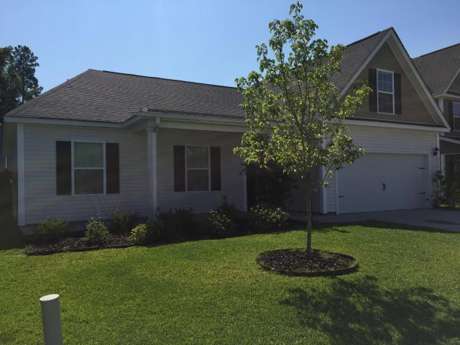
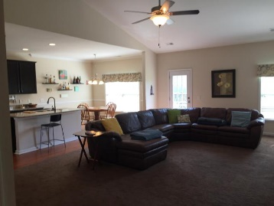
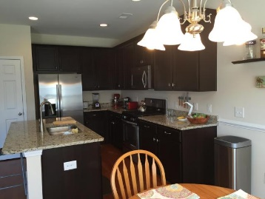
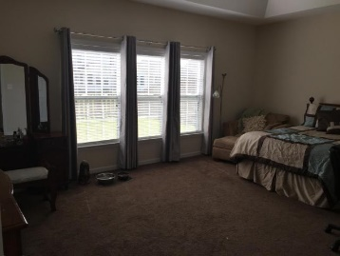
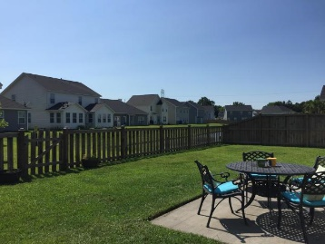
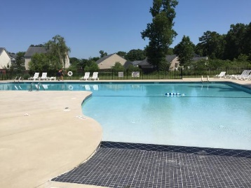


Price Just Reduced!
Price Reduced!
8170 Little Sydneys Way
Baker Plantation ~ North Charleston
MLS# 16013708 ~ $205,000
Why Wait to Build? Ready to Move In.
This home features an open floor plan with first floor Master Bedroom and split bedroom floor plan. The Master Suite is spacious with a tray ceiling and 2 walk in closets and lots of windows. Also offers a Bonus room upstairs that can have multiple uses. Open Kitchen with Dining/ Breakfast area. Stainless Steel appliances and a gas range/oven, Granite, and Beautiful Walnut cabinets Many upgrades! A Must See!
Robyn Lane, Realtor
843-222-5599
robynlane01@icloud.com
ERA Wilder Realty, 125-F Wappoo Creek Dr, Charleston, SC 29412

