Slide 1
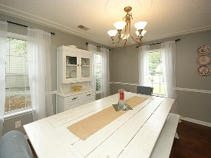
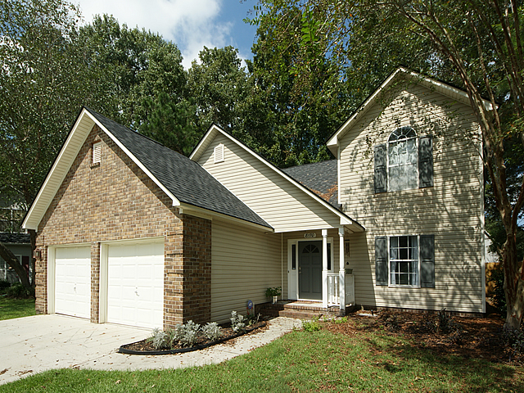
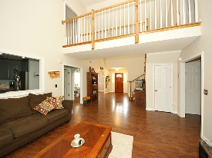
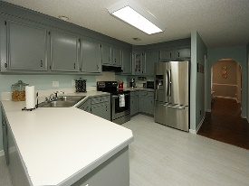
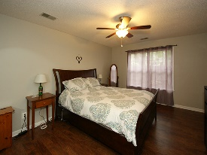
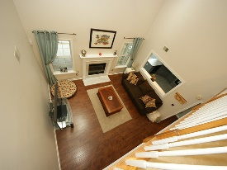
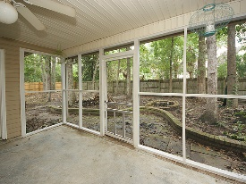
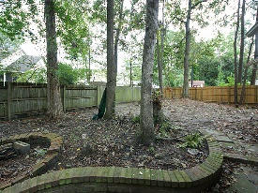


Sellers Are Motivated!
8170 Sherbrooke Ln
Archdale
North Charleston, SC 29418
Open House Canceled!
Under Contract In 3 Days!
MLS# 16025307 | $219,500
4 Bed / 2½ Bath
Spectacular home in Archdale! Located in the subsection of Brookshire this chic home boasts, custom paint, an open floor plan, spacious kitchen, a soaring cathedral ceiling, surrounded by a gorgeous stair case and cat walk. Nestled on a cul-de-sac this lot is private with many mature trees in the back yard.
Connie White, Broker
C: 843-532-3356
conniesyouragent@gmail.com
Charleston Homes
111 Spring Hall Dr
Goose Creek, SC 29445

