Slide 1
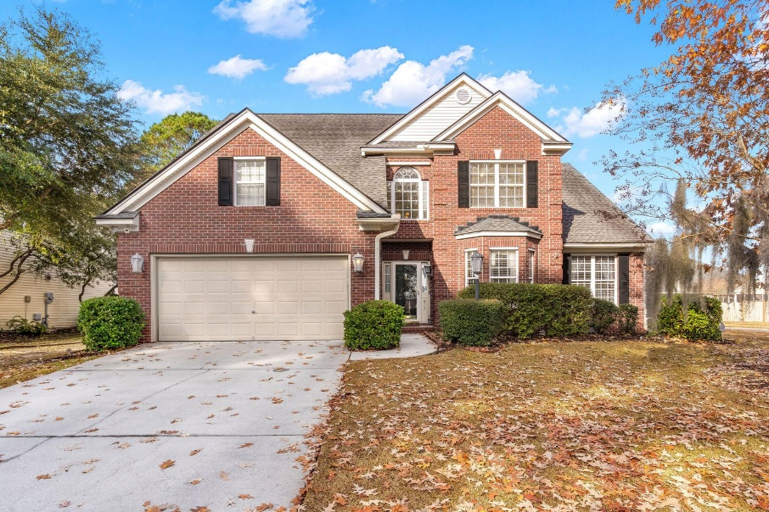
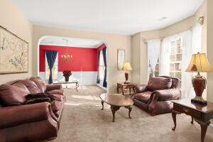
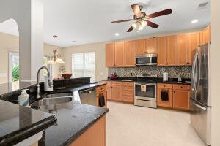
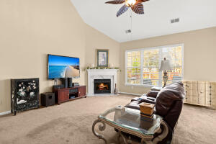
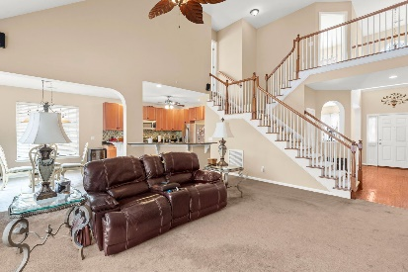
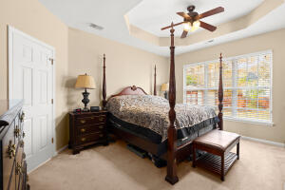
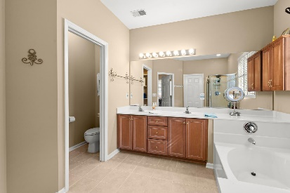
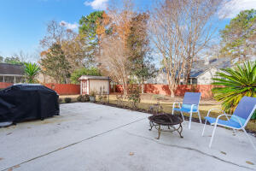
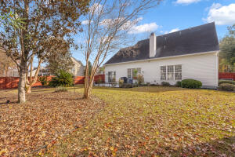



Gorgeous Grand Oaks Home on Corner Lot!
817 Paran Oaks Drive
Grand Oaks Plantation
Charleston, SC 29414
MLS# 21032335
$500,000
4 Bed | 2½ Bath | 2,622 sf
Welcome home! Stunning two story home in the highly desirable Grand Oaks subdivision! This stunning open floor plan style home was one of the firsts in the entire neighborhood, making it one of the few unique floor plans. Upon entering this 4 bedroom, 2.5 bathroom plus office home has ceilings that extend to the roof. The master bedroom is located on the first floor with an ensuite containing a garden tub and separate shower. You'll notice the hardwood floors throughout the first floor along with all new paint throughout the entire house. You truly cannot beat open kitchen overlooking the living area with a gas fireplace and tiled mantle, right next to the formal dining room with a custom bronze chandelier. The kitchen boasts tile flooring, ton of cabinetry, thick granite countertops, incinerator garbage disposal, all appliances and even under-cabinet lighting in case you're trying to make a late night snack! Upstairs you'll find an additional office area with access to plenty of storage along with 3 additional bedrooms and an additional bathroom. Walking into the backyard, you will not be able to miss the beautiful landscaping with special yard lights, huge patio, gutters with downspouts, privacy fence and hurricane-rated shed. A few other noteworthy items; the HVACs are a few years old, security system, hurricane shutters will come WITH the sale along with the ladder to reach the second story windows, there will be a $500 carpet credit for the master bedroom carpet, the access on top of the garage for storage also has a double entrance from the storage door in the bedroom over the garage, and most of the furniture may convey with the sale of the property. The neighborhood pool is located right across the street, making sunny summer days a breeze when you get to dip into the pool! Grand Oaks is a very established neighborhood with plenty of amenities, walkable sidewalks and trails, extremely close to shopping, restaurants, bars, grocery stores, etc. You do NOT want to let this one slip by! Come take a look today!
Take a Virtual 3D Tour: https://my.matterport.com/show/?m=QjdVUByfdcm
Nick Mazzilli
(843) 640-5575
nick@nickmcharleston.com
www.mavenrealtysc.com
Maven Realty
2180 McMillan Ave
#71672
Charleston, SC 29405

