Slide 1
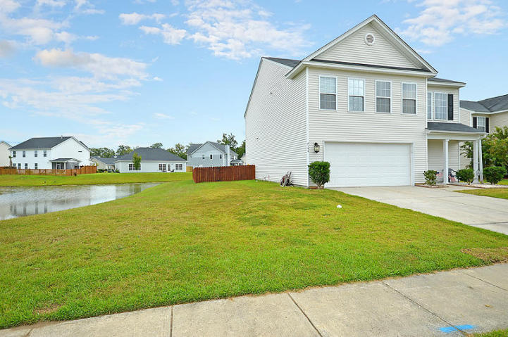
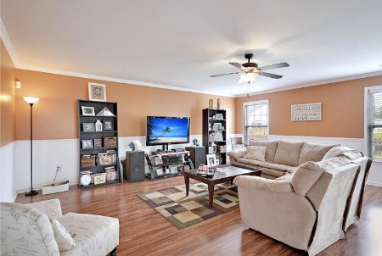
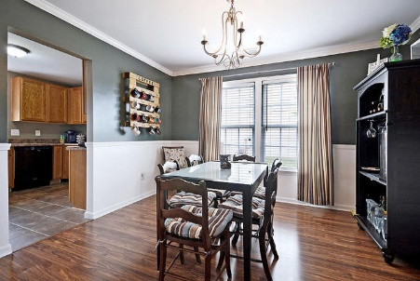
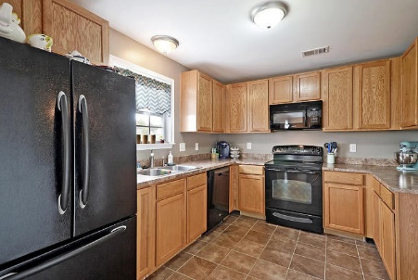
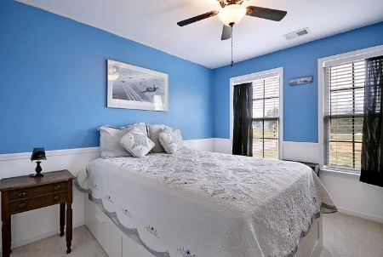
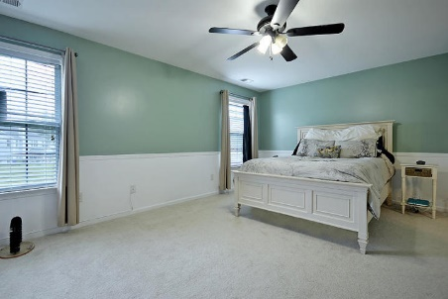
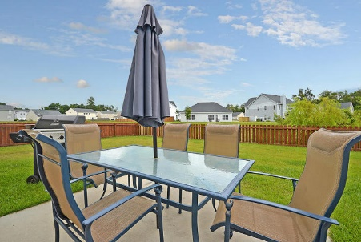
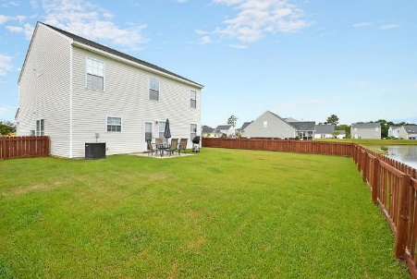
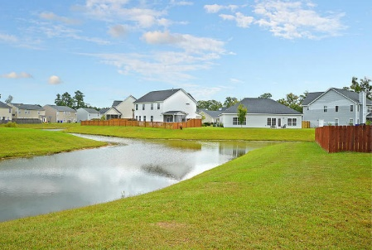


Privacy and Ponds for Under $215k
8196 Halbert Drive
Baker Plantation
Charleston, SC 29406
MLS# 15021690
$214,900
4 Bedrooms | 2½ Baths | 2,244 sf
Privacy and ready today!! Great opportunity to own a home in an established area of a growing neighborhood. This home features a pond lot, and no neighbor on one side. This is a wonderful home with a large open floor plan. The current owners have made tremendous upgrades including hardwoods on the main floor, ceramic tile in the kitchen and chair rail throughout the first floor. The two story foyer is welcoming and provides a great look at the rest of the home. The ground floor has ample space with a large family room and kitchen that offers 42'' Custom size Cabinets with space. Off of the kitchen is an eat-in dining room area and is open to the family room. The upstairs is very large and includes a spacious master suite that has views of the pond and walk-in closet. The master bathroom is fully equipped with dual vanities, a garden tub and separate shower. Three other bedrooms up offer plenty of space for the whole family. Large garage offers plenty of storage, and ponds on 2 sides make this home extremely unique. Make an appointment to take a look today.
Larry Mazalatis
843-693-0529
lmaz@sc.rr.com
Kevin Goemaat
(843) 693-1468
krgoemaat@gmail.com
www.mazteam.com
AGENTOWNED PREMIERE GROUP | 1800 TROLLEY RD | SUMMERVILLE, SC 29485

