Slide 1
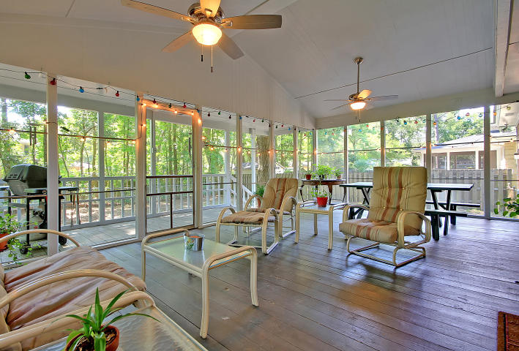



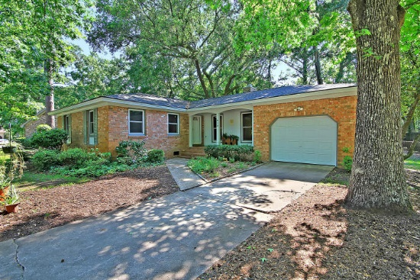
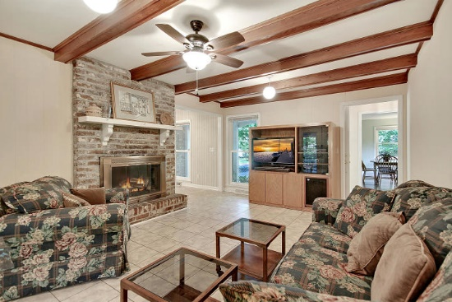
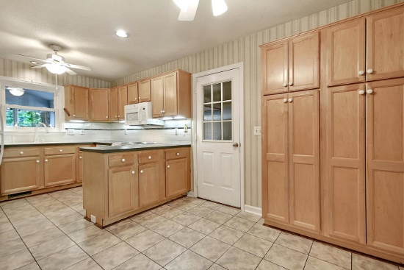
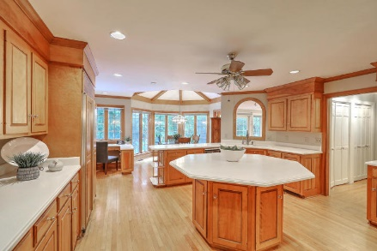




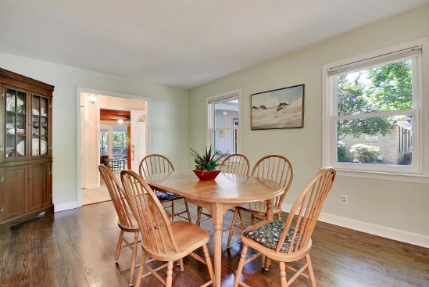
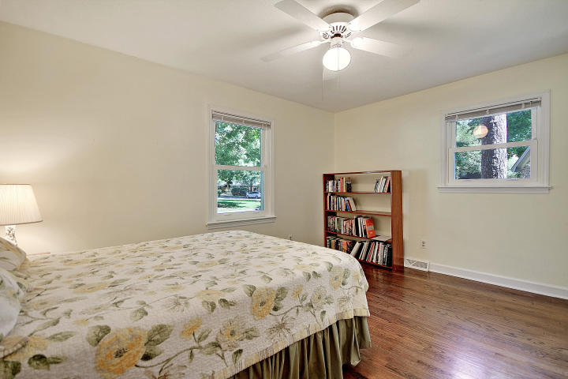
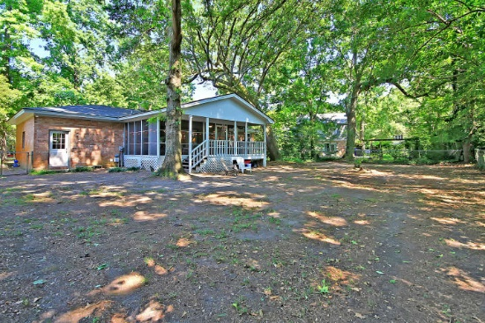
Parkshore Marshfront
Come live the Mount Pleasant life!
819 Abcaw Way
Parish Place ~ Mount Pleasant, SC 29464 ~ MLS# 19014548 ~ $374,900
This one story ranch in the quiet, tucked away community of Parish Place in Mount Pleasant is a wonderful place to call home! The cozy, brick fireplace in the living room brings a warmth to the home but by far the best place to be is on the expansive, screened-in porch that overlooks the large, private, fenced-in backyard.
With the exception of tile flooring in the kitchen, foyer and living room, the home has beautiful hardwood floors throughout and baseboard molding in the dining room. The master bedroom has a walk-in closet and en-suite full bath with a walk-in shower.
You'll love how close you are to shopping, dining, the beaches and downtown Charleston from this location. This home has been lovingly cared for and is eagerly awaiting its new owners.
Christopher Smith christopher@mattoneillteam.com 843-267-0735

