Slide 1
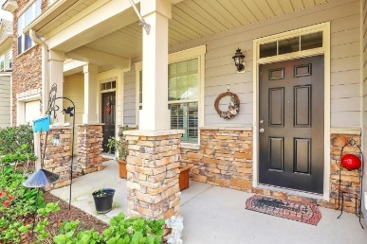
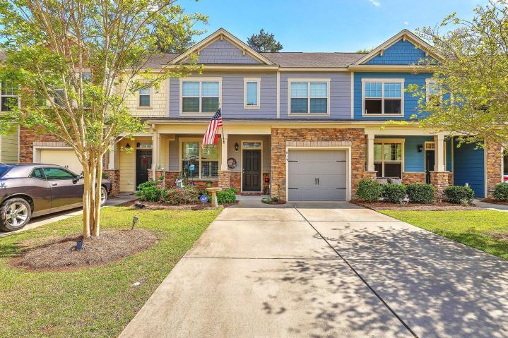
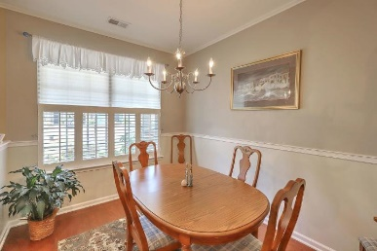
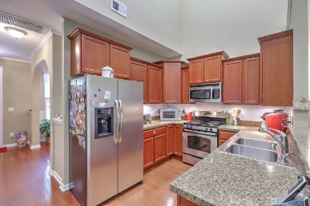
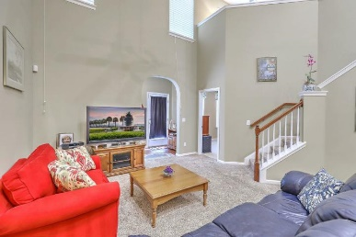
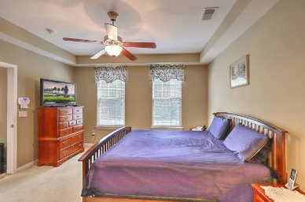
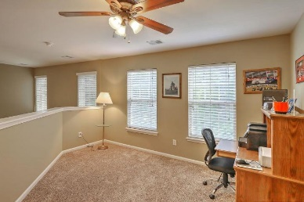
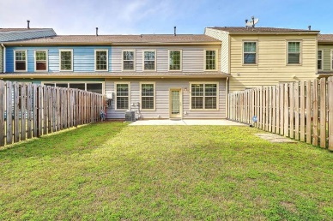
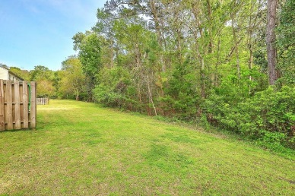
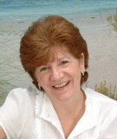

819 Bibury Court Hunt Club ~ Charleston, SC 29414 MLS# 19009957 Reduced to $249,900
Need A Master On The 1st Floor? This Townhome Has It & More
$1,000 Buyer's Agent Bonus
For Ratified Contract That Can Close By 9/27/2019
Hard to find 1ST FLOOR MASTER BEDROOM!
This townhome features an Open floorplan with a spacious two story family room that opens to the 2 story kitchen. Kitchen has lots of counter space, staggered 36'' cabinets, stainless steel appliances and gas range. There is also a Separate dining room. The large 1st floor master suite features a tray ceiling, dual sinks, oversized shower and walk in closet. Upstairs there are two generously sized bedrooms with ample closet space, a full bath and a loft that would make a great office or playroom. Back on 1st floor, There is also a sunroom at the back of the home that could double as a home office. It overlooks the private backyard with fencing on either side and is open at the rear to provide views of a private wooded area.
Come view today!
Maggie Curtis
REALTOR, EPRO, LMC, ABR
(843) 693-8207
maggiecurtis@comcast.net
Debra Whitfield
ABR, SRES
(843) 367-4845
debra.whitfield@coldwellbanker.com
Coldwell Banker Residential Brokerage | 1127 Queensborough Blvd. 103 | Mt Pleasant, SC 29464

