Slide 1
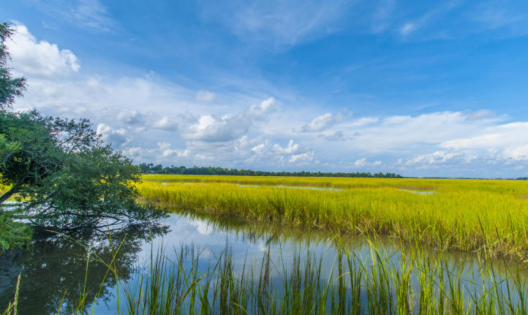
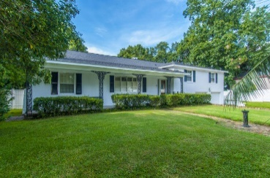
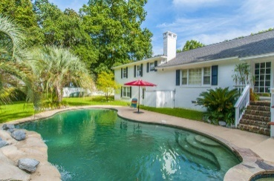
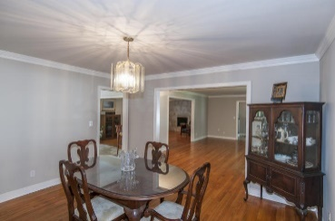
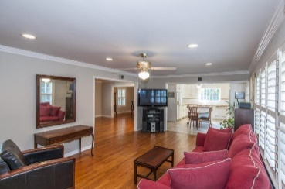
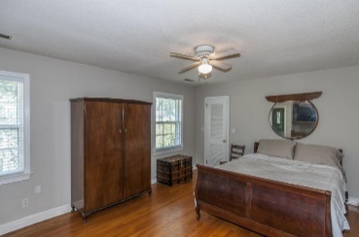
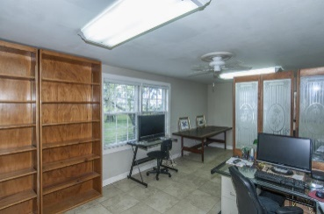
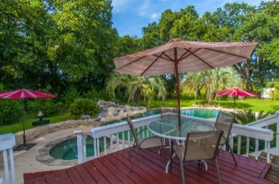
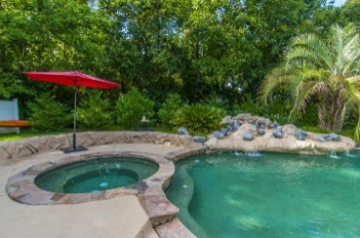
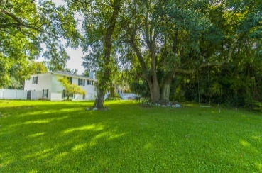
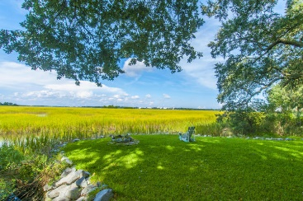

Brokers Only Open House - Wednesday, Oct 14th, 11a-2p Catered lunch by Hamby's Catering & a $100 cash drawing!
819 Colony Drive
Avondale | Charleston, SC 29407 | MLS# 15024242 | $767,500
Don’t miss the stunning forever views from this charming Avondale home.
819 Colony Drive is located on the marsh overlooking the Ashley River with breathtaking views of The Citadel. You have your own personal fireworks display every time there is an event at The Joe! The 2560 sqft 4Br/2.5Ba home is situated on a large .38 acre lot that juts out into the marsh on its own private peninsula. The property allows you to launch your kayak or paddleboard at high tide right from your own back yard. The interior boasts hardwood floors, smooth ceilings, crown moldings, and a wood burning fireplace. The exterior brick has just been repainted and there is also a brick walkway to the front door. The backyard has everything you could want with a pool, waterfall, deck, and plenty of open space.
Will E Freeman
Office - (843) 971-1312
Mobile - (843) 270-5454
wfreeman@thebeachcompany.com
BH&G RE The Beach Company, 1973 Riviera Drive, Suite 7, Mt Pleasant, SC 29464

