Slide 1
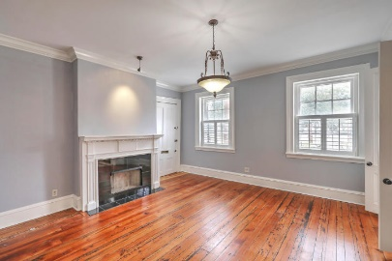
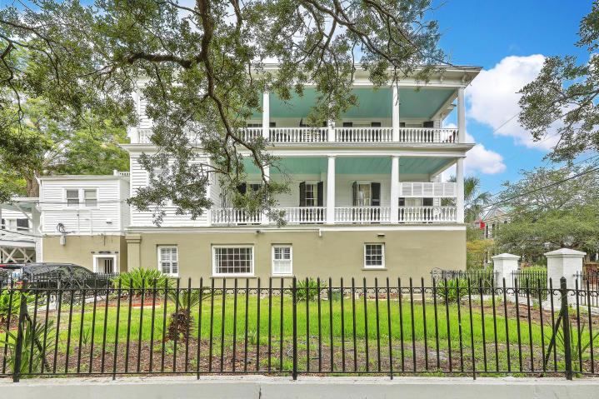
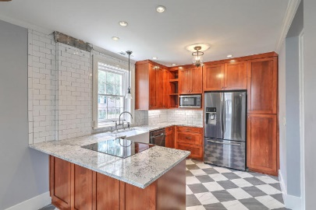
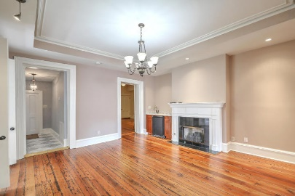
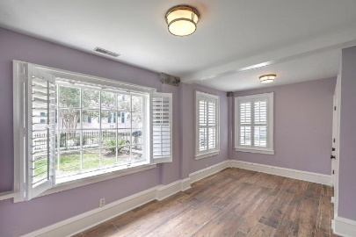
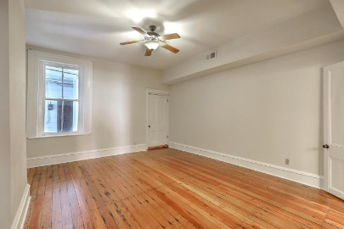
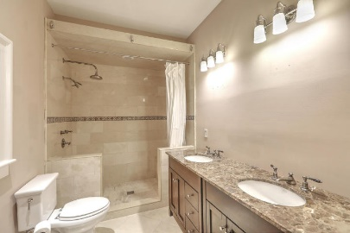
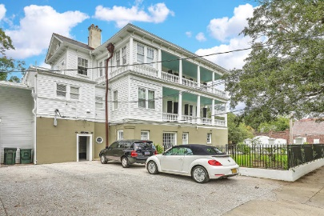


81 Ashley Avenue A
Harleston Village | Charleston, SC 29401 | MLS# 18020757 | $599,900
REALTOR OPEN HOUSE FRIDAY & SATURDAY
October 5th & 6th from 11A TO 2P
Beautiful 2 bedroom condo on ground floor with heart pine and marble floors. County says 3 bedrooms but that room is more suited for a dining or sitting room which has a wet bar and refer. LR has gas fireplace. Kitchen has marble floors and granite counter tops and large eat-in area. This spacious condo is within walking distance to everything downtown MUSC and the College of Charleston. Large master bedroom. New kitchen appliances and kitchen cabinets. New A/C and handler. New DW will be installed Friday August 17,2018. New wetbar refer on order.
You won't find a better value.
Randy Bazemore
O (843) 277-6677 | M (843) 524-6900
randybazemore99@gmail.com
http://rbazemore.century21properties.com
Century 21 Properties Plus | 2000 Sam Rittenberg Blvd #118 | Charleston, SC 29407

