Slide 1
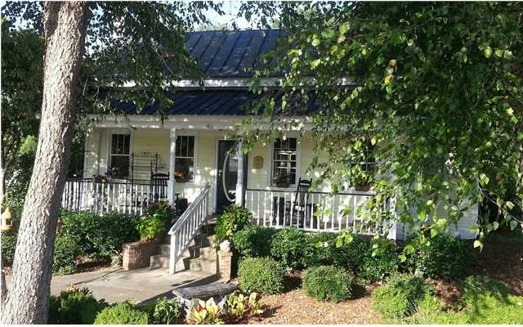
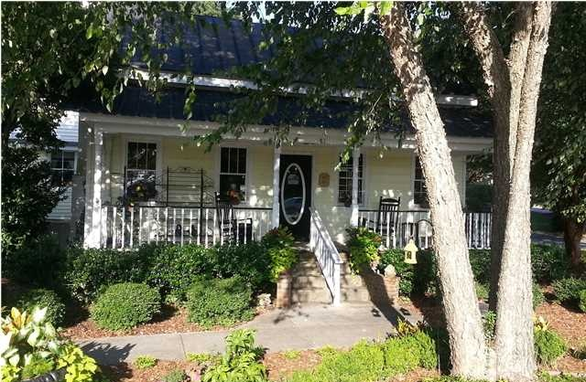

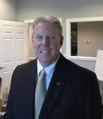
81 Old Trolley Rd Summerville MLS# 29854041 $295,000
Office/Retail Space in High-Traffic Area
Property Subtypes: | Office Building
Building Size (RSF): | 1,547 SF
Gross Land Area: | 0.40 Acres
Sale Price: | $295,000
Unit Price: | $190.69 PSF
Property Use Type: | Business, Investment, Vacant/Owner-User
Sale Terms: | Cash to Seller, Other
Michelle Riser & Bob Glover
843-860-1229 (Michelle) | 843-693-1837 (Bob)
mriser@ccim.net | bobglover08@gmail.com
Matthew Ryan Company, 104 Berkeley Square, PMB 59, Goose Creek, 29445

