Slide 1
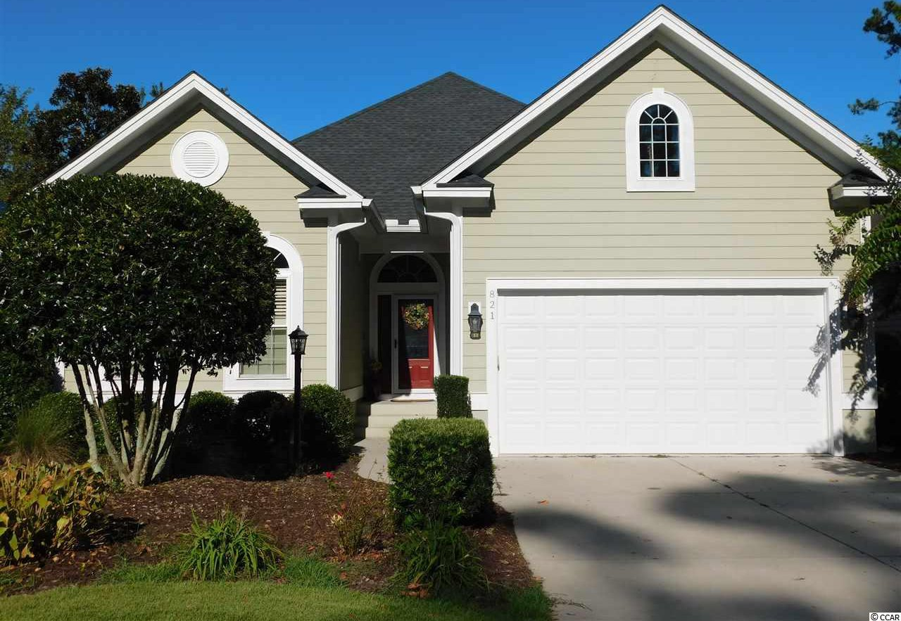
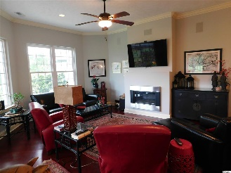
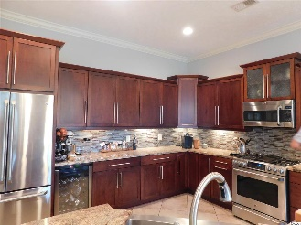
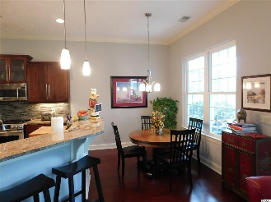
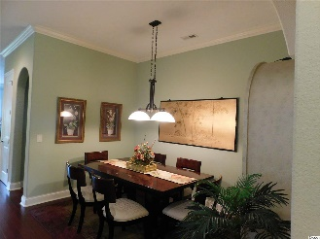
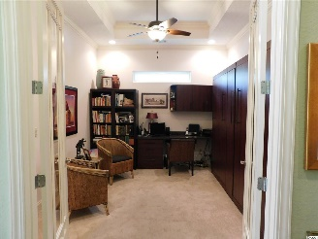
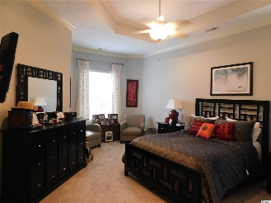
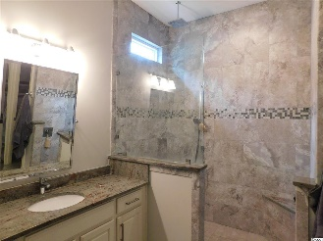
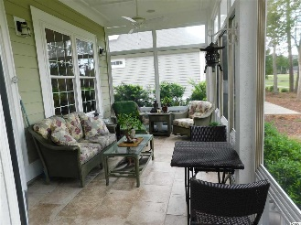
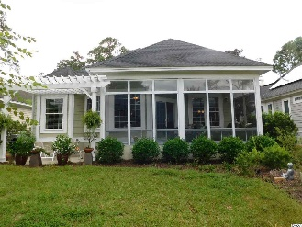
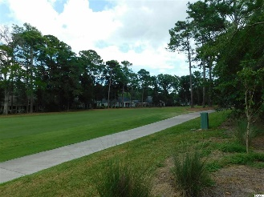

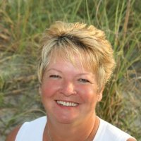
Custom Home in Tidewater Plantation
821 Morrall Dr
North Myrtle Beach, SC 29582 | MLS# 1920510 | $449,900
Unique & wonderful upscale custom built home in Tidewater, located on #14 fairway with a view of the lake. It is wonderfully livable, 2,700 heated square feet of planned functional space on one-living level. This home has all of the upgrades, custom gourmet kitchen with granite counter tops, top of the line Café GE appliances, wine cooler, gas/electric range, electric oven and gas stove top. All cabinets have soft close drawers. Farm sink with breakfast bar and Eat-in kitchen. The Family room offers gas fireplace with lots of room for entertainment. A Lovely living room and formal dining room. Home has surround sound throughout. Ceiling fans in family room, bedrooms and living room. 3 bedrooms with 2 full baths. Master on-suit with walk-in shower, his and her sinks, walk-in closets. 3rd bedroom with murphy beds and used as an office/den and a bonus room above the garage. All walls are knock down textured with custom molding. Features screen porch and pergola, back yard with lots of flower for the avid gardener. 2 car garage and parking in the driveway. Tidewater offers tennis, golf, 3 pools, fitness center and beach cabana for homeowners on 57 ave. in Cherry Grove. Tidewater Resort reflects the luxury and comfort of a beach/golf lifestyle. Community is secured by a 24/7 a gated community.
Donna Fortney 703-624-3517
dofortney@aol.com
Robert Jacoby 843-455-7075
NEW WAY PROPERTIES MYRTLE BEACH

