Slide 1
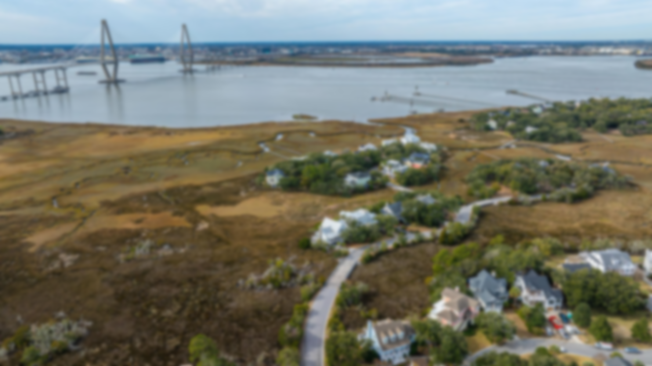
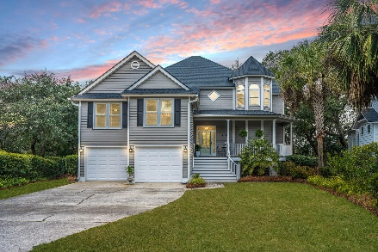
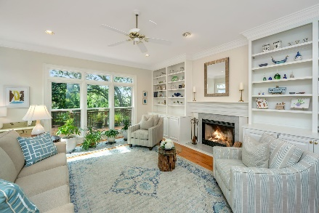
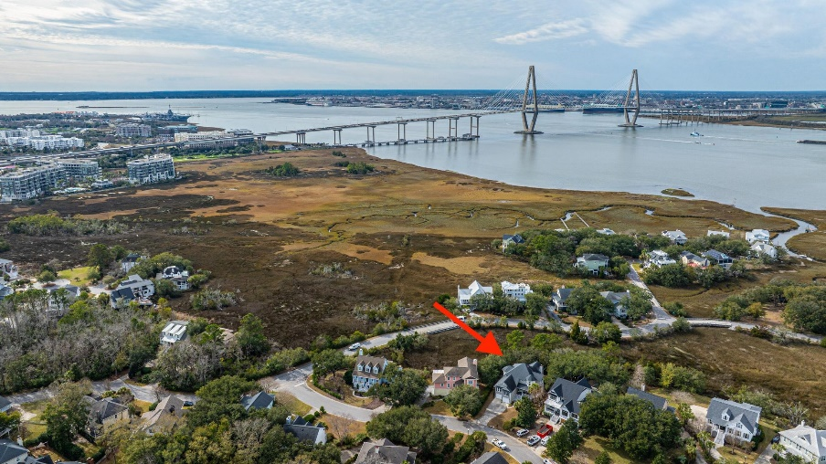
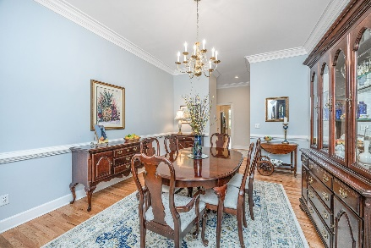
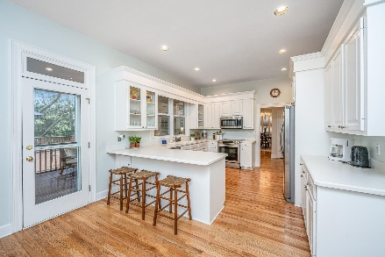
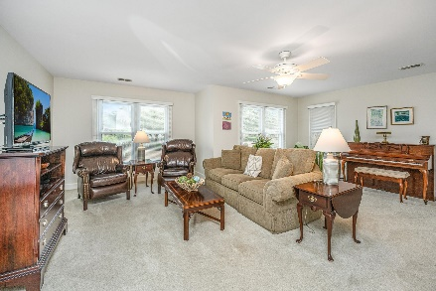
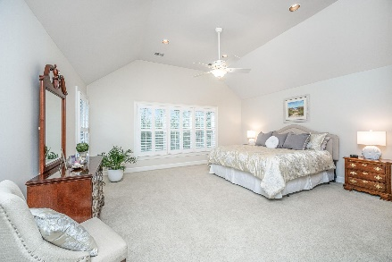
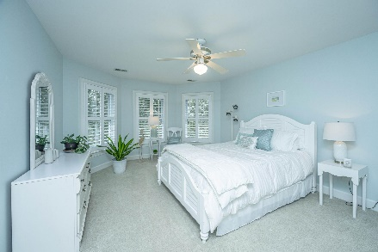
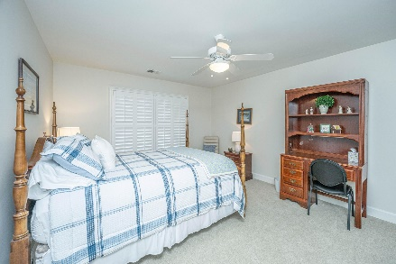
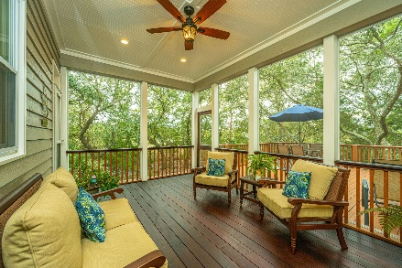
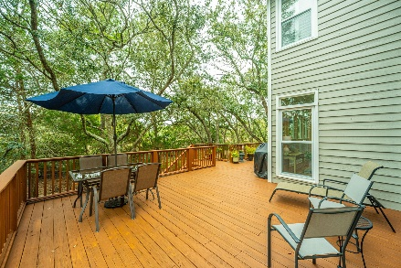
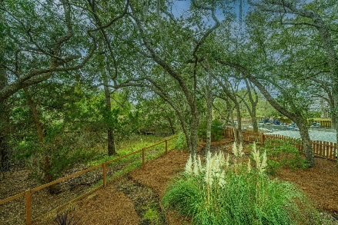
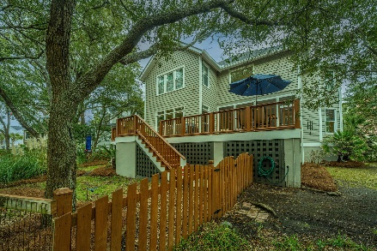


821 Fiddlers Point Lane Harbour Watch Mount Pleasant, SC 29464 MLS# 24001127 | $1,630,000
Location! Location!
Nestled into one of Mount Pleasant's most well-kept secret neighborhoods, Harbour Watch, this gorgeous home is situated a mere five minutes to the Ravenel Bridge and Downtown Charleston yet exudes a feel of tranquility and privacy with its marsh front location. Lovingly maintained, you'll note that no detail was left unattended. A classic southern sitting porch welcomes you into the home which boasts a true foyer for greeting guests. Gleaming hardwood floors, multi-piece crown moulding, and plantation shutters are just a few of the upgraded custom touches found throughout. The formal Dining Room is perfect for hosting holiday dinners and could easily be converted to anything from home office to playroom, to art studio. One of the many flex spaces in this home, it can adapt and change as your needs do. A home chef's dream, this bright and open kitchen will easily be the hub of family activity. Ideally designed, there is plenty of room for friends to perch on a stool and enjoy a glass of wine or for kids to complete homework while dinner is prepared. Oversized FROG is perfect for use as a teen retreat, in-law or guest suite, playroom, or man cave. With a full bathroom and large walk-in closet the possibilities are truly endless. The Owners' Suite is located on the back of the home and features a vaulted ceiling, two closets (including one large walk-in) amazing marsh views, and a generously sized, completely updated en-suite luxury bath. The spa-like bathroom boasts a private water closet with linen tower, freestanding soaker tub, large frameless glass shower, and an exceptionally long and spacious double vanity with updated fixtures. As exceptional as the interior of the home is, the true beauty lies in the outdoor spaces. Lush Lowcountry flora and fauna surround the lot making it a haven for wildlife. Coupled with stunning marsh views, you'll want to enjoy morning coffee on your screened-in porch while watching Egrets hunt for breakfast in the tidally fed creek. The porch is accessible from both the kitchen and living room and boasts Ipe flooring, which is not only beautiful but extremely durable, rot and insect resistant. Off of the porch is an open air deck, large enough to host parties or just grill dinner for yourself while watching the kids and pets frolic in the fully fenced yard. The rear fence is a "living fence" allowing for unobstructed views of the marsh. There are peek-a-boo views of the tops of the Ravenel Bridge and at night the lights of the bridge are visible in the distance. The neighborhood pool's entrance path is across the street from the home and you can walk or bike to the Mount Pleasant Memorial Waterfront Park. All of this and located incredibly close to everything in Mount Pleasant, the Coleman Blvd corridor, Sullivan's Island and area beaches as well as the world-class shopping and dining of Historic Downtown Charleston.
Enjoy a 3D virtual tour!
Don Dawson 843-514-0452 ddawson@carolinaone.com Carolina One Real Estate • 2713 Highway 17 North • Mount Pleasant, SC 29466
www.TeamDawsonSC.com

