Slide 1
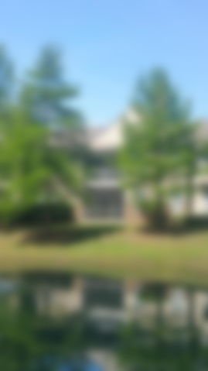
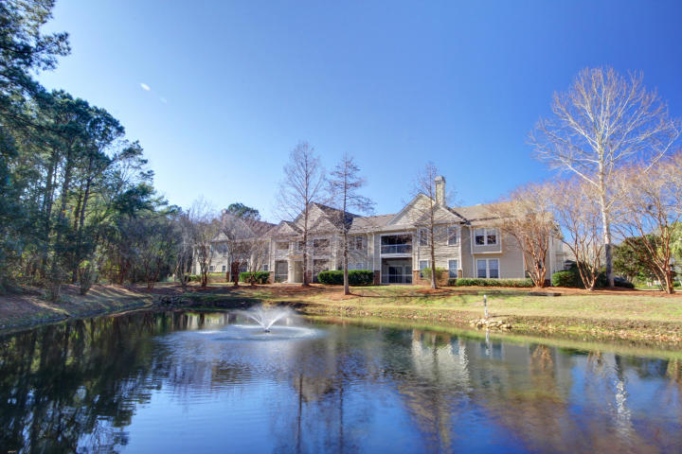
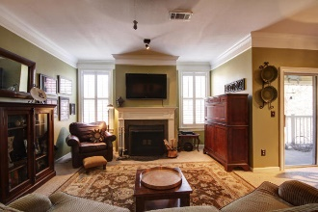
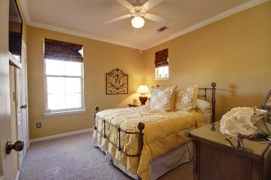
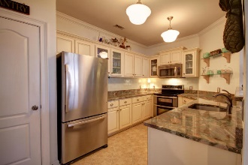
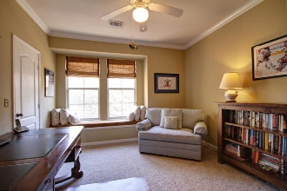
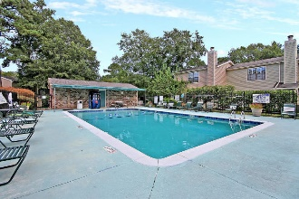
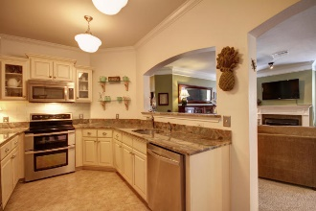
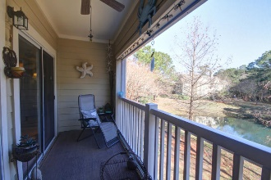
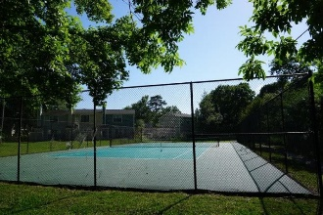
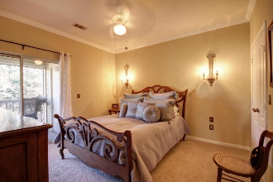
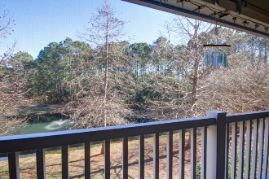


Newly Resurfaced Private Tennis Court With Nightlights
822 Legends Club Drive
The Legends at Mt Pleasant | Mount Pleasant, SC 29466
MLS# 19003883 | $315,000
Starbucks card to first 10 agents
Fabulous Opportunity to own a 3 bedroom 2 bath condo right in front of Charleston National. Close to shopping, schools, and hospitals. These condos in gated Sweetgrass Landing rarely come on the market. You'll find stainless steel appliances as well as a brand new kitchen. All 3 bedrooms have walk in closets. The screened in porch over looks a pond and woods and is extremely private. There is a wood burning fireplace in the living room The amenities include a newly decorated clubhouse with a kitchen, conference room, fitness room, and entertainment room. There is also a private, lit tennis court and gated pool with a BBQ for your enjoyment. Also on the property is a gated dog park, a children's play ground, a BBQ area, and a designated car wash and vacuum area.
Elke Pizzo
(843) 991-5304 | elke.pizzo@carolinaone.com
www.pizzohomes-charleston.com
Carolina One Real Estate | 195 W Coleman Blvd | Mt Pleasant, SC 29464-3495

