Slide 1
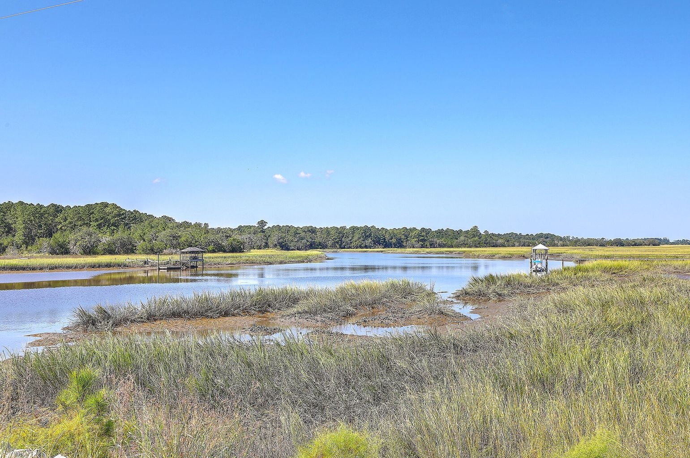

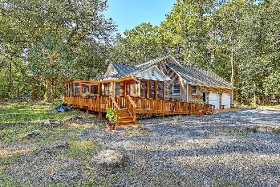
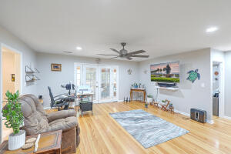
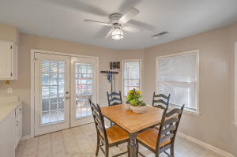
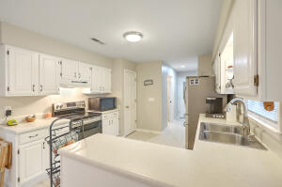
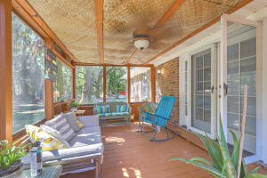

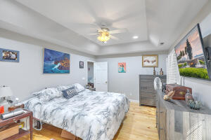
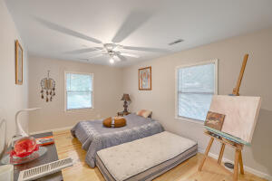
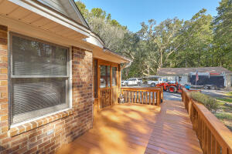
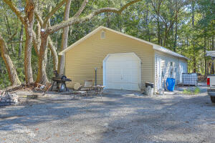
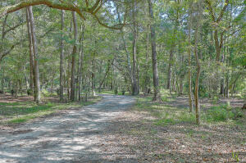
Joe Stalvey
843-460-2850
jstalvey@century21properties.com
joestalveyrealtor.com
Peaceful Home on Edisto
8251 Chisolm Plantation Road
Middleton Plantation | Edisto Island, SC 29438 | MLS# 22024939 | $759,000
Welcome home to Middleton Plantation on Edisto Island. This single-story home is nestled on over 9 acres of wooded property. This is an all brick, three bedroom, two and half bath home. The large owner's suite features dual closets, tray ceiling, and dual vanity bowls. The second bedroom will accommodate a king size bed as well. All bedroom closets are lighted. The bathrooms have new faucets. The kitchen has ample cabinet and countertop space with an adjacent dining area. The family room is large enough for entertaining, with two French doors leading to the two screened porches. New pine flooring beautifully accents the family room and bedrooms. As you enter the home from the two-car garage you'll find a large laundry room. This property is a ''MUST SEE'' with its ample storage. Above the garage there's storage that could perhaps be made into a room. The 15X40 shed is great for storage, and the 24X46 garage and shop area await your projects, there's a 10X20 greenhouse for your green thumb. This location contains the best of both worlds: plenty of peace and quiet on this property, and Edisto Beach, with its beautiful beach, shops, and restaurants only 8 miles away. Charleston is 40 minutes away, with Beaufort and Savannah near enough for day trips.
Come tour this home and the simple, wonderful life it offers.
NEW QUARTZ KITCHEN COUNTER TOPS HAVE JUST BEEN INSTALLED !
Take a video tour: https://vimeo.com/752142914
Century 21 Properties Plus | 140 N Main Street, Suite 101 | Summerville, SC 29483

