Slide 1
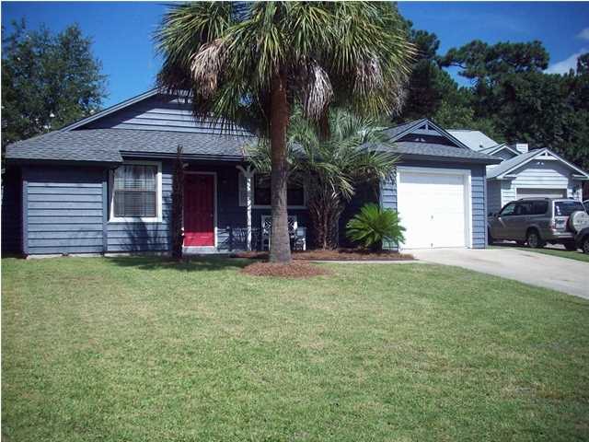
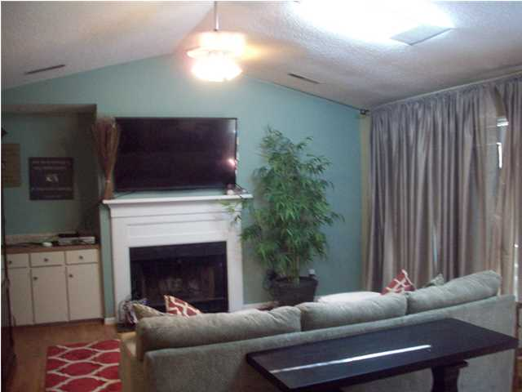
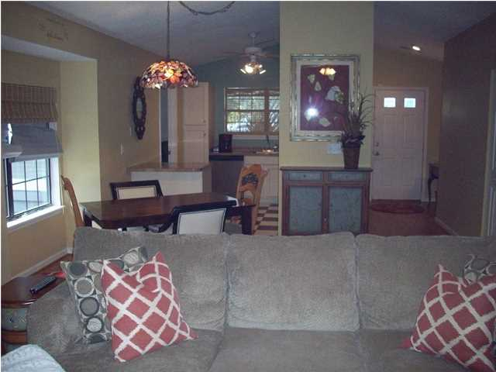
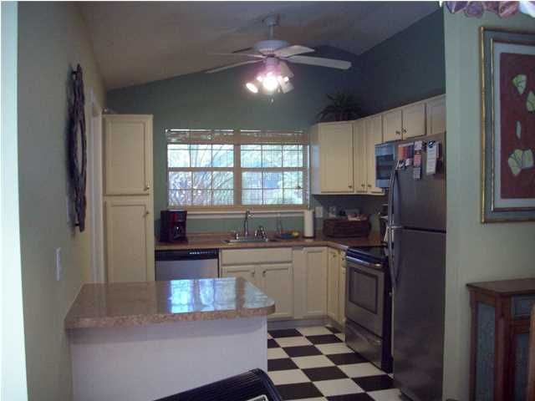
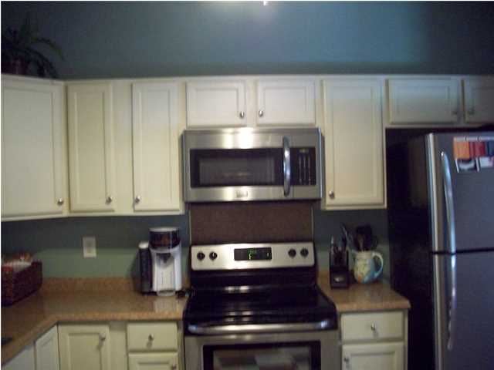
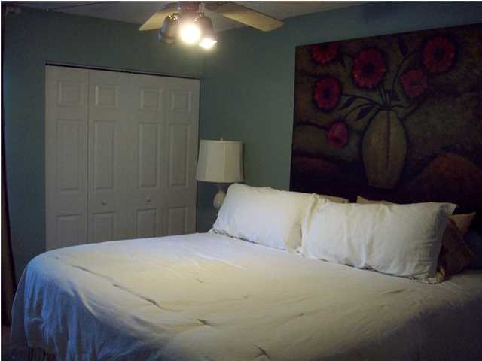
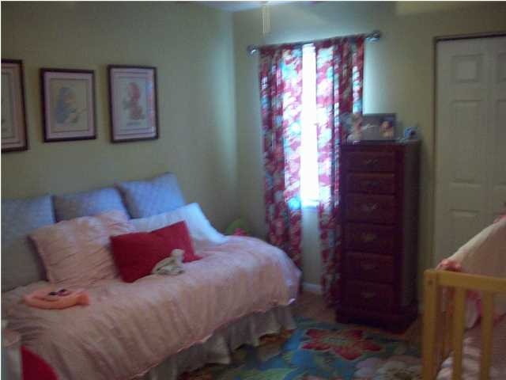
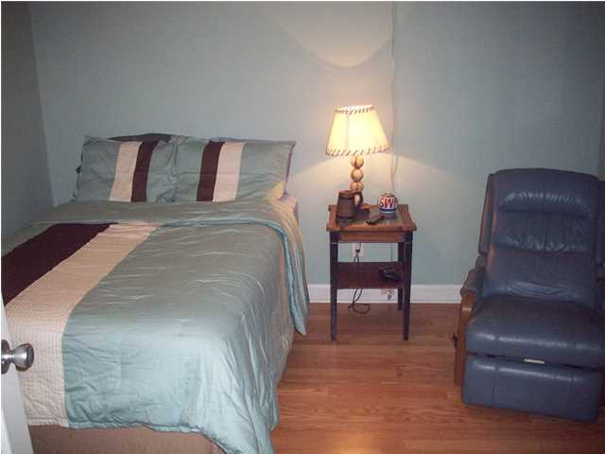
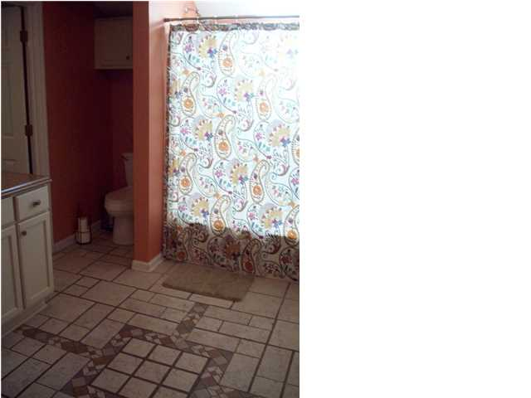
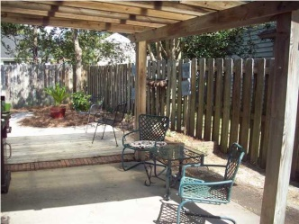
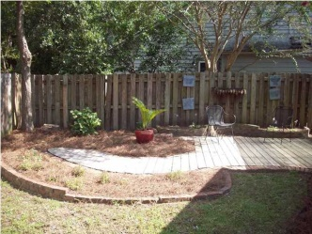
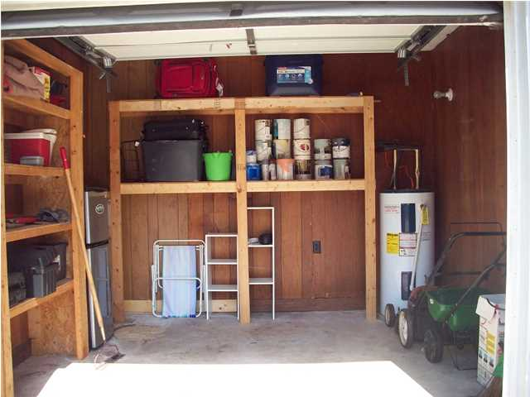
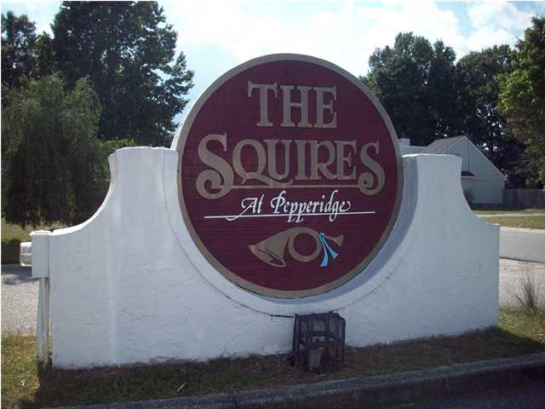
8252 Timberidge Ct
Pepperidge ~ Charleston ~ MLS# 1423534
Just Reduced to $113,500
Move-in Ready!
$2,000 Realtor Bonus!
A MUST SEE! Cozy up to your fireplace in this lovely 3 bedroom home in well desired Dorchester County II school district!! Home is centrally located with easy access to interstate. Features include a covered front porch and back patio with deck, fenced backyard, high ceilings, a wet bar and laminated hardwood floors in all the rooms except master bedroom. Master bedroom has 2 large closets. Within the last 2 years new kitchen cabinets including pantry, counter tops, roof, skylights and home has been re-plumbed and new HVAC unit. Over sized (approximately 9'x10') bathroom! Home is also fully upgraded with all new stainless steel appliances!! Drapes and Refrigerator do not convey with home.
Regina Cook
Mobile - (843) 224-2429
reginatherealtor@yahoo.com
Harbourtowne Real Estate | 672 Marina Drive, Ste 110 | Daniel Island, SC 29492

