Slide 1
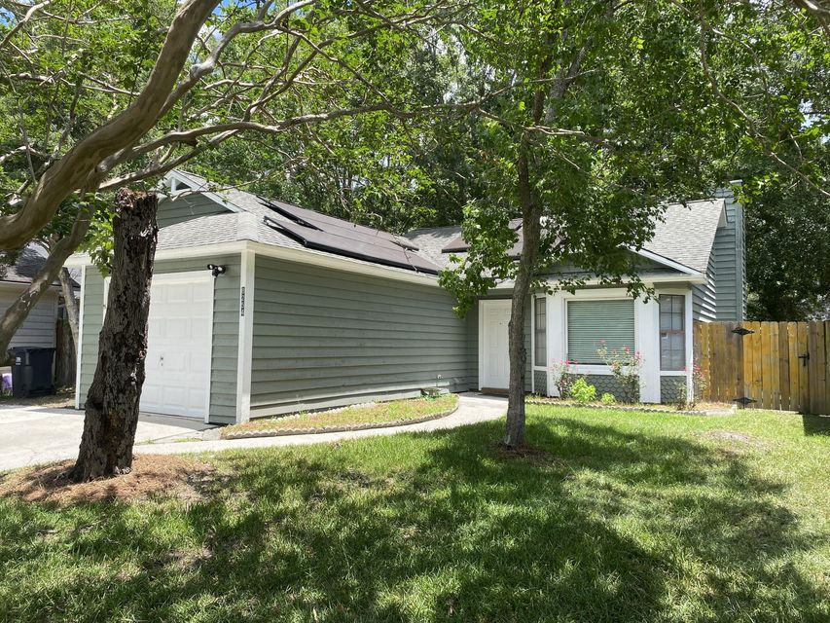
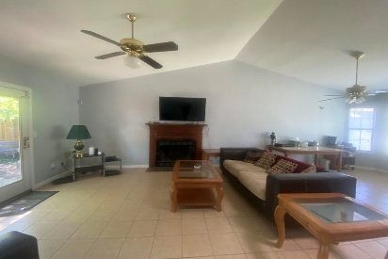
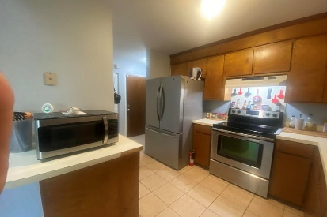
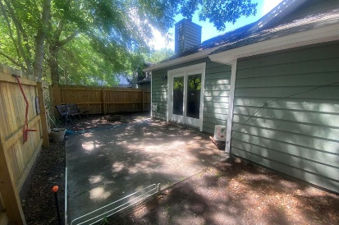
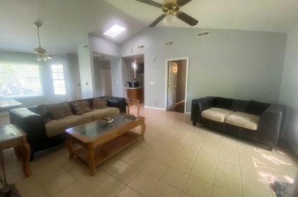
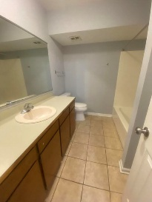
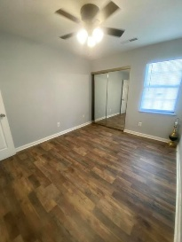
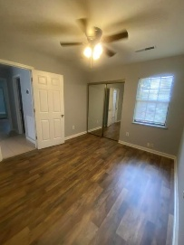
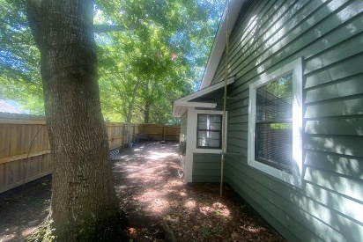


8254 Timberidge Court
Pepperidge | North Charleston, SC 29420 | MLS# 25013295 | $290,000
NEW PRICE!
MOTIVATED SELLER!
Relaxed, low maintenance and energy efficient one-story home, conveniently located to interstate, shopping, restaurants, airport, Bosch, Boeing, joint base and downtown Charleston. Step inside to a light-filled open floor plan with cathedral ceilings, tile floors and a wood-burning fireplace in the great room. Step out back and enjoy the privacy of this outdoor space with a newer, fully fenced yard. Larger patio is perfect for entertaining and can easily fit a grill and furniture. New roof to be installed prior to closing. Enjoy low utility bills as solar panels will be paid off at closing. Freshly painted both inside and outside. New garage door plus pegboard for holding tools or lawn gear, storage shed in backyard, fridge in garage and washer and dryer to convey.
Beth Mandell
M 803-463-7734 | O 843-871-2121
bmandell@century21properties.com
www.bestcarolinahomedeals.com
Century 21 Properties Plus of Summerville | 568-A Savannah Highway | Charleston, SC 29407

