Slide 1
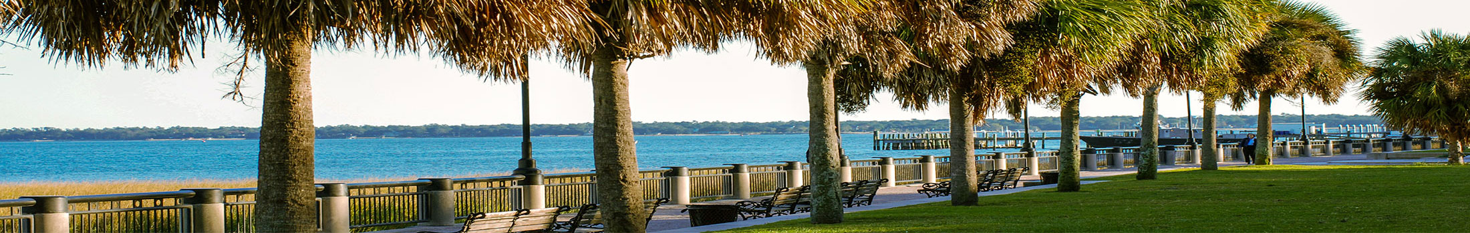



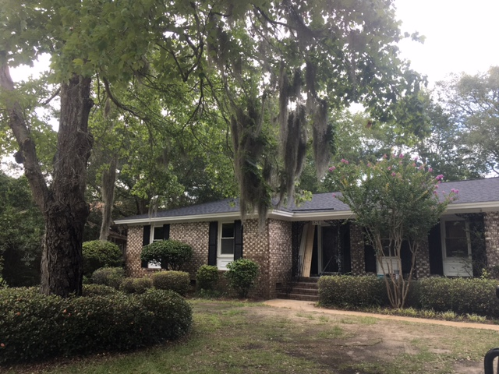
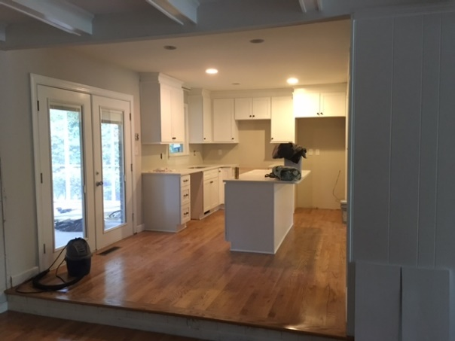
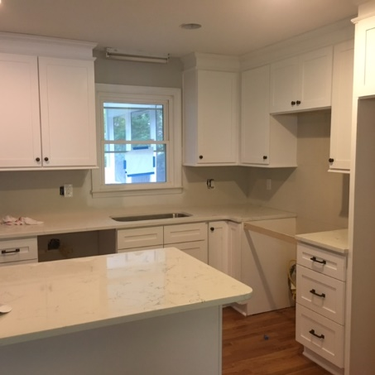
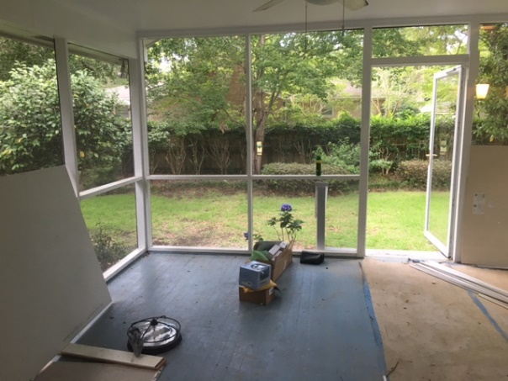
Coming Soon on James Island!
Lennie Woods
843-864-6760 lenniewoods@gmail.com
825 Stiles Drive
Clearview ~ $369,900
1771 Sq Ft
Open Floorplan
Totally New Kitchen
Huge Screened Porch
Updated Bathrooms
Solid Hardwood Floors
X Flood Zone
Walk To Stiles Point Elementary

