Slide 1

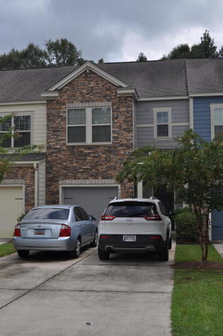
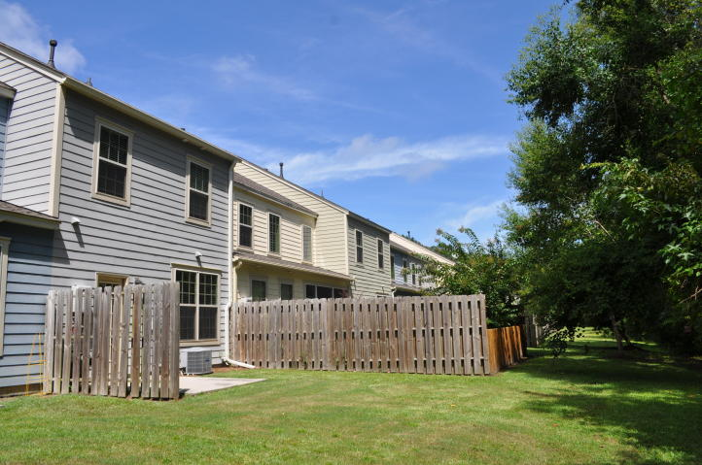
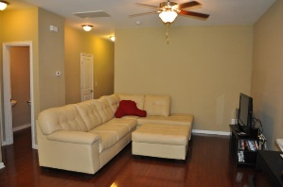
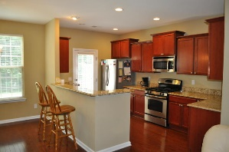
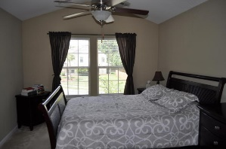
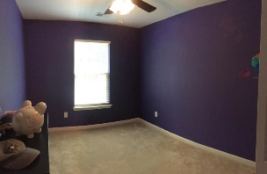
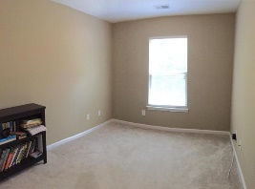



Fantastic 3 bed/2½ Bath Townhouse In Hunt Club!
1138 Waterfront Dr
Hidden Lakes ~ Mt Pleasant ~ MLS# 16000069 ~ $765,000
827 Bibury Court
Charleston, SC 29414 ~ MLS# 17022617 ~ $219,000
The original owner of this 3 bedroom, 2.5 bath townhouse in Hunt Club has METICULOUSLY MAINTAINED it over the years. Some of the first things you'll notice about these great units are the WIDE DRIVEWAYS, CEMENT PLANK SIDING, AND SINGLE CAR GARAGES. Inside on the ground floor you'll find wood flooring throughout the open floor plan's living room, dining room, and spacious, upgraded kitchen. The kitchen features GRANITE COUNTER TOPS, STAINLESS APPLIANCES, and even a GAS COOKTOP! Upstairs is a huge Master Suite with walk-in closet, and an awesome Master bath with separate tub and shower. The laundry closet is situated on the landing next to the two comfortable guest rooms and an additional bathroom. This unit also features a TANKLESS WATER HEATER and partial privacy fencing in the back yard.
Mark Macpherson
mark@beachbreak-properties.com
843.367.5640 Mobile

