Slide 1

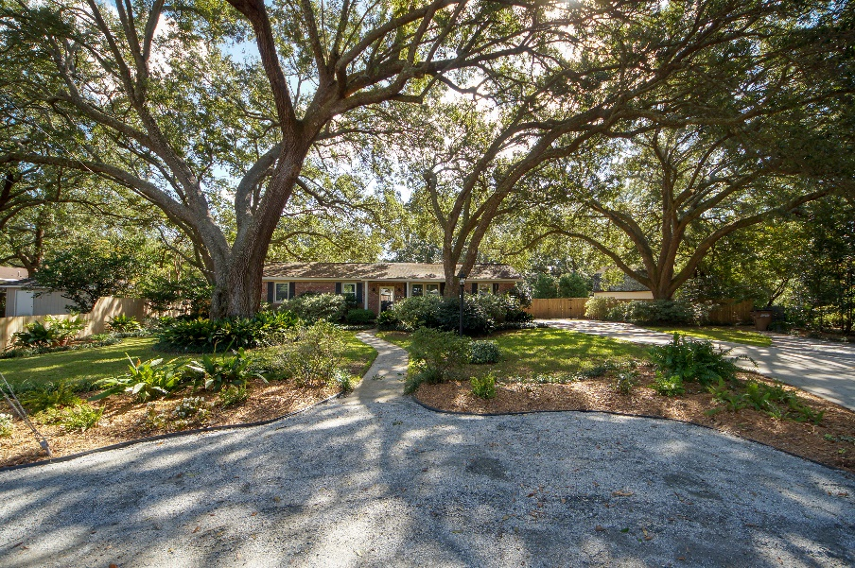
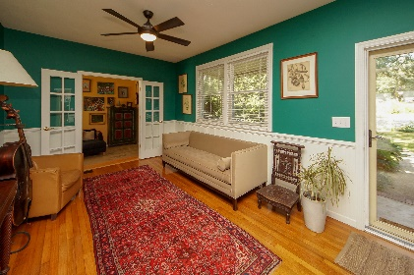
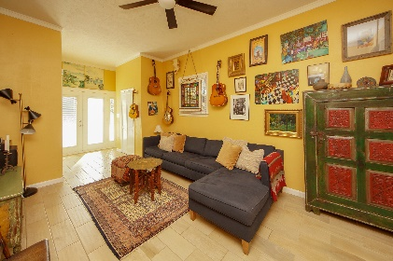
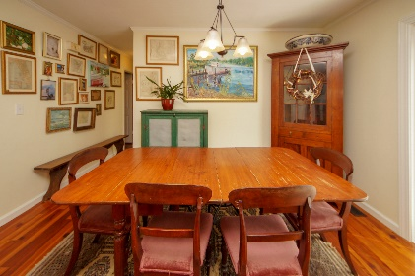
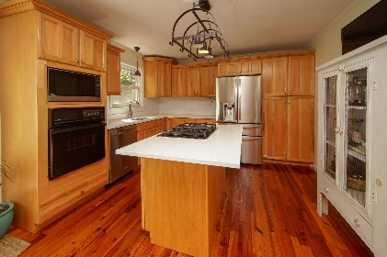
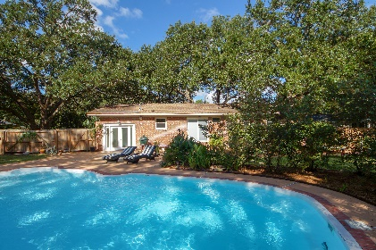
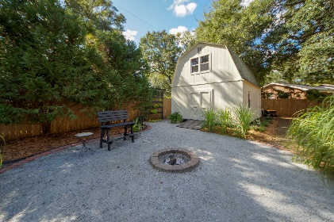
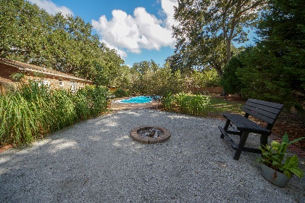
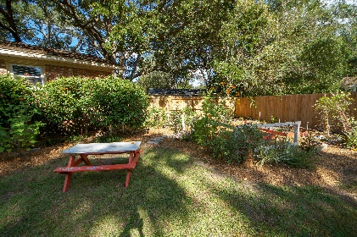
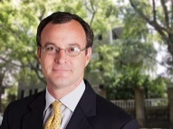

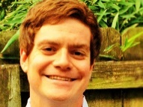
Just Listed!! Minutes To Downtown & The Beach
828 Joey Circle
Clearview
Charleston, SC 29412
MLS# 18028366
$425,000
3 Bedrooms :: 2 Bath :: 1,450 sf
828 Joey Circle is on the market! This one of a kind home with a stunning half acre lot is in the popular Clearview subdivision - tucked into a quiet cul-de-sac. The yard is adorned with tasteful plantings and studded with numerous Grand Live Oaks. With a pool, and a tropical feel to the back yard, this property is perfect for entertaining guests. Inside, you will find that this house has been well kept. There are beautiful hardwood floors throughout the home. The kitchen has been nicely appointed with new quartz counter tops and a new sink and faucet, as well as the hall bath. Another huge perk of this property is the large, two-story barn in the back yard. The barn is equipped with separate power, lighting, and window units to condition the space. Perfect for an artist studio, workshop, gym, play house for kids, or ample storage space. The crawl space has been encapsulated with a dehumidifier and condensation pump. Since the improvements of Harborview Road, there are sidewalks up and down the road, contributing to the walkability of the area. Sunrise Park, which overlooks Charleston's Harbor, and Pinckney Park are both within a mile and a half of the property. One mile from Harris Teeter, one fifth mile from a local pizzeria, 7 minutes to Downtown Charleston and 10 minutes to Folly Beach.
Eric Draper
(843) 442-7118
eric.draper@gmail.com
Jon Moore
(843) 732-3365
jon@charlestonrealestategroup.com
www.charlestonrealestategroup.com
Charleston Real Estate Group | 443 Folly Road | Charleston, SC 29412

