Slide 1
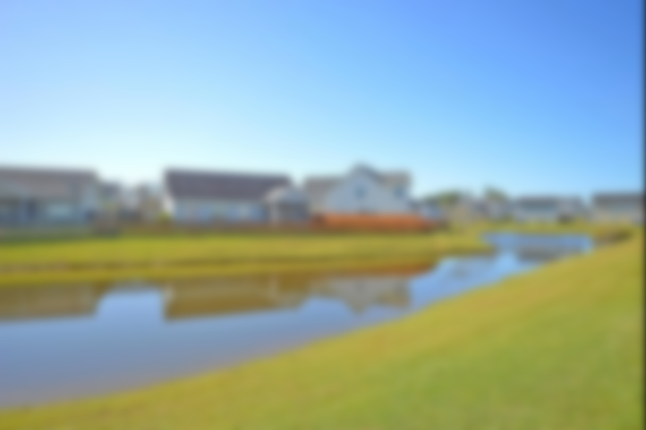
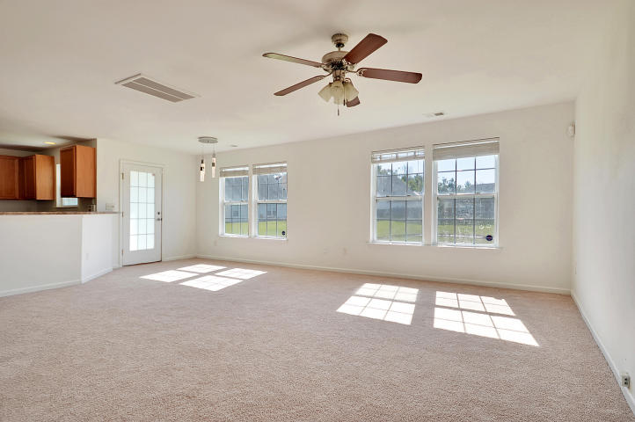
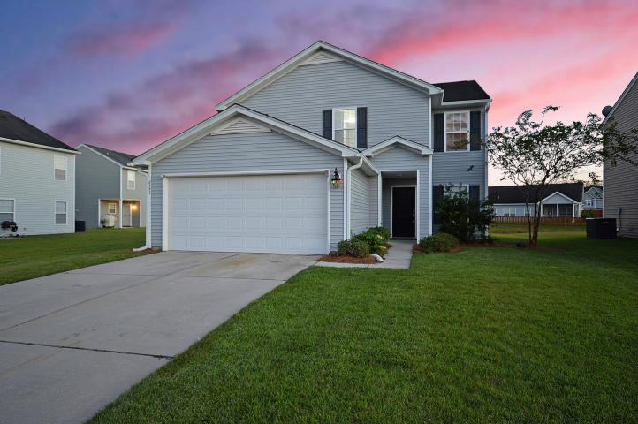
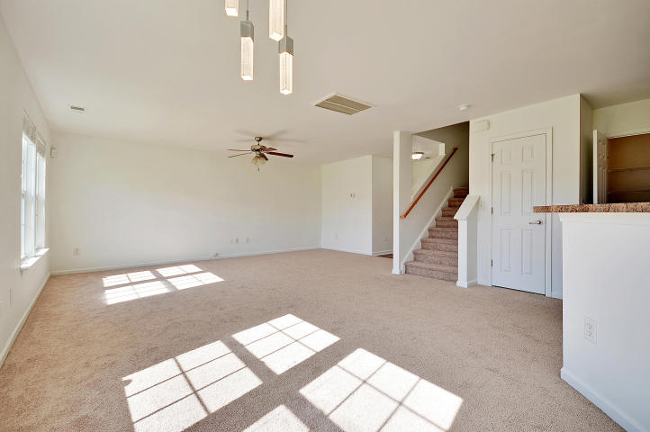
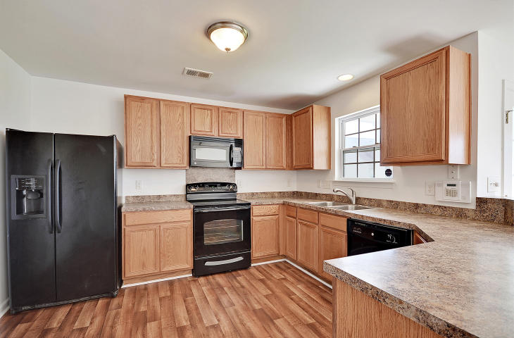
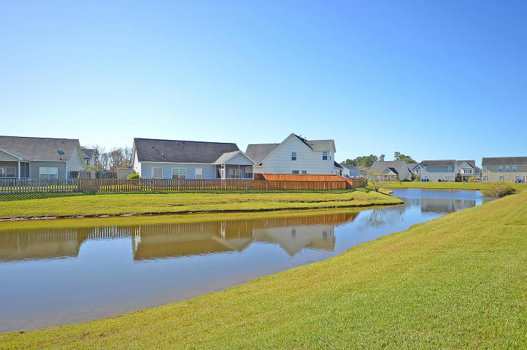
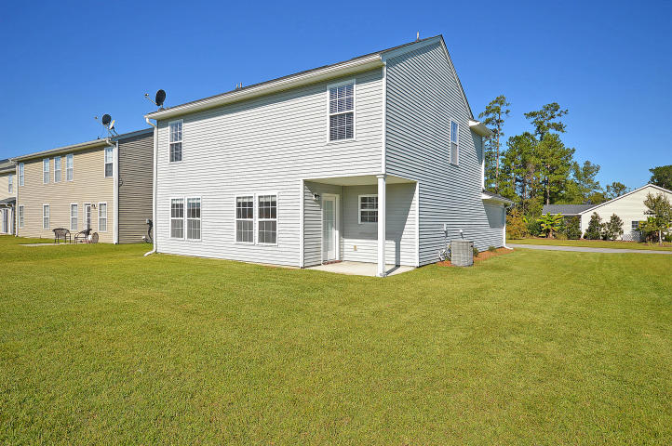
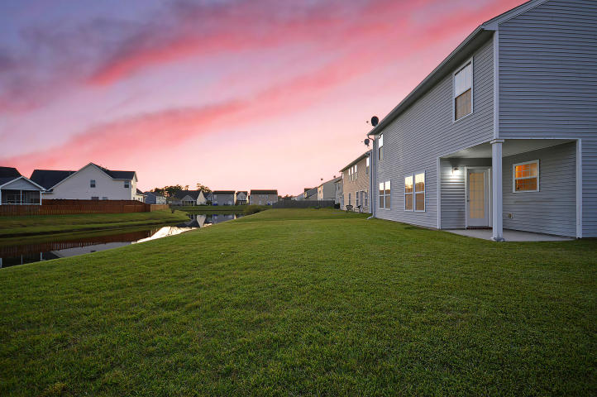

BEST BARGAIN PRICE IN NORTH CHARLESTON!
8292 Little Sydneys Way Baker Plantation | North Charleston
MLS# 17028608 | $209,000
BEAUTIFUL HOME ON GOLDEN POND! 4 bedroom, 2.5 bath home in great condition. New paint, new flooring and new carpets. Most rooms in the home have spectacular views of the glorious pond. At sunset, the pond becomes like nature’s enchanted village where birds of all kinds congregate. Ultra-open floorplan where the kitchen flows into the oversized great room with exquisite pond views from every vantage point. The location is only 5 minutes from Route I-26, so you are a short ride to the airport, Boeing, Joint Base Charleston, the Air Force Base, the Naval Weapons Station, the new Volvo and Mercedes plants, the world-class beaches of Isle of Palms, Sullivan’s Island and Folly as well as historic downtown Charleston. This home can be yours for the BEST BARGAIN PRICE IN NORTH CHARLESTON!
Chip Walsh
843-822-4663
chipwalsh@gmail.com
The Boulevard Company, LLC 35 Broad Street Charleston, SC 29401
www.TeamWalshRealEstate.com

