Slide 1
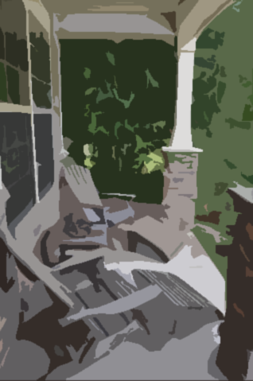
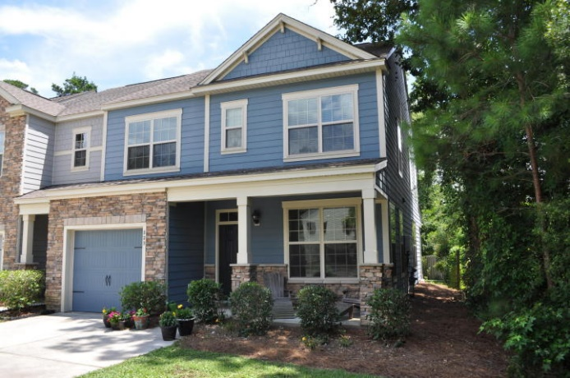
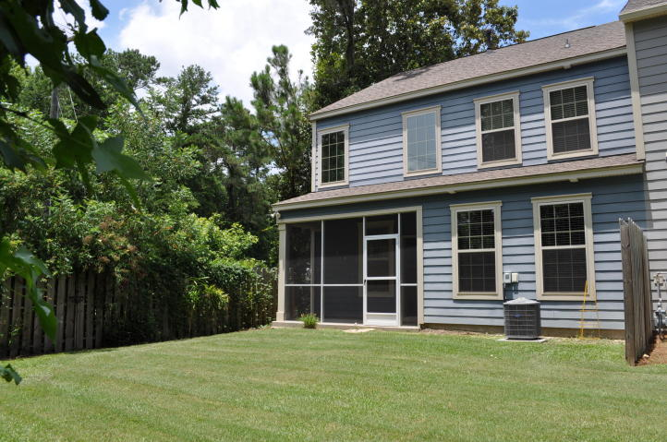
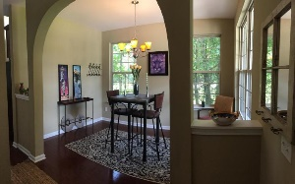
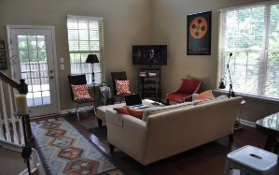
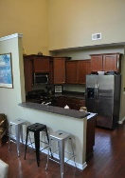
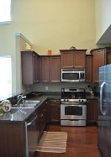
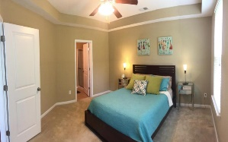
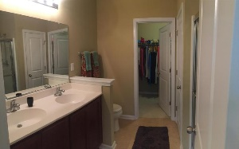
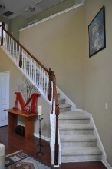
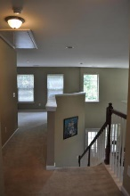
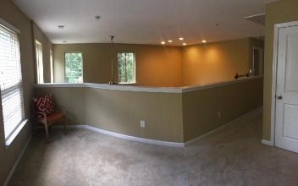
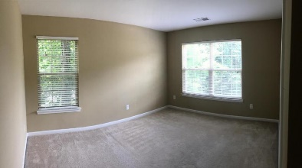
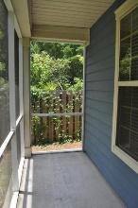
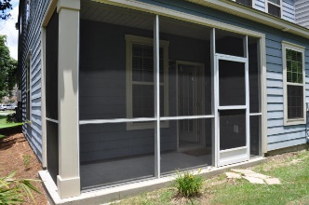



End Unit In Hunt Club
1138 Waterfront Dr
Hidden Lakes ~ Mt Pleasant ~ MLS# 16000069 ~ $765,000
829 Bibury Court
Charleston, SC 29414
MLS# 17018436
$239,900
Fantastic END UNIT townhouse in Hunt Club with large downstairs Master Bedroom! A wide driveway, 1 car garage, and cute front porch welcome you to this wonderful home. Inside you'll find a separate dining room next to the foyer, a powder room, and the washer/dryer closet and spacious kitchen and living room all under a soaring two-story ceiling! The Master bedroom features a tray ceiling and the Master bathroom has dual vanities, a large shower, and big walk-in closet. Upstairs you'll find two additional bedrooms, a guest bathroom, and a bonus room/loft overlooking the living room. This unit and townhouse community are a fantastic find so come see this beautiful home today before it's gone!
The Boulevard Company, LLC
Mark Macpherson
mark@beachbreak-properties.com
843.367.5640 Mobile

