Slide 1
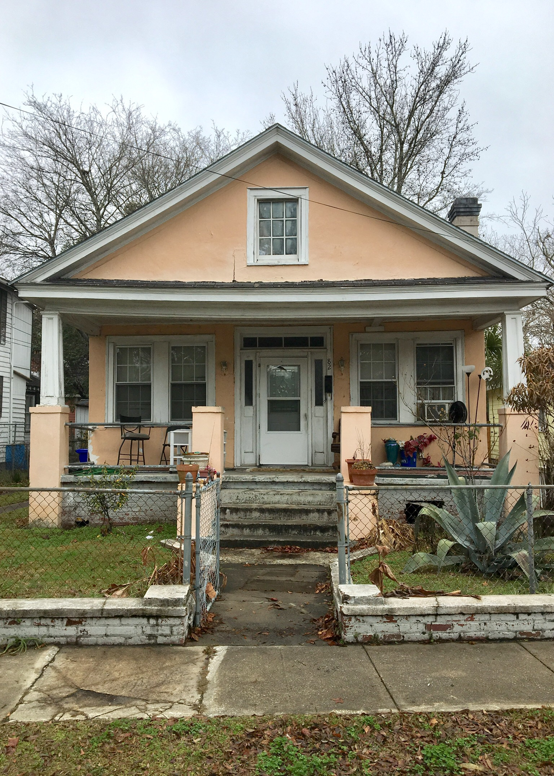
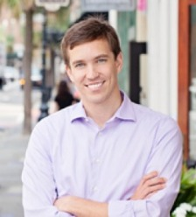

Downtown Fixer-Upper Coming Soon…
DRAFT
82 Sans Souci Street
Charleston, SC 29403
3 Bed/1 Bath | 1,168 Sq Ft
0.11 Acre Lot
List Price Will Be $350,000
Greg Gelber
(843) 494-2354
greg.gelber@agentownedrealty.com
AgentOwned Charleston Group | 902 Savannah Hwy | Charleston, SC 29407-7802

