Slide 1
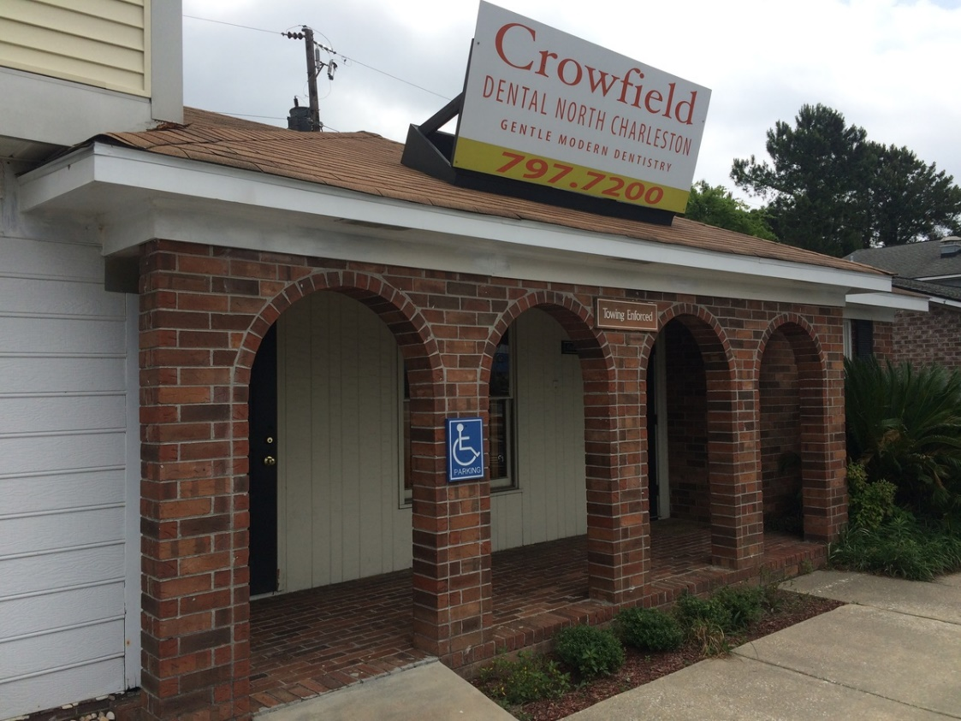
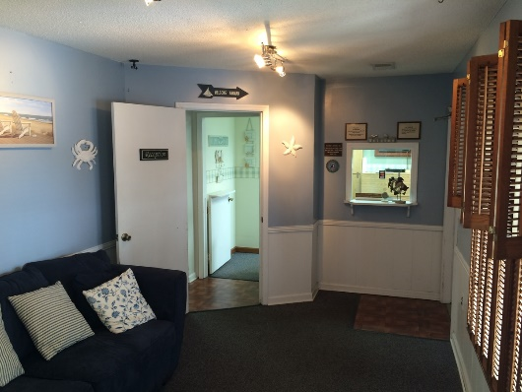
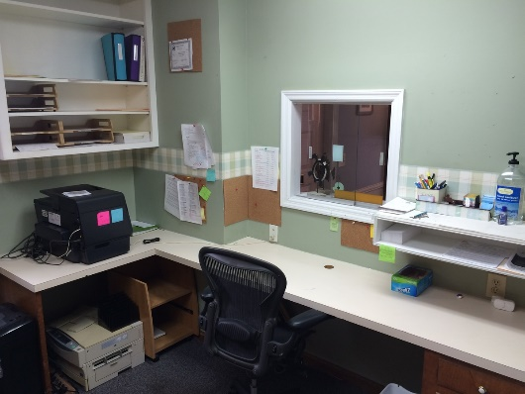
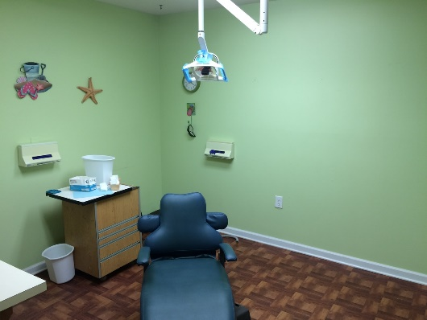
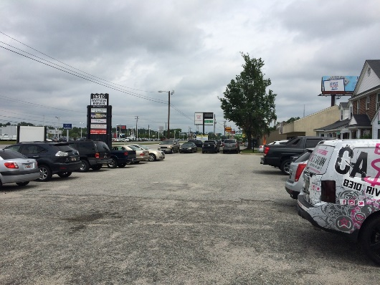


North Charleston Office for Sale
8310 Rivers Ave, Unit D
N Charleston, SC 29406
OFFICE FOR SALE
An amazing opportunity to get into business quickly. Formerly a dental office, this space could continue as a dental/medical office or easily be an office use. A video of the space exists, but you may also see the attached photos. A very busy area of Rivers Avenue, this property has easy access, signage and is a ground floor layout that has a waiting area, reception, three offices, a lab and a restroom.
Catylist ID: | #29977966
Typical SF / Floor | 964 SF
Property Visibility: | Excellent
Submarket/Township: | 32 - N.Chas./Summerville outside I-526
Zoning: | CC - Community Commercial District
Site Description: | Level, surface parking. (Shared)
Year Built: | 1981
County: | Charleston
Tax ID/APN: | 485-00-00-092
David H Seay
CCIM, BIC, CCIM, REALTOR
(843) 364-6720
david@seaydevelopment.com
Seay Development, LLC
3404-202A Salterbeck Street
Mt. Pleasant, SC 29466
www.seaydevelopment.com

